Slide 1
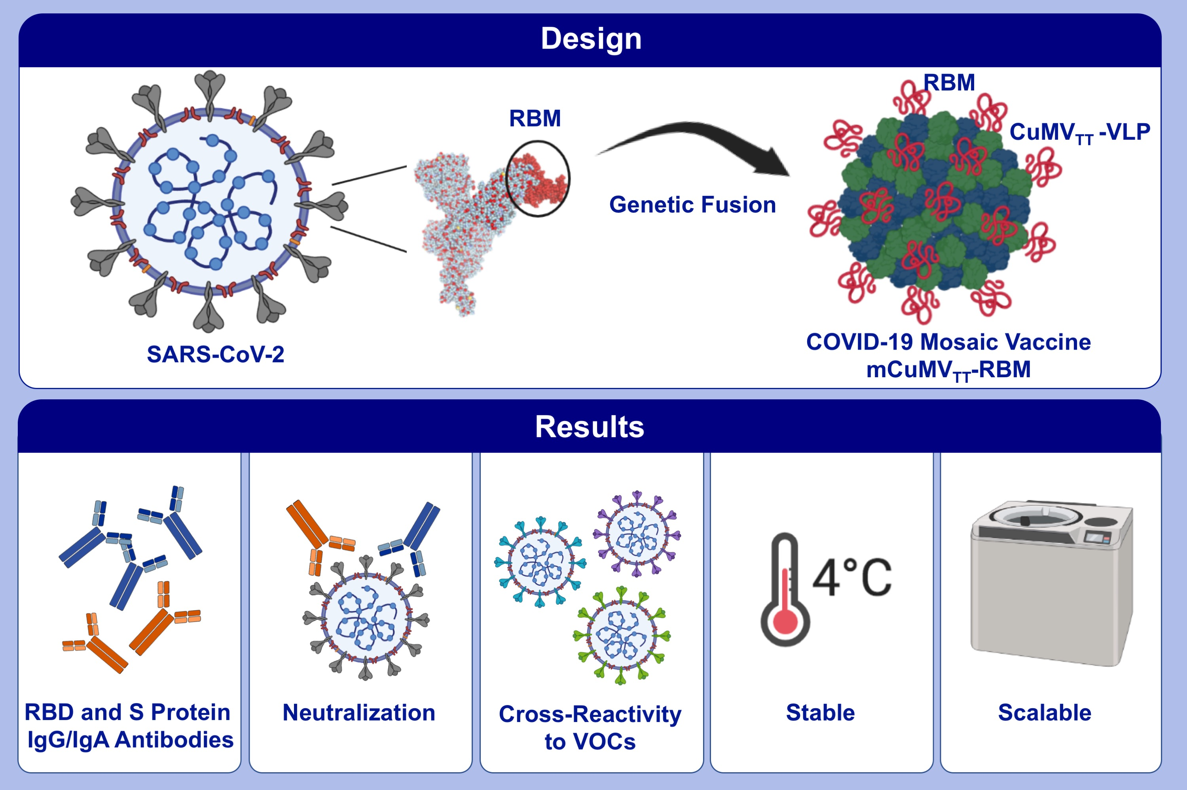
A scalable and highly immunogenic virus-like particle-based vaccine against SARS-CoV-2
Mona O. Mohsen,, Ina Balke,, Simon Zinkhan,, Villija Zeltina,, Xuelan Liu,, et al.
Allergy. 2022; 243-257 https://doi.org/10.1111/all.15080
© 2019 EAACI and John Wiley and Sons A/S. Published by John Wiley and Sons Ltd.
Notes:
HIGHLIGHTS
In this study, we describe a novel conventional COVID-19 vaccine consists of the RBM of SARS-CoV-2 genetically grafted onto the surface of our optimized cucumber-mosaic virus-like particles.
We demonstrate that the vaccine candidate (mCuMV_{TT}-RBM) is highly immunogenic in mice and rabbits, can efficiently neutralize SARS-CoV-2, and is stable and highly scalable.
The induced antibodies show cross-reactivity with VOCs.
Abbreviations: COVID-19, coronavirus disease 2019; CuMV_{TT}-VLPs, cucumber-mosaic virus-like particles; RBD, receptor-binding domain; RBM, receptor-binding motif; SARS-CoV-2, severe acute respiratory syndrome coronavirus 2; VOCs, variant of concerns

