Slide 1
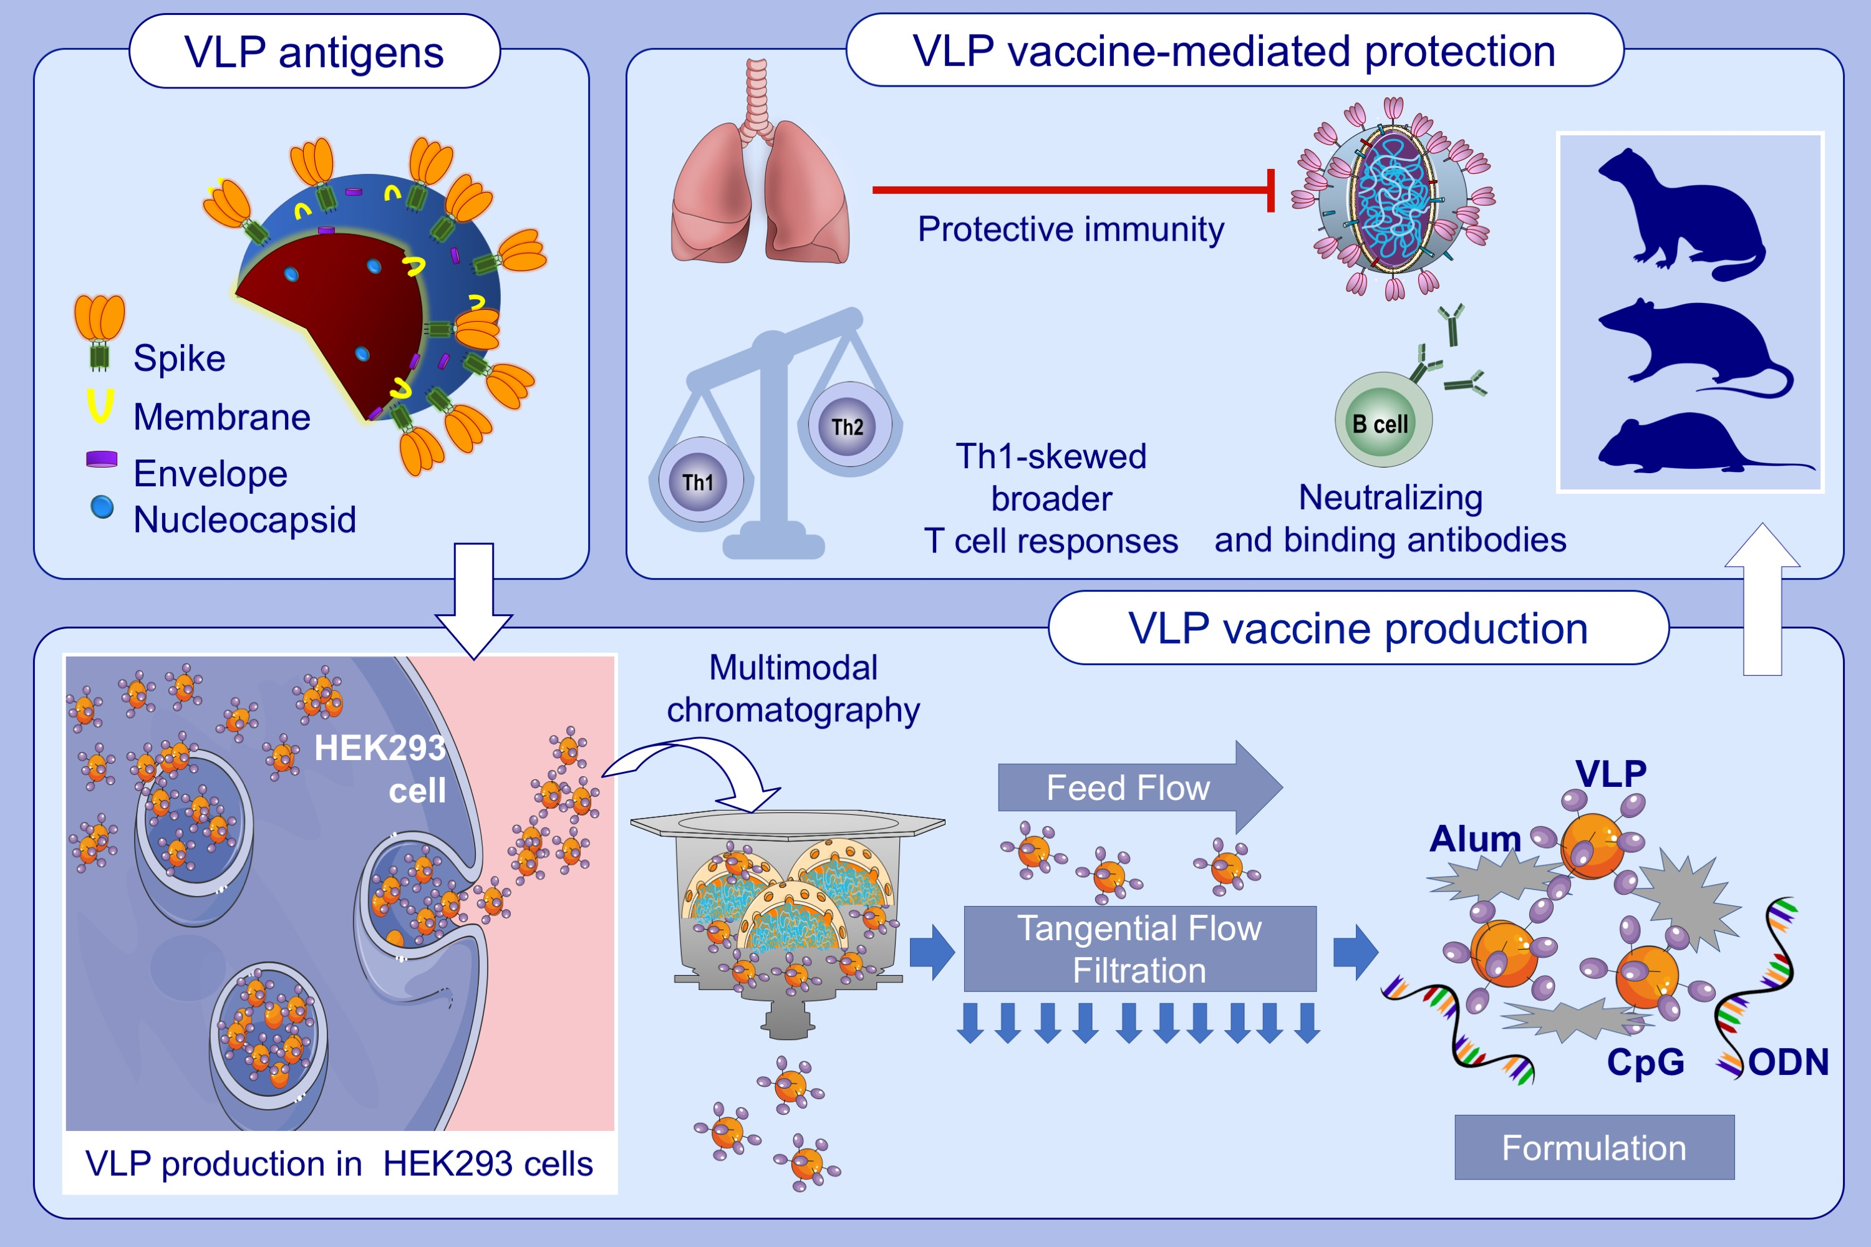
Development and preclinical evaluation of virus-like particle vaccine against COVID-19 infection
Ismail Cem Yilmaz,, Emre Mert Ipekoglu,, Artun Bulbul,, Nilsu Turay,, Muzaffer Yildirim,, et al.
Allergy. 2022; 258-270 https://doi.org/10.1111/all.15091
© 2019 EAACI and John Wiley and Sons A/S. Published by John Wiley and Sons Ltd.
Notes:
HIGHLIGHTS
SARS-CoV-2 VLP vaccine that incorporates the 4 structural proteins of SARS-CoV-2 are reproducibly produced in suspension adapted HEK293 cells.
Alum adsorbed, K3-CpG ODN adjuvanted VLPs elicit high titer anti-S, anti-RBD, anti-N IgG and neutralizing antibodies in mice, rats and ferrets
The VLP vaccine support multifunctional Th1-biased T cell responses and demonstrate immunoprotective activity against live SARS-CoV-2 challenge in vaccinated mice
Abbreviations: Alum, aluminum hydroxide; CpG, cytosine-phosphate-guanosine dinucleotide; HEK293, human embryonic kidney cell line; ODN, oligodeoxynucleotide; RBD, receptor binding domain; SARS-CoV-2, severe acute respiratory syndrome coronavirus 2; Th, T-helper cell; VLP, virus-like particle

