Slide 1
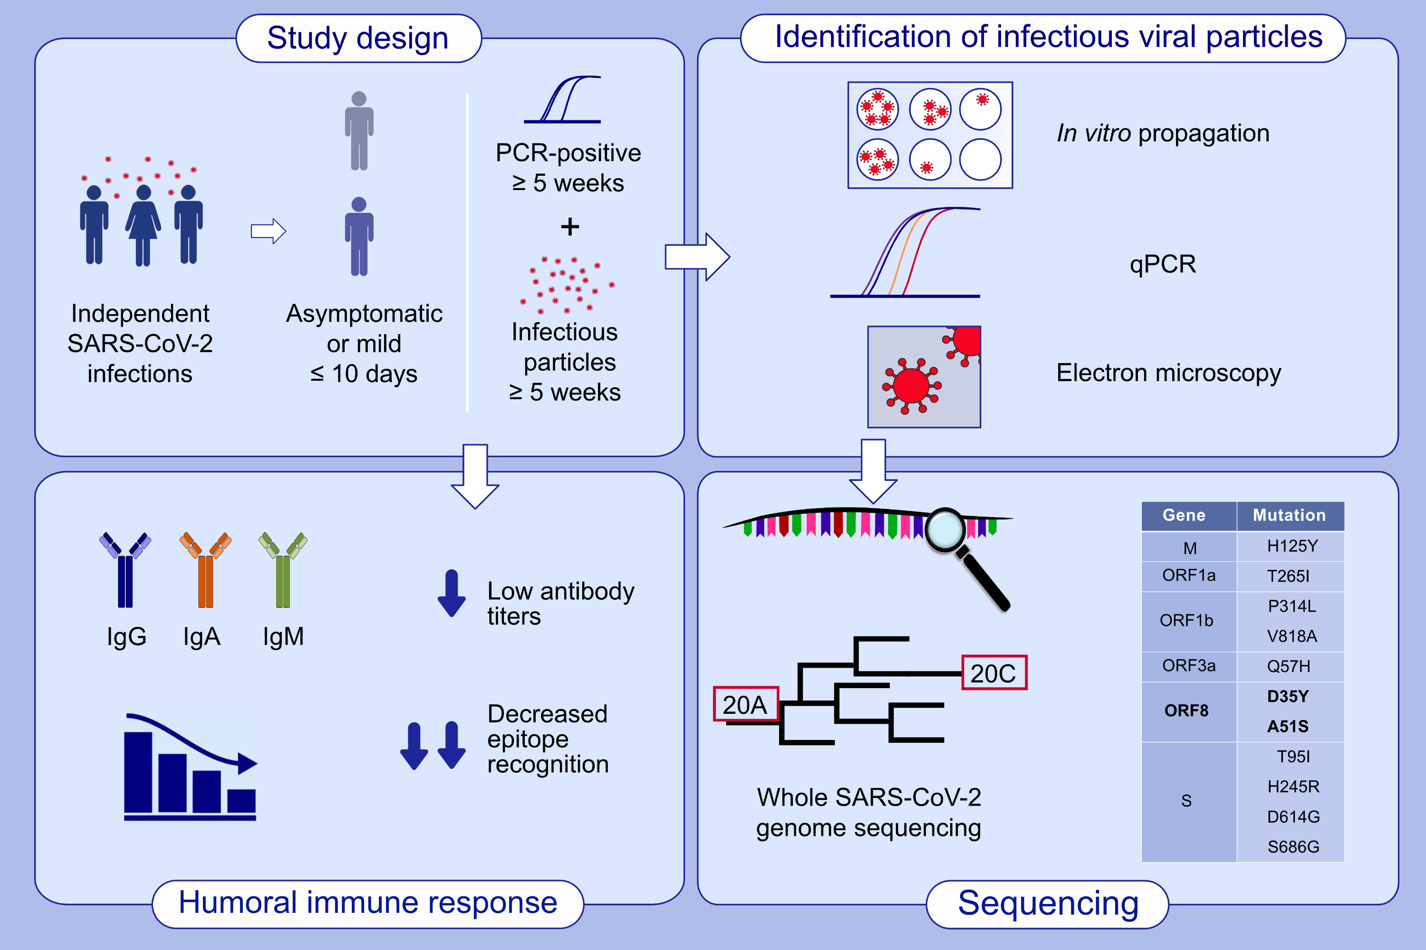
Persistence of infectious SARS-CoV-2 particles for up to 37 days in patients with mild COVID-19
Tobias Zahn, Ines Mhedhbi, Sascha Hein, Jan Raupach, Csaba Miskey, et al.
Allergy. 2022; pages: 2053-2066 https://doi.org/10.1111/all.15138
© 2019 EAACI and John Wiley and Sons A/S. Published by John Wiley and Sons Ltd.
Notes:
HIGHLIGHTS
This study shows three long-term SARS-CoV-2 PCR-positive patients persistently producing infectious virus for up to 37 days without lasting symptoms.
Patients displayed low antibody titers and decreased binding of IgG against sequential epitopes of spike protein in comparison to patients that fully recovered from mild COVID-19.
WGS revealed that isolates belong to the 20A or 20C clade and viral eradication might be affected by two mutations in ORF8.
Abbreviations: COVID-19, coronavirus disease 2019; M, membrane protein; ORF, open reading frame; qPCR, quantitative polymerase chain reactions; S, spike protein; SARS-CoV-2, severe acute respiratory syndrome coronavirus 2; WGS, whole genome sequencing

