Slide 1
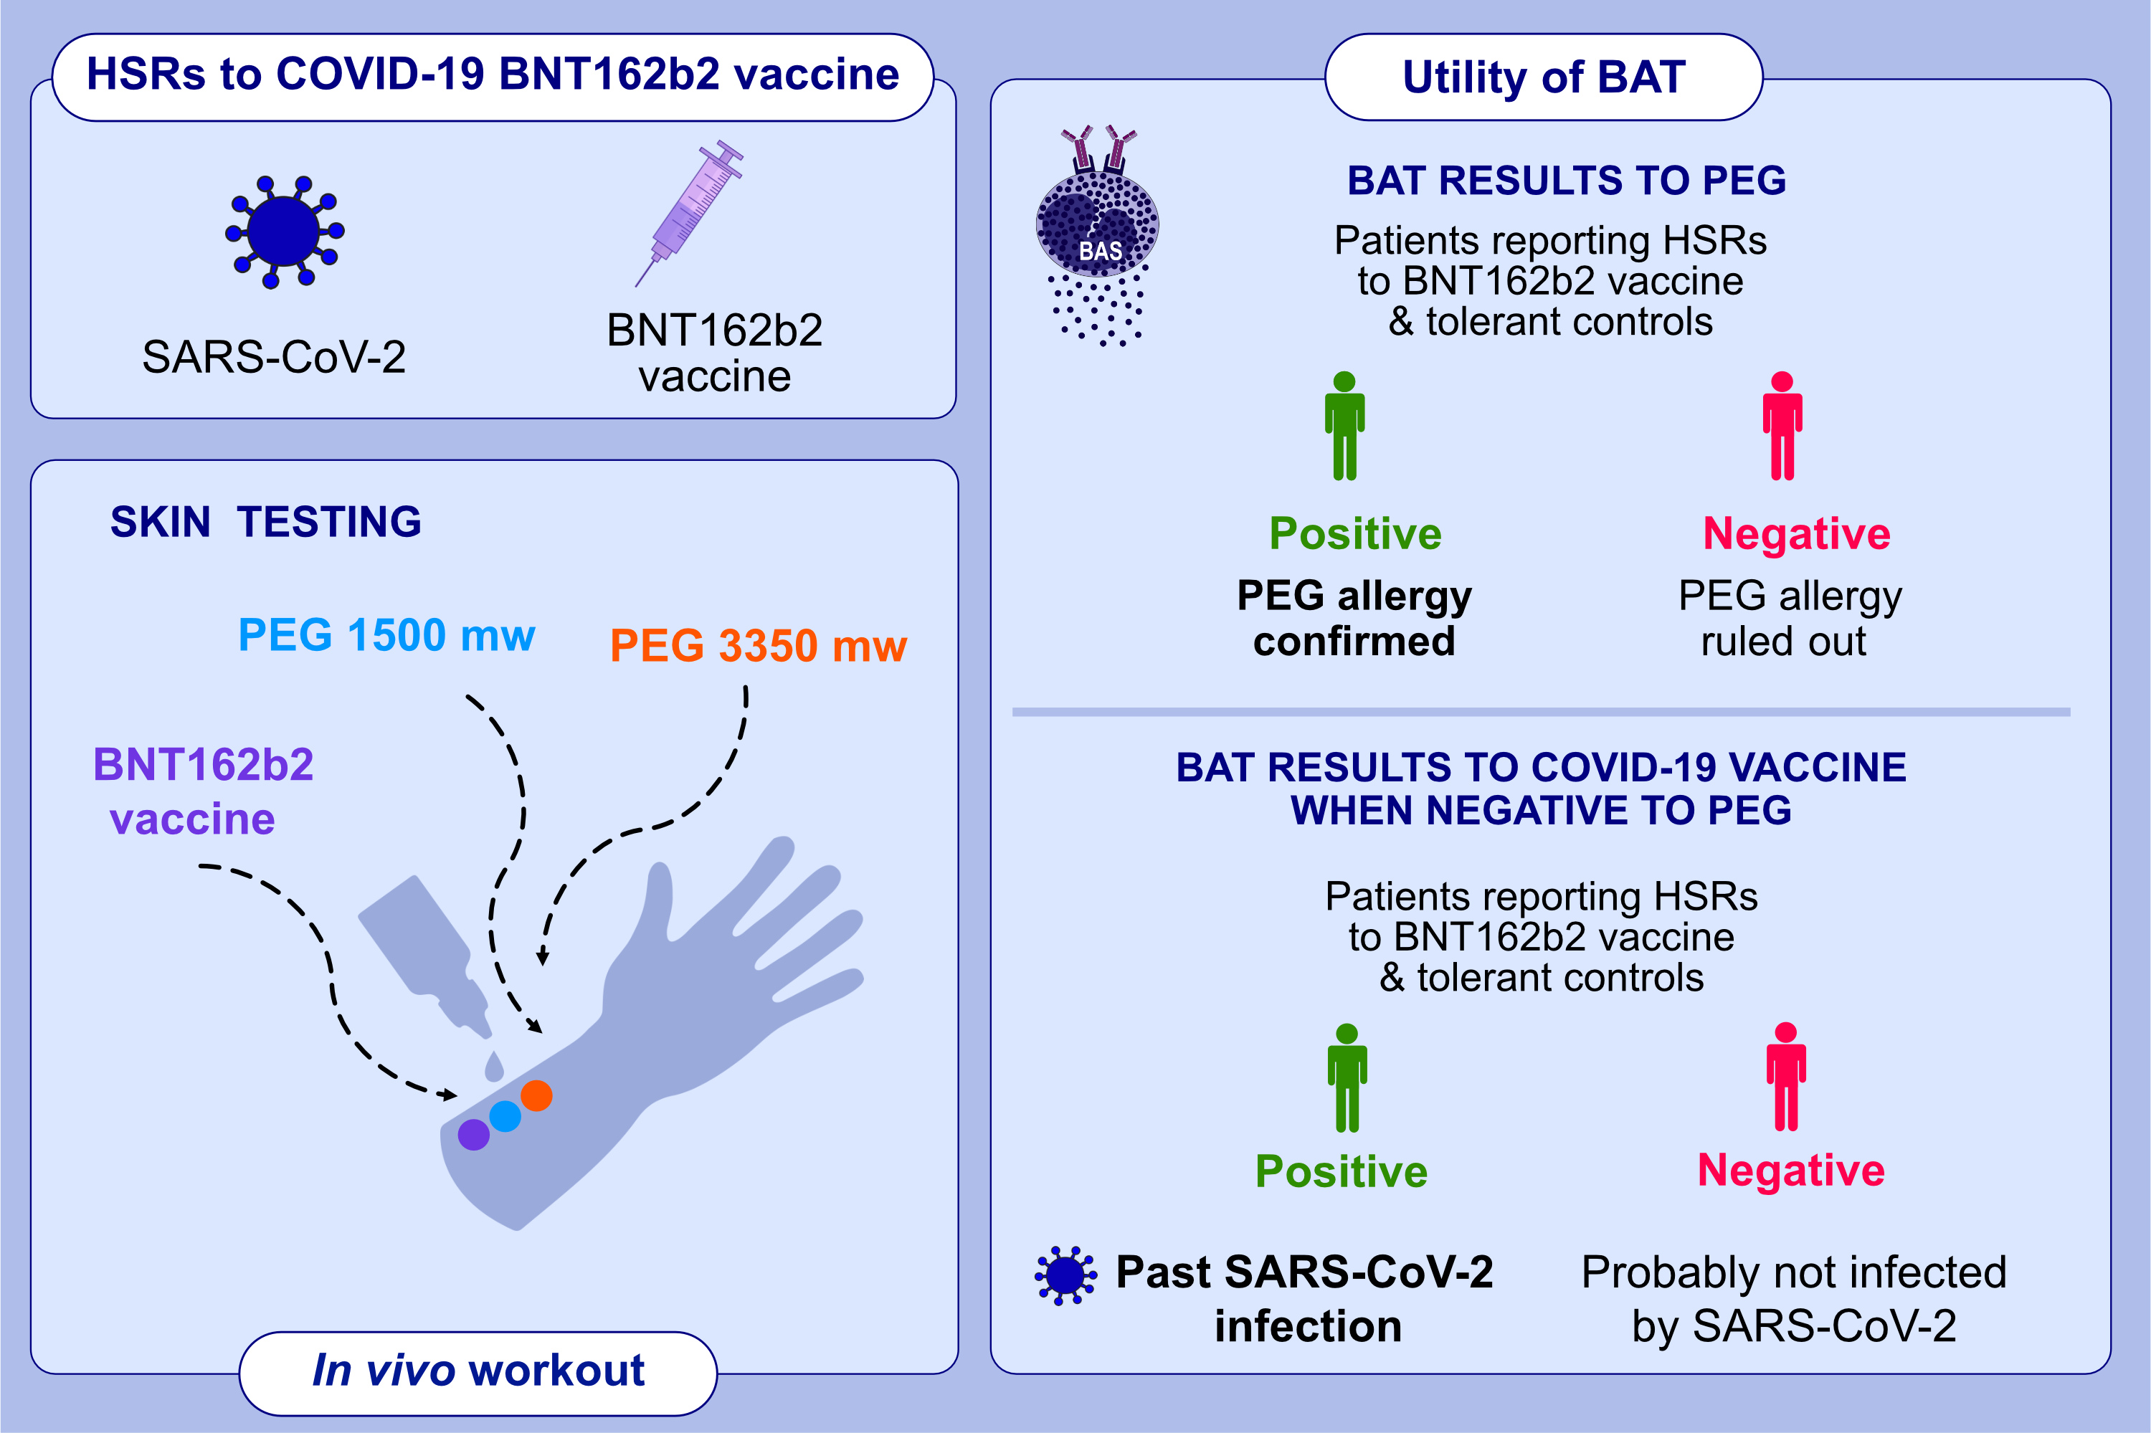
The value of the basophil activation test in the evaluation of patients reporting allergic reactions to COVID-19 BNT162b vaccine
Marina Labella, Jose Antonio Céspedes, Inmaculada Doña, Mohamed H. Shamji, Ioana Agache, et al.
Allergy. 2022;pages: 2067-2079 https://doi.org/10.1111/all.151148
© 2019 EAACI and John Wiley and Sons A/S. Published by John Wiley and Sons Ltd.
Notes:
HIGHLIGHTS
The allergological workup of the patients reporting reactions after the vaccine administration is crucial to achieve a precise diagnosis.
BAT can be used as a potential diagnostic tool for confirming allergy to PEG excipient.
A positive result in BAT to COVID-19 BNT162b vaccine may indicate a past COVID-infection instead of an allergy.
Abbreviations: BAT, basophil activation test; COVID-19, coronavirus disease 2019; HSRs, hypersensitivity reactions; mw, molecular weight; PEG, polyethene glycol; SARS-CoV-2, severe acute respiratory syndrome coronavirus 2

