Slide 1
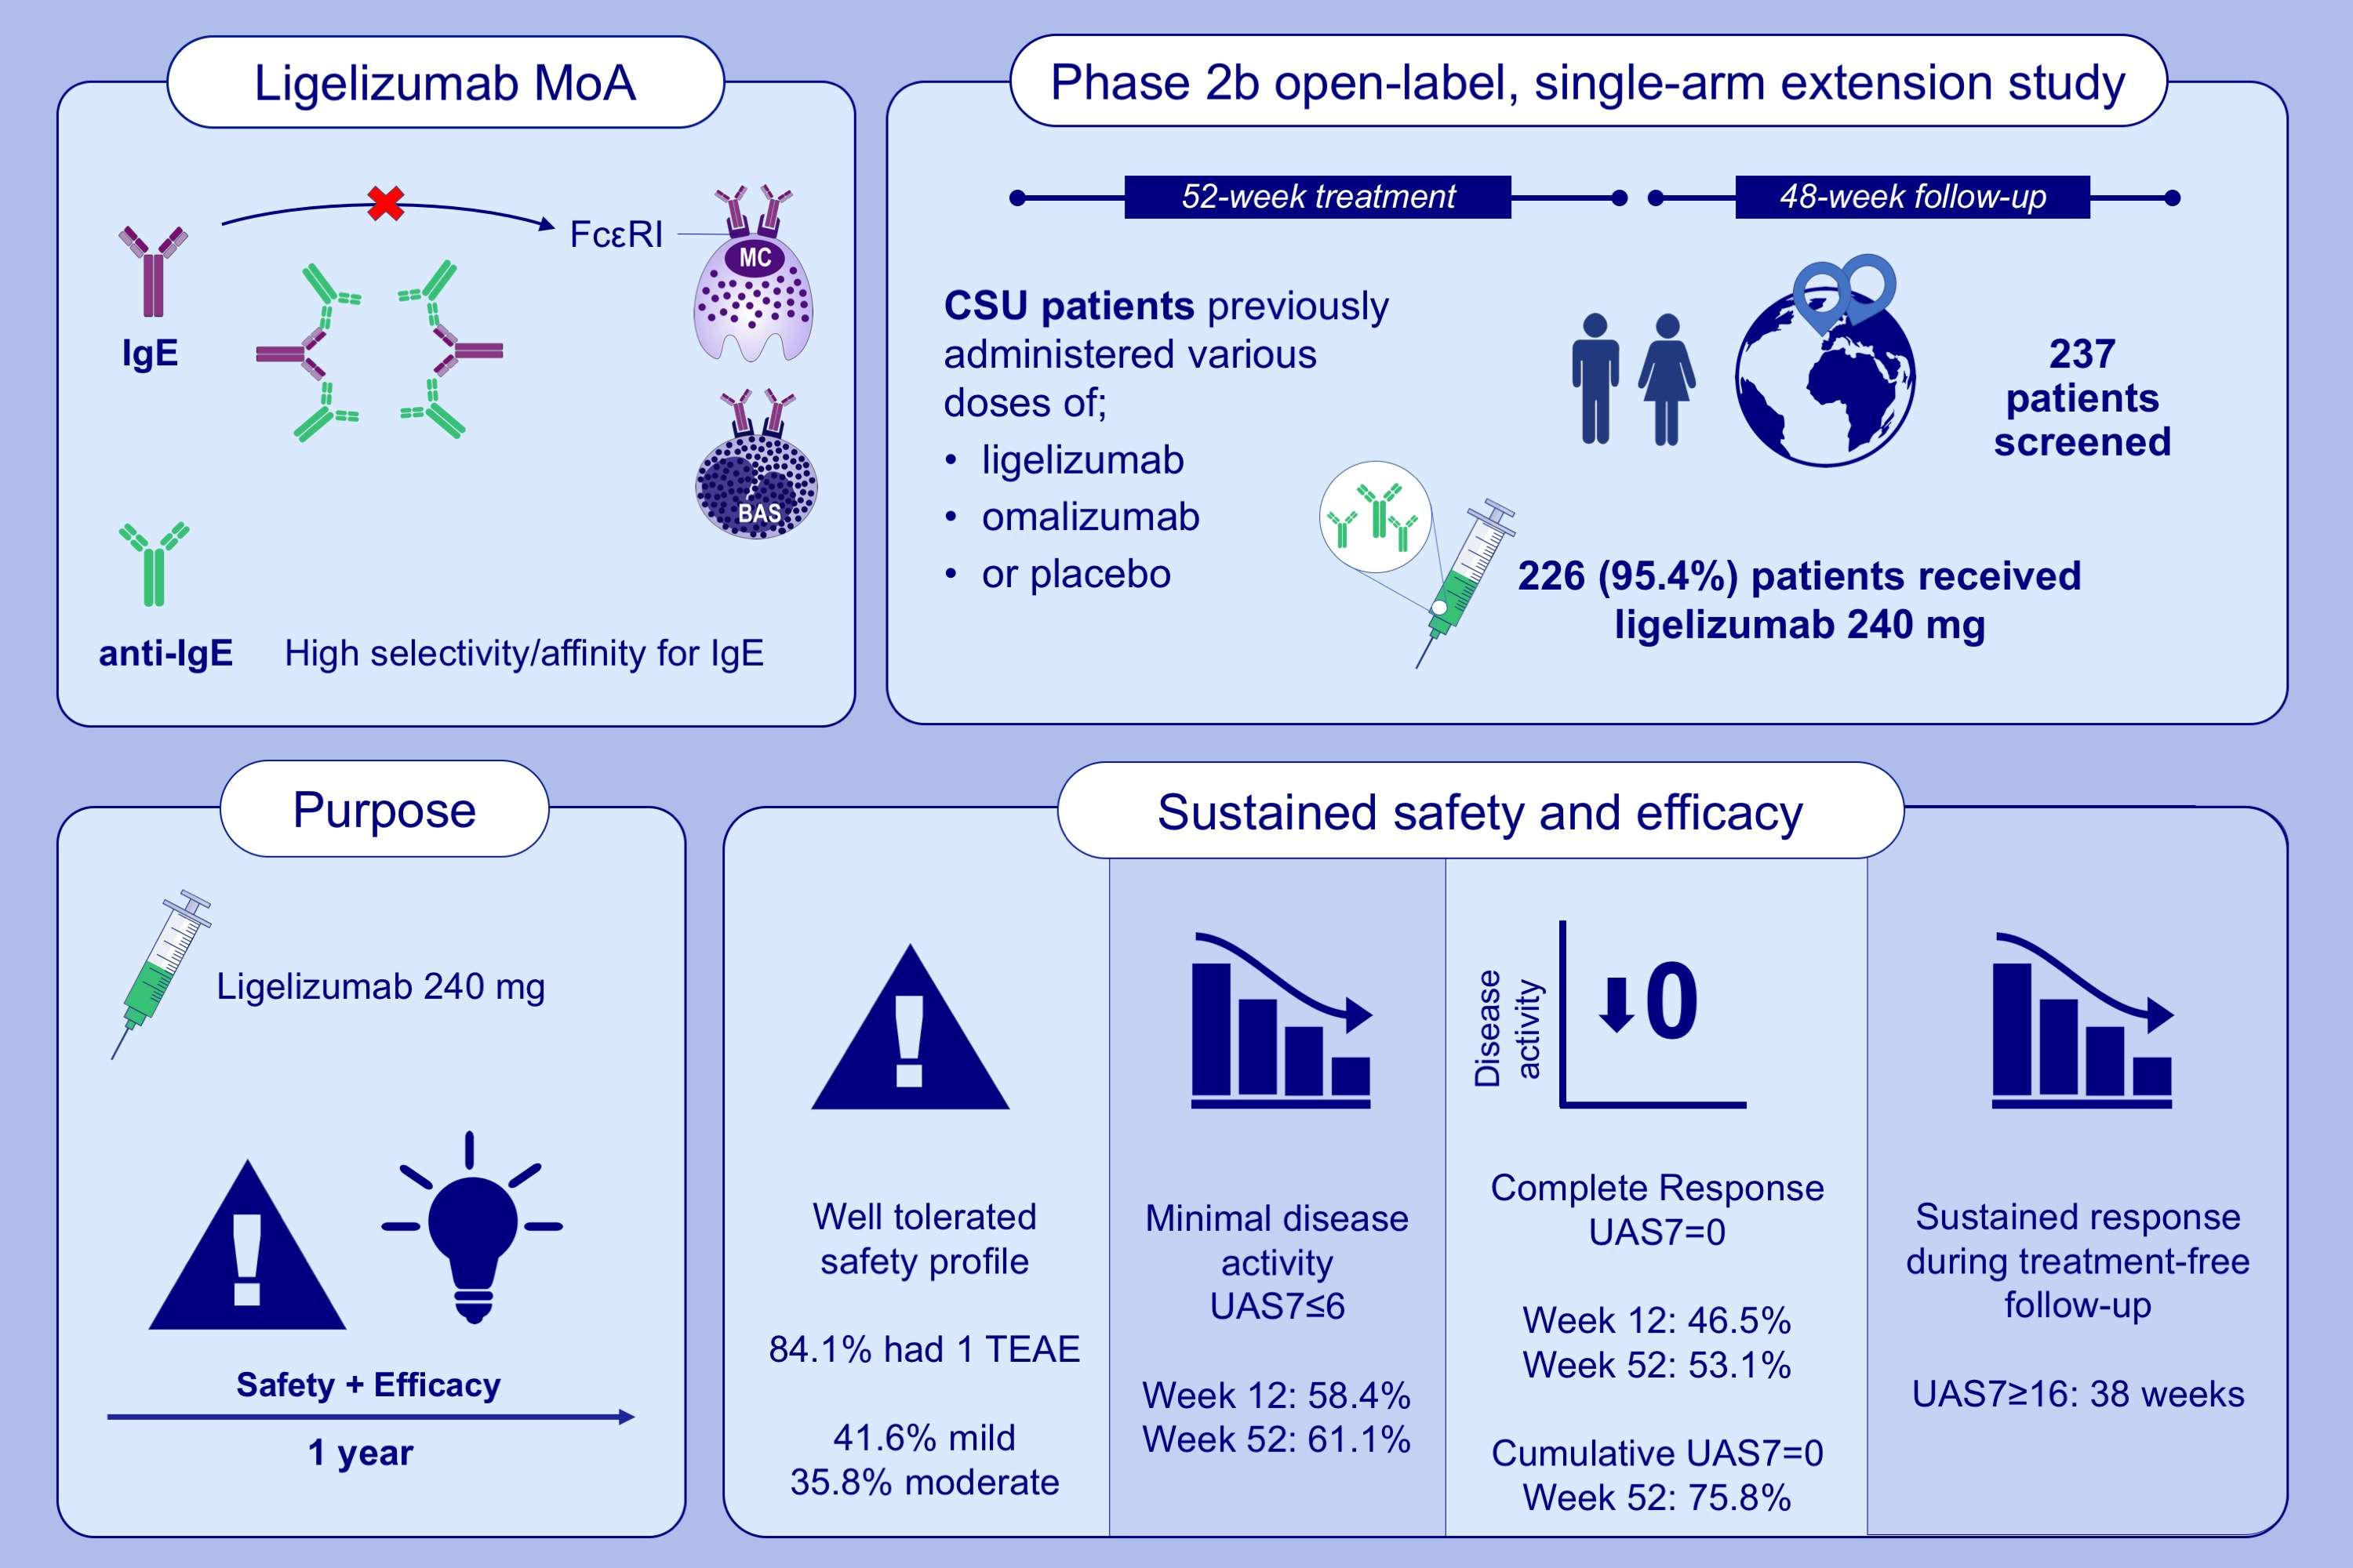
Sustained safety and efficacy of ligelizumab in patients with chronic spontaneous urticaria: A one-year extension study
Marcus Maurer, Ana Giménez-Arnau, Jonathan A. Bernstein, Chia-Yu Chu, Inna Danilycheva, et al.
Allergy. 2022; pages2175-2184 https://doi.org/10.1111/all.15175
© 2019 EAACI and John Wiley and Sons A/S. Published by John Wiley and Sons Ltd.
Notes:
HIGHLIGHTS
A total of 226 patients received ligelizumab 240 mg for 52 weeks.
Overall, 84.1% of patients experienced at least one TEAE. After 52 weeks of treatment, 53.1% of patients had a complete response and 75.8% of patients had cumulative complete responses.
The long-term safety profile of ligelizumab 240 mg in patients was consistent with the core study and re-treatment efficacy was shown.
Abbreviations: BAS, basophil; CSU, chronic spontaneous urticaria; FcεRI, Fc epsilon receptor 1; IgE, immunoglobulin E; MC, mast cell; MoA, mechanism of action; TEAE, treatment-emergent adverse event; UAS7, weekly urticaria activity score; UAS7=0, complete response; UAS7≤6, minimal disease activity.

