Slide 1
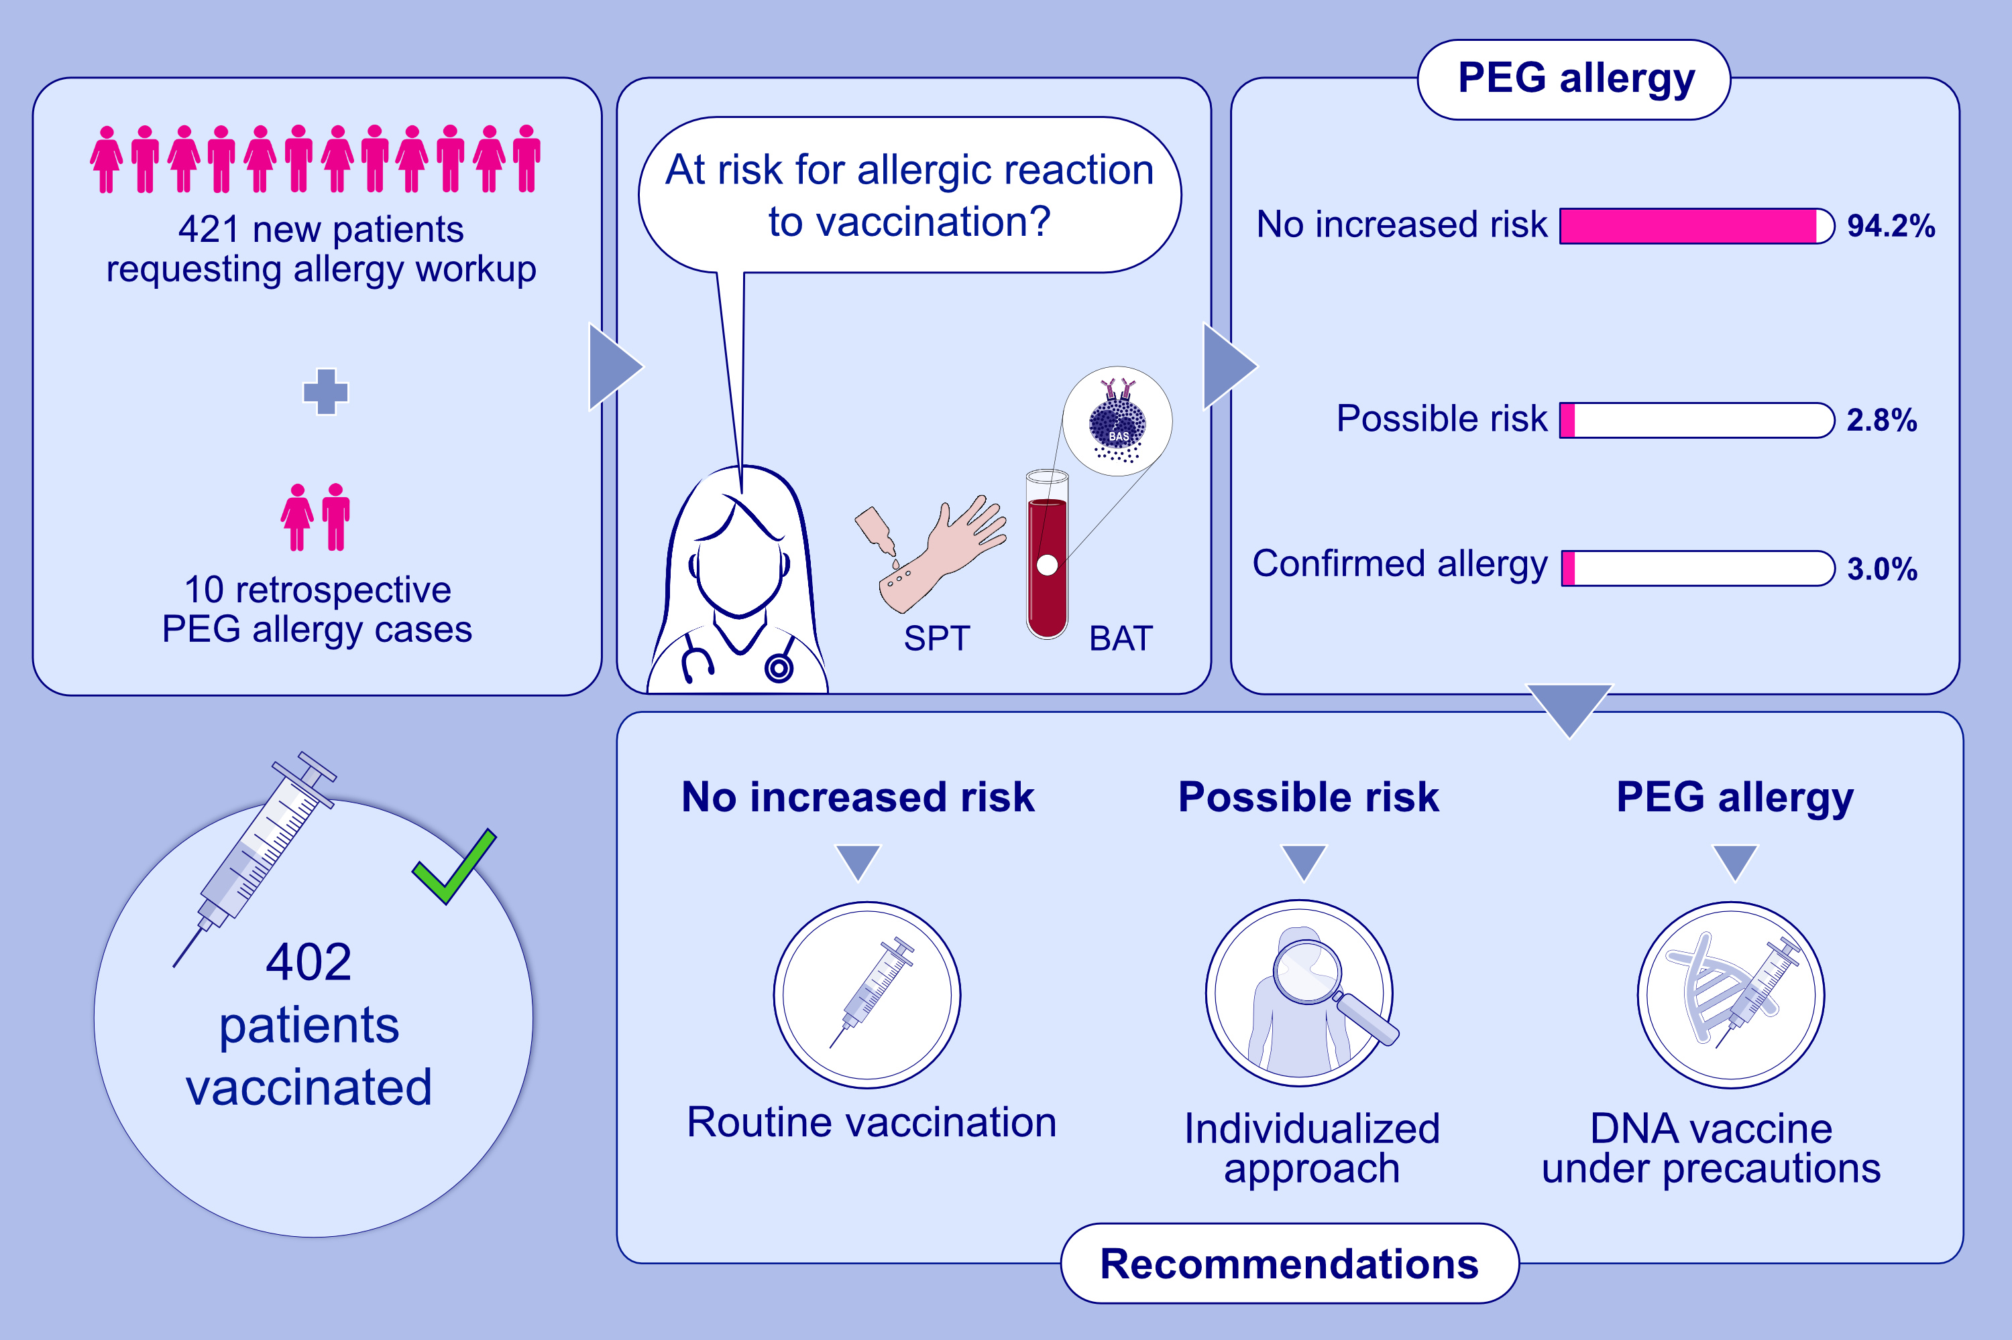
Experience with polyethylene glycol allergy-guided risk management for COVID-19 vaccine anaphylaxis
Knut Brockow, Sonja Mathes, Jörg Fischer, Sebastian Volc, Ulf Darsow, et al.
Allergy. 2022; 2200-2210 https://doi.org/10.1111/all.15183
© 2019 EAACI and John Wiley and Sons A/S. Published by John Wiley and Sons Ltd.
Notes:
HIGHLIGHTS
Lack of immediate urticaria/anaphylaxis to typical elicitors largely excludes PEG allergy and enables routine vaccination.
Allergy tests identify PEG allergy and help to select the vaccination approach.
PEG-allergic patients may tolerate COVID-19 vaccines.
Abbreviations: BAT, basophil activation test; COVID-19, coronavirus disease 2019; PEG, polyethylene glycol; SPT, skin prick test

