Slide 1
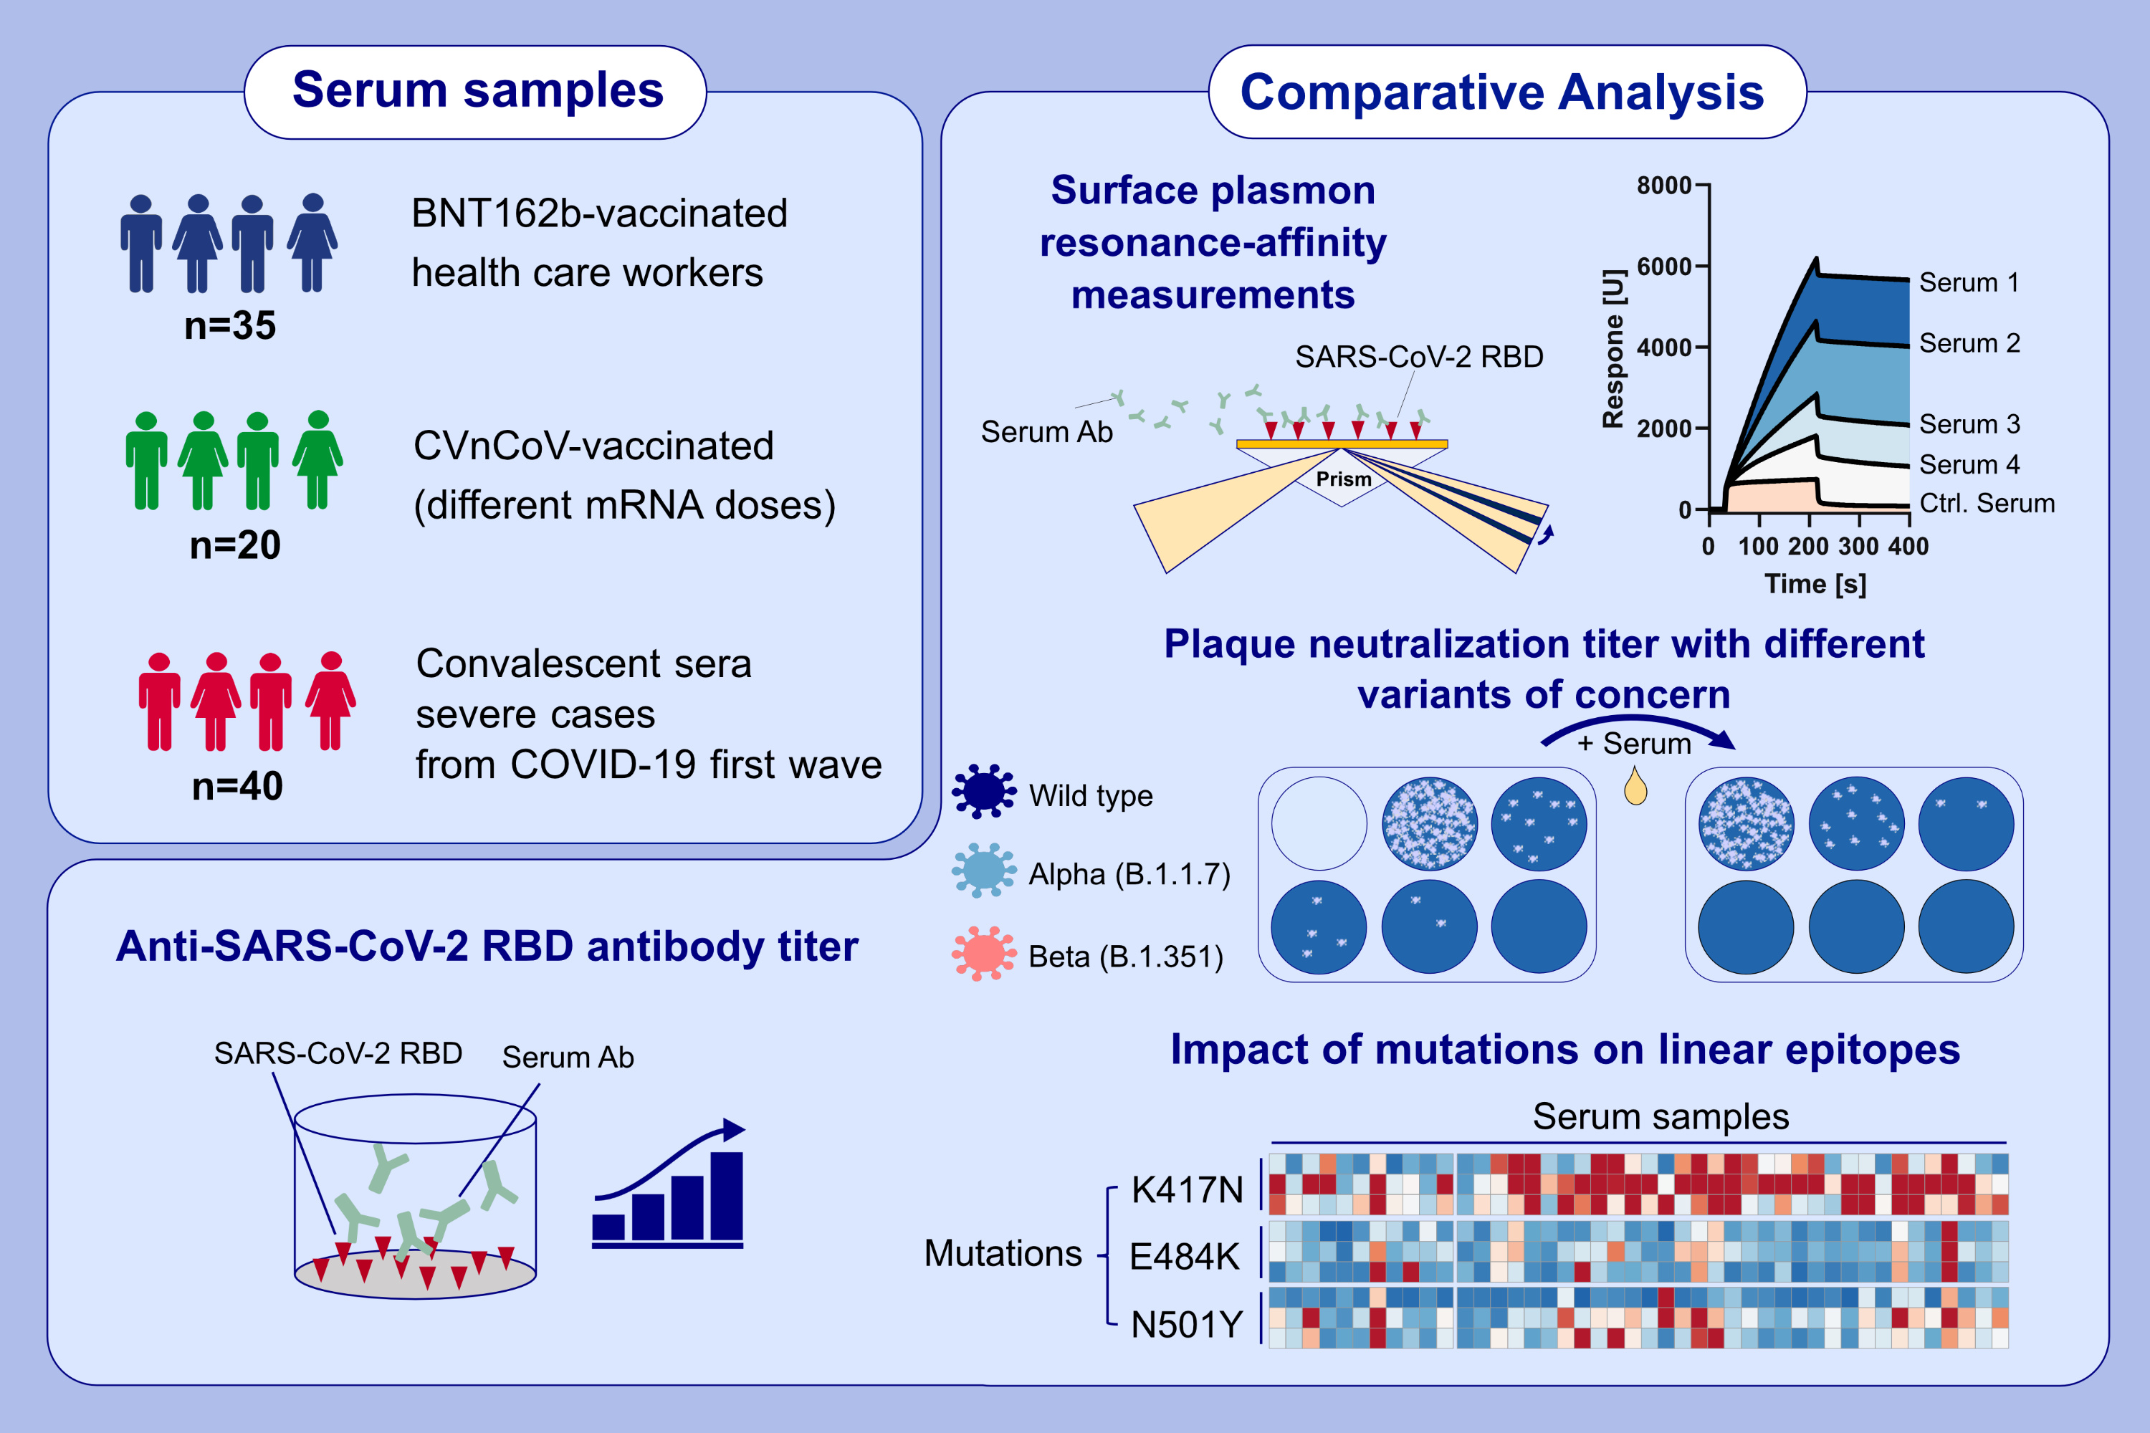
Analysis of BNT162b2- and CVnCoV-elicited sera and of convalescent sera towards SARS-CoV-2 viruses
Sascha Hein, Marie-Luise Herrlein, Ines Mhedhbi, Daniela Bender, Vanessa Haberger, et al.
Allergy. 2022; 1885-1894 https://doi.org/10.1111/all.15189
© 2019 EAACI and John Wiley and Sons A/S. Published by John Wiley and Sons Ltd.
Notes:
HIGHLIGHTS
This study presents comparative characterization of differences between sera derived from BNT162b- or CVnCoV-vaccinated individuals and first-wave convalescent patients.
In addition to standard titer measurements, we used novel methods for sera analysis, such as SPR to measure antibody-antigen complexes and SARS-CoV-2 variant-specific peptide arrays to study efficiency against linear epitopes.
Our results indicate a strong difference between all three serum groups (also between the two vaccine types), especially with respect to the titer, affinity and binding pattern to linear epitopes of the elicited antibodies.
Abbreviations: Ab, antibody; Alpha, SARS-CoV-2 Alpha variant; Beta, SARS-CoV-2 Beta variant; BNT162b2, mRNA COVID-19 vaccine; COVID-19, coronavirus disease 2019; Ctrl, negative control sera; CVnCoV, mRNA COVID-19 vaccine; mRNA, messenger ribonucleic acid; RBD, receptor-binding-domain; SARS-CoV-2, severe acute respiratory syndrome coronavirus 2

