Slide 1
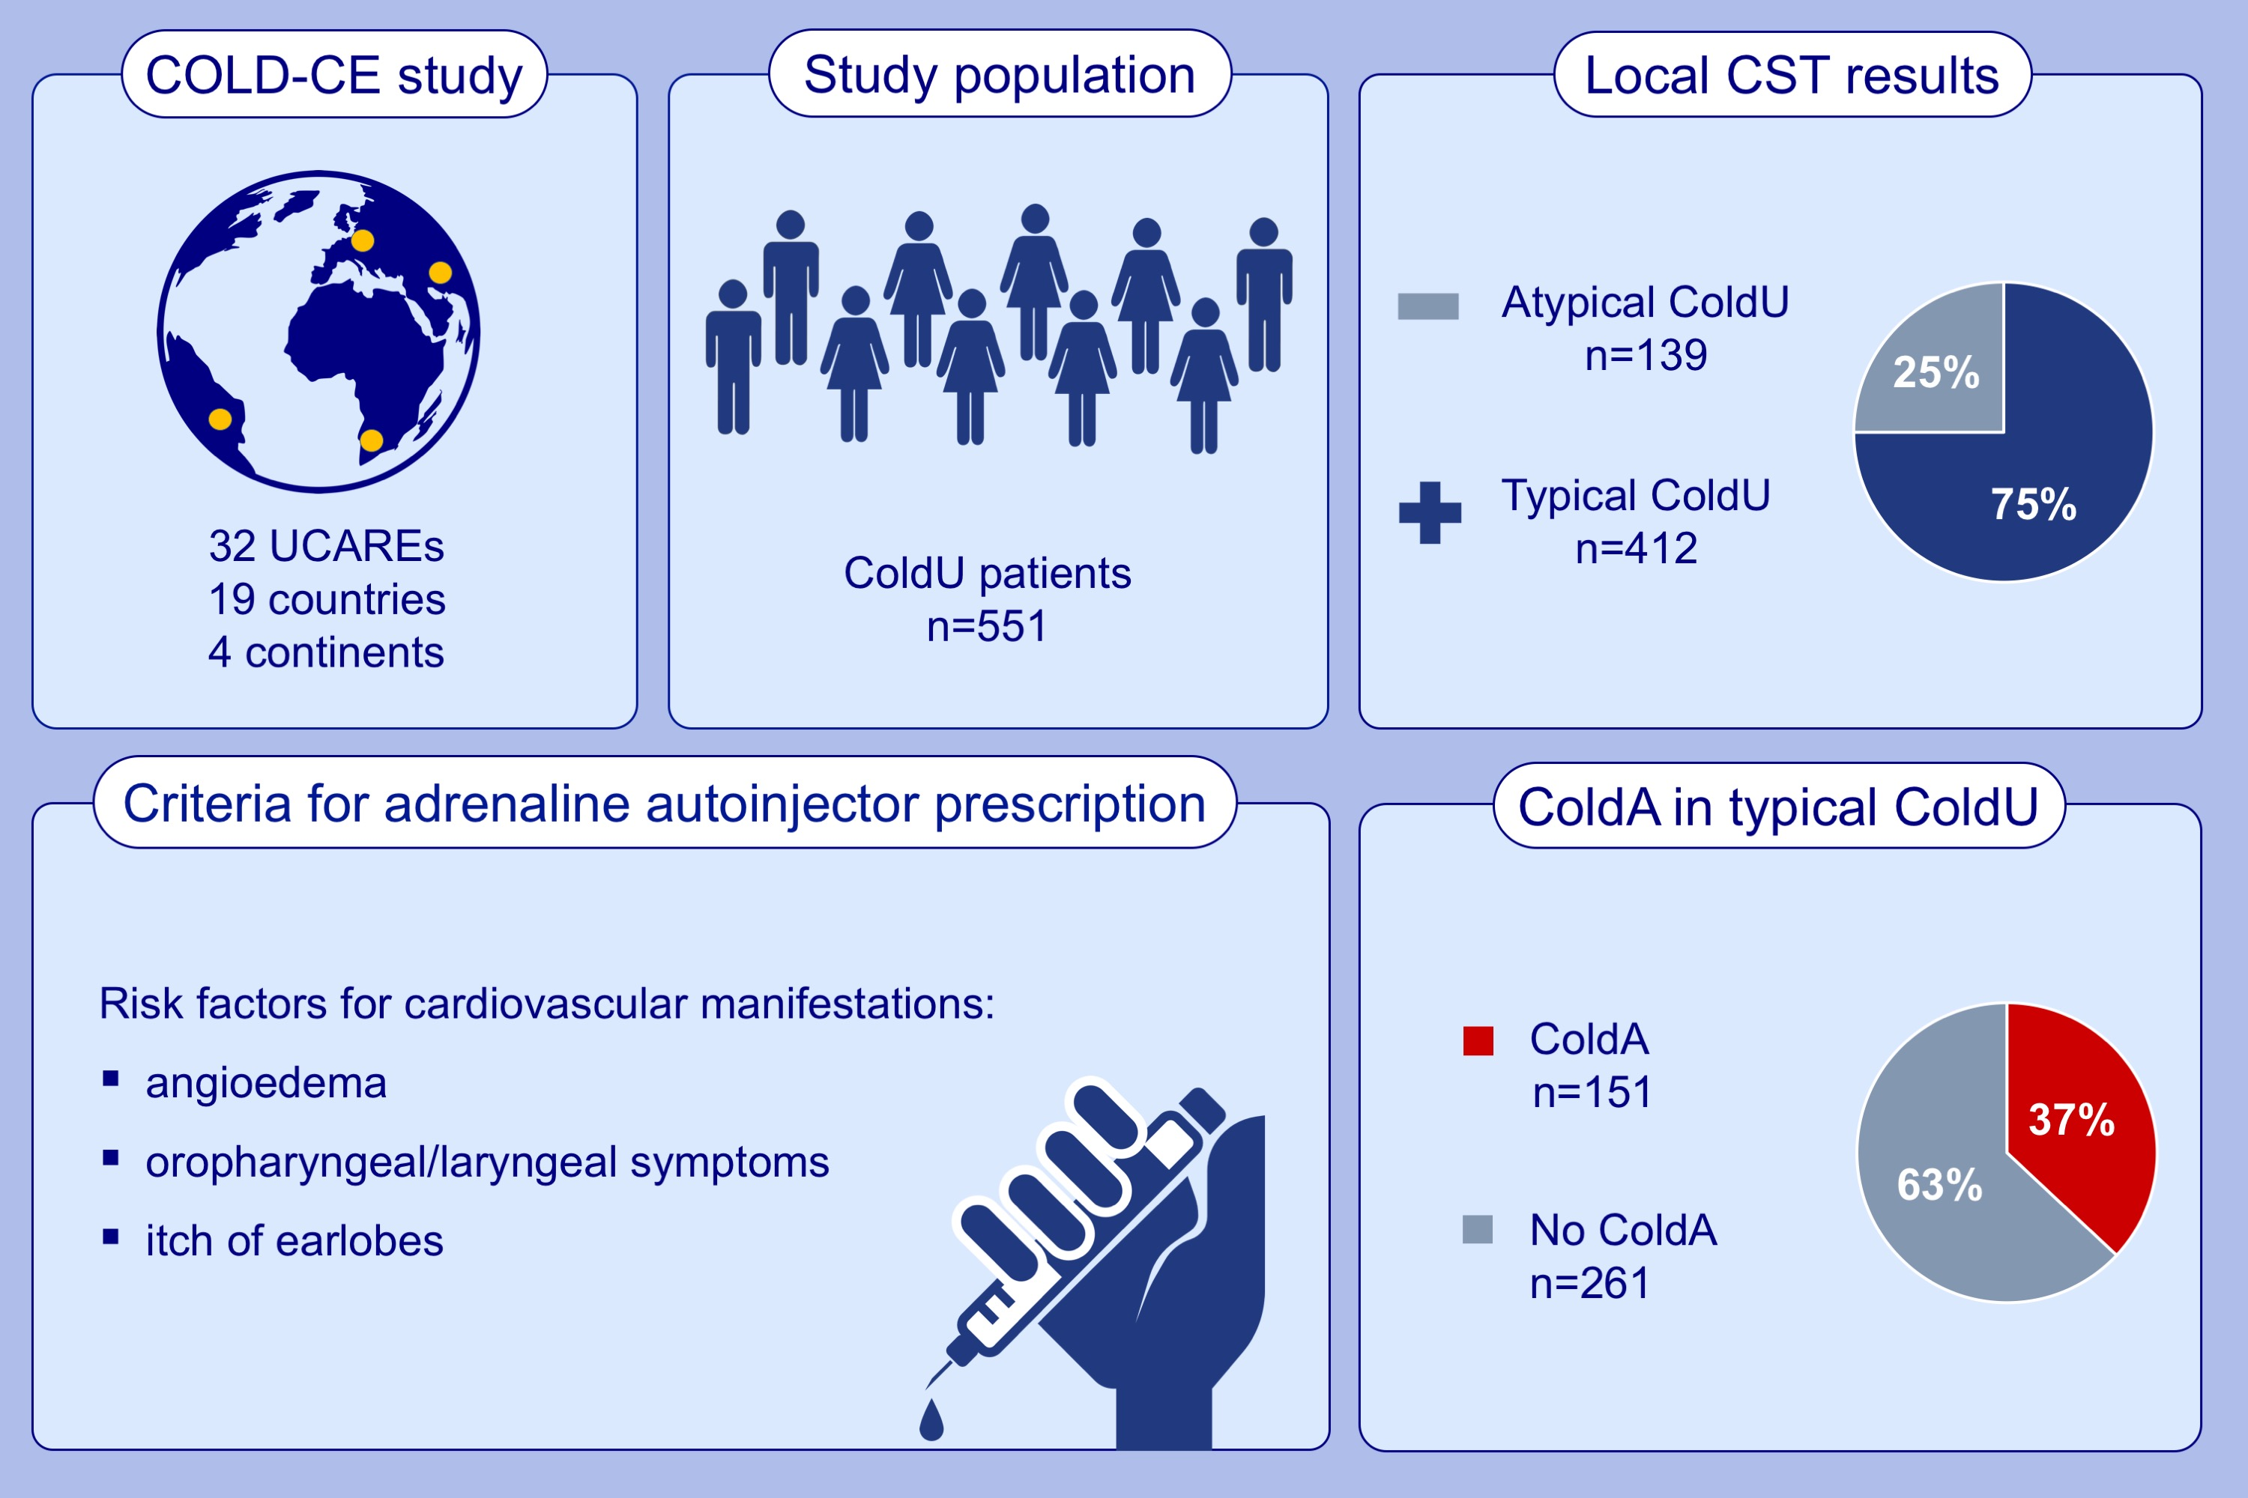
Risk factors for systemic reactions in typical cold urticaria: results from the COLD-CE study
Mojca Bizjak, Mitja Košnik, Dejan Dinevski, Simon Francis Thomsen, Daria Fomina, et al.
Allergy. 2022; 2185-2199 https://doi.org/10.1111/all.15194
© 2019 EAACI and John Wiley and Sons A/S. Published by John Wiley and Sons Ltd.
Notes:
HIGHLIGHTS
The COLD-CE study was carried out at 32 UCAREs from 19 countries and 4 continents.
Among 551 ColdU patients, 75% had positive local CST (i.e., typical ColdU) and ColdA occurred in 37% of the latter.
For the first time, we propose the criteria for adrenaline autoinjector prescription for patients with typical ColdU.
Abbreviations: ColdA, cold-induced anaphylaxis; COLD-CE, comprehensive evaluation of cold urticaria and other cold-induced reactions, a study of the GA²LEN UCARE network; ColdU, cold urticaria; CST, cold stimulation testing; UCAREs, Urticaria Centers of Reference and Excellence

