Slide 1
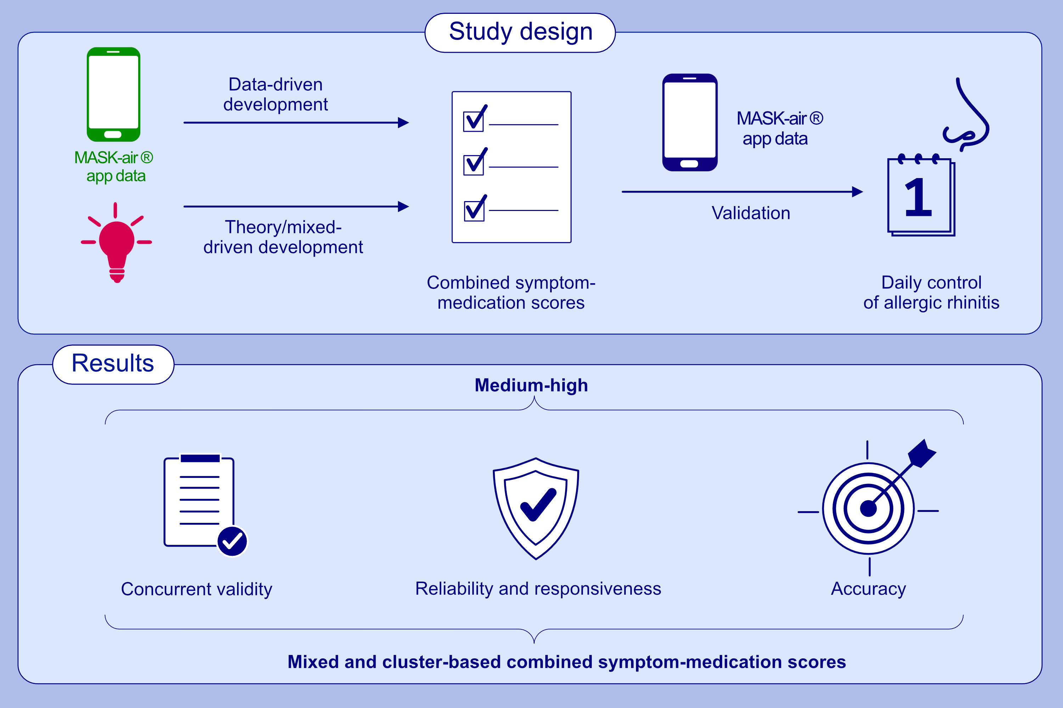
Development and validation of combined symptom- medication scores for allergic rhinitis
Bernardo Sousa-Pinto, Luís Filipe Azevedo, Marek Jutel, Ioana Agache, G. Walter Canonica, et al.
Allergy. 2022; 2147-2162 https://doi.org/10.1111/all.15199
© 2019 EAACI and John Wiley and Sons A/S. Published by John Wiley and Sons Ltd.
Notes:
HIGHLIGHTS
This study assessed 317,176 days of MASK-air® (Mobile Airways Sentinel networK) use from 17,780 users aged between 16 and 90 years, in 25 countries.
Real-world data obtained with the MASK-air® app were used to develop combined symptom-medication scores to assess the daily control of allergic rhinitis.
These scores had medium-high validity, reliability and accuracy, rendering them candidates for clinical practice, and for primary endpoints in future rhinitis trials and observational studies.

