Slide 1
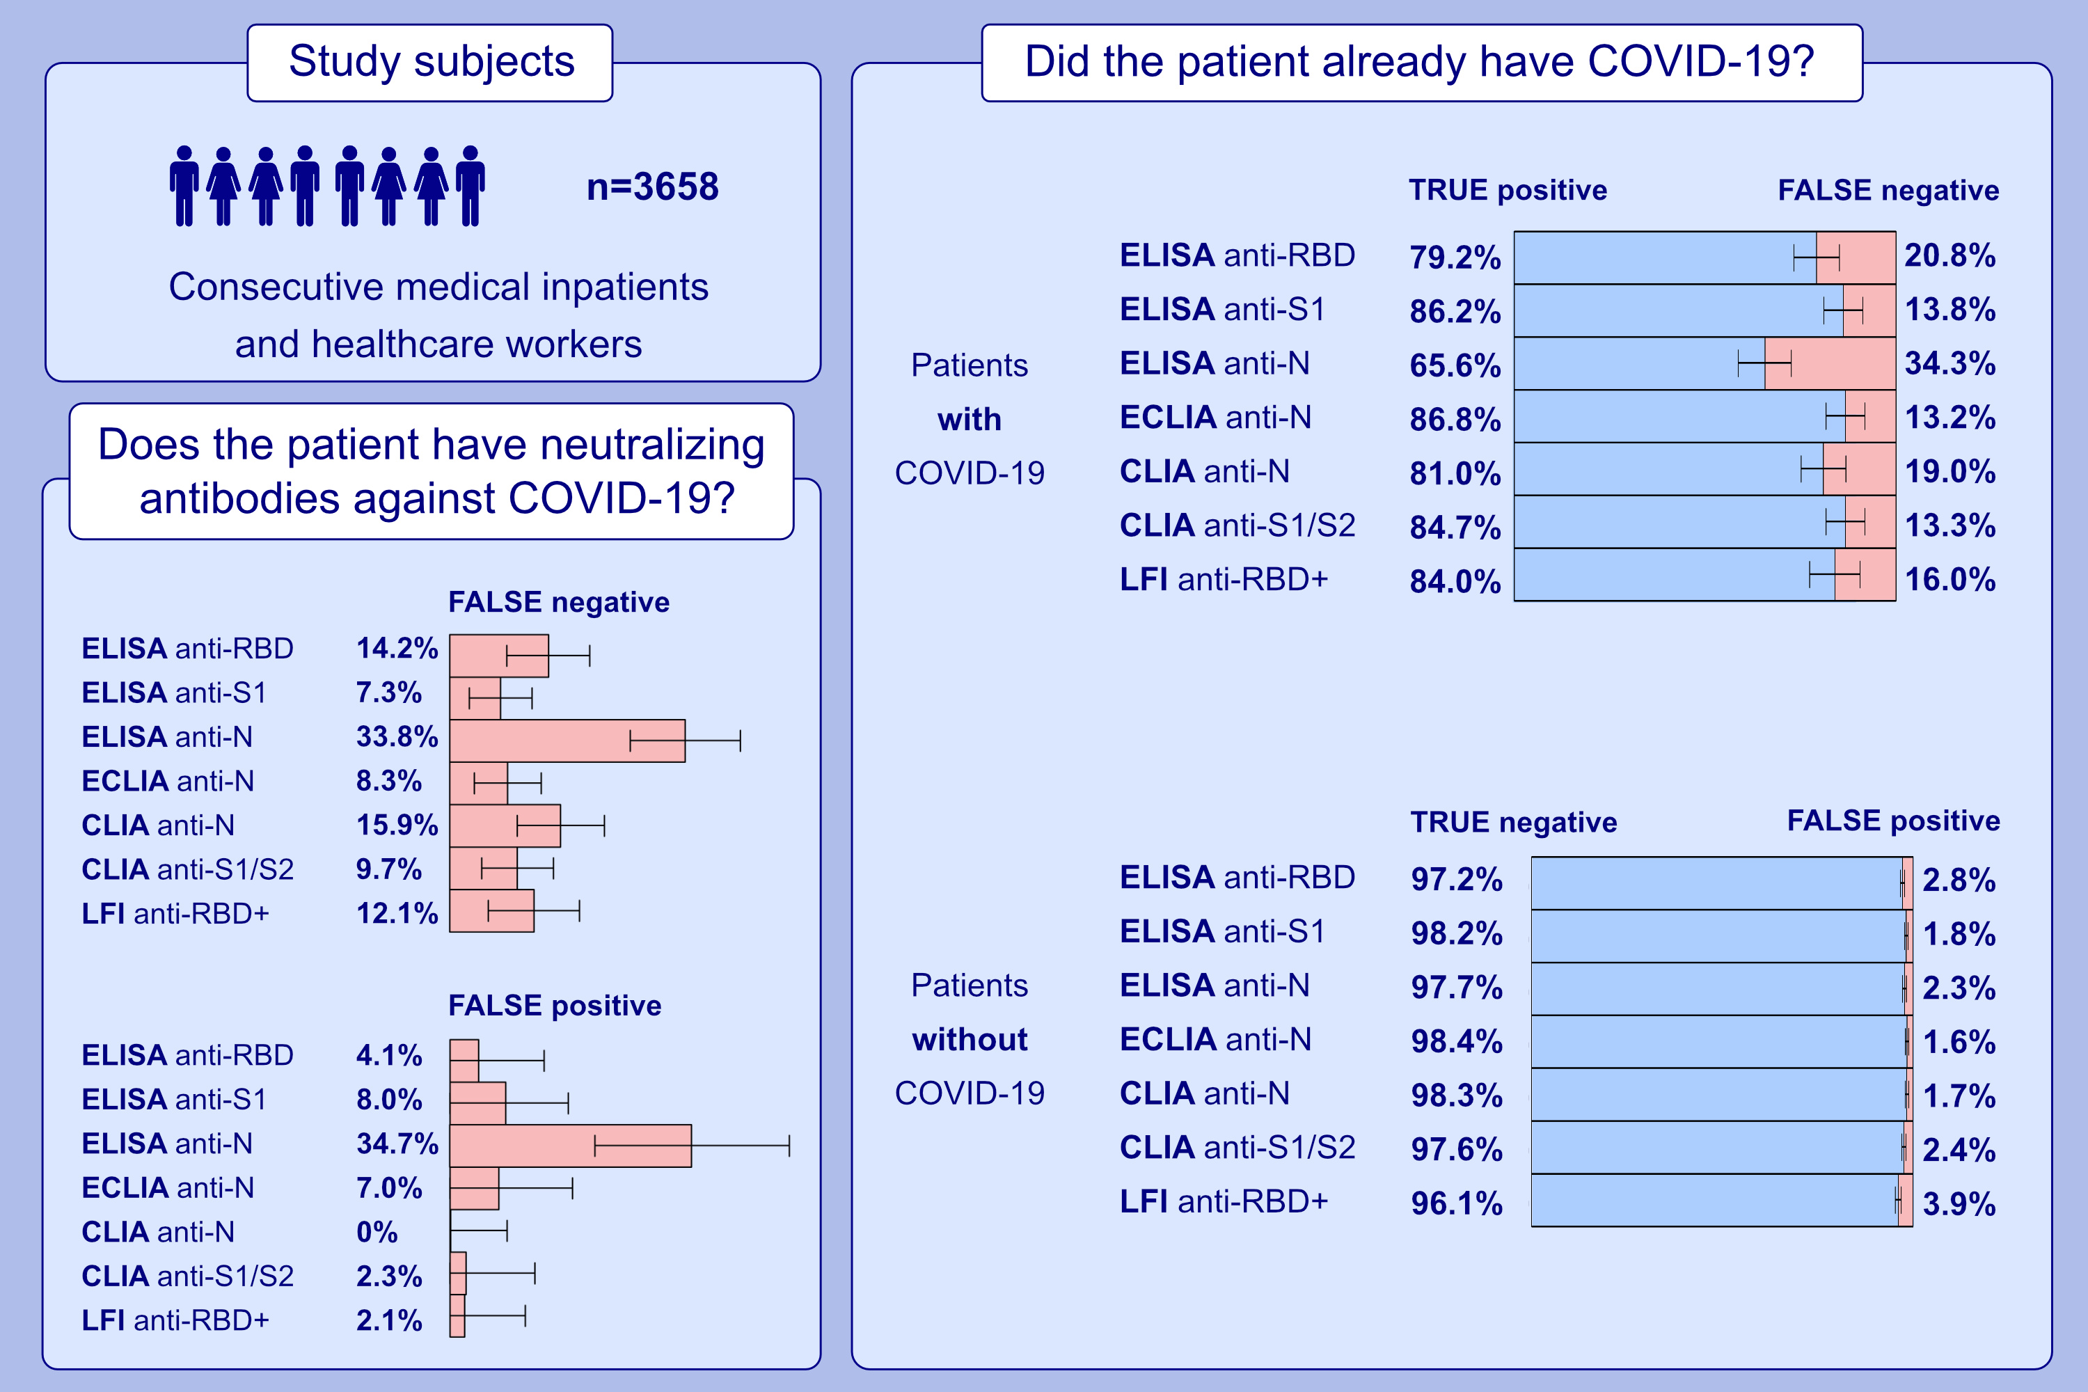
Serological testing for SARS-CoV-2 antibodies in clinical practice: a comparative diagnostic accuracy study
Michael P. Horn, Hulda R. Jonsdottir, Daniel Brigger, Lauro Damonti, Franziska Suter-Riniker, et al.
Allergy. 2022; 2090-2103 https://doi.org/10.1111/all.15206
© 2019 EAACI and John Wiley and Sons A/S. Published by John Wiley and Sons Ltd.
Notes:
HIGHLIGHTS
This large prospective cross-sectional study determines the diagnostic accuracy of various serological testing strategies for identification of patients with previous COVID-19 and prediction of neutralizing antibodies against SARS-CoV-2 in real-life clinical settings.
The diagnostic accuracy in detecting patients with previous COVID-19 was high in anti-N ECLIA and anti-S1 ELISA (sensitivity ≥ 85%; specificity ≥97%).
The accuracy in detecting neutralizing antibodies was high in anti- S1/S2 CLIA and anti-RBD+ LFI (sensitivity ≥ 85%; specificity ≥97%).
Abbreviations: CLIA, chemiluminescence immunoassay; COVID-19, coronavirus disease-2019; ECLIA, electrochemiluminescence immunoassay; ELISA, enzyme-linked immunosorbent assay; LFI, lateral flow immunoassay; N, nucleoprotein; RBD, receptor binding domain of the SARS-CoV-2 spike glycoprotein; RBD+, extended receptor binding domain of the SARS- CoV-2 spike glycoprotein; SARS-CoV-2, severe acute respiratory syndrome coronavirus 2; S1/2, domain 1 or 2 of the SARS-CoV-2 spike glycoprotein

