Slide 1
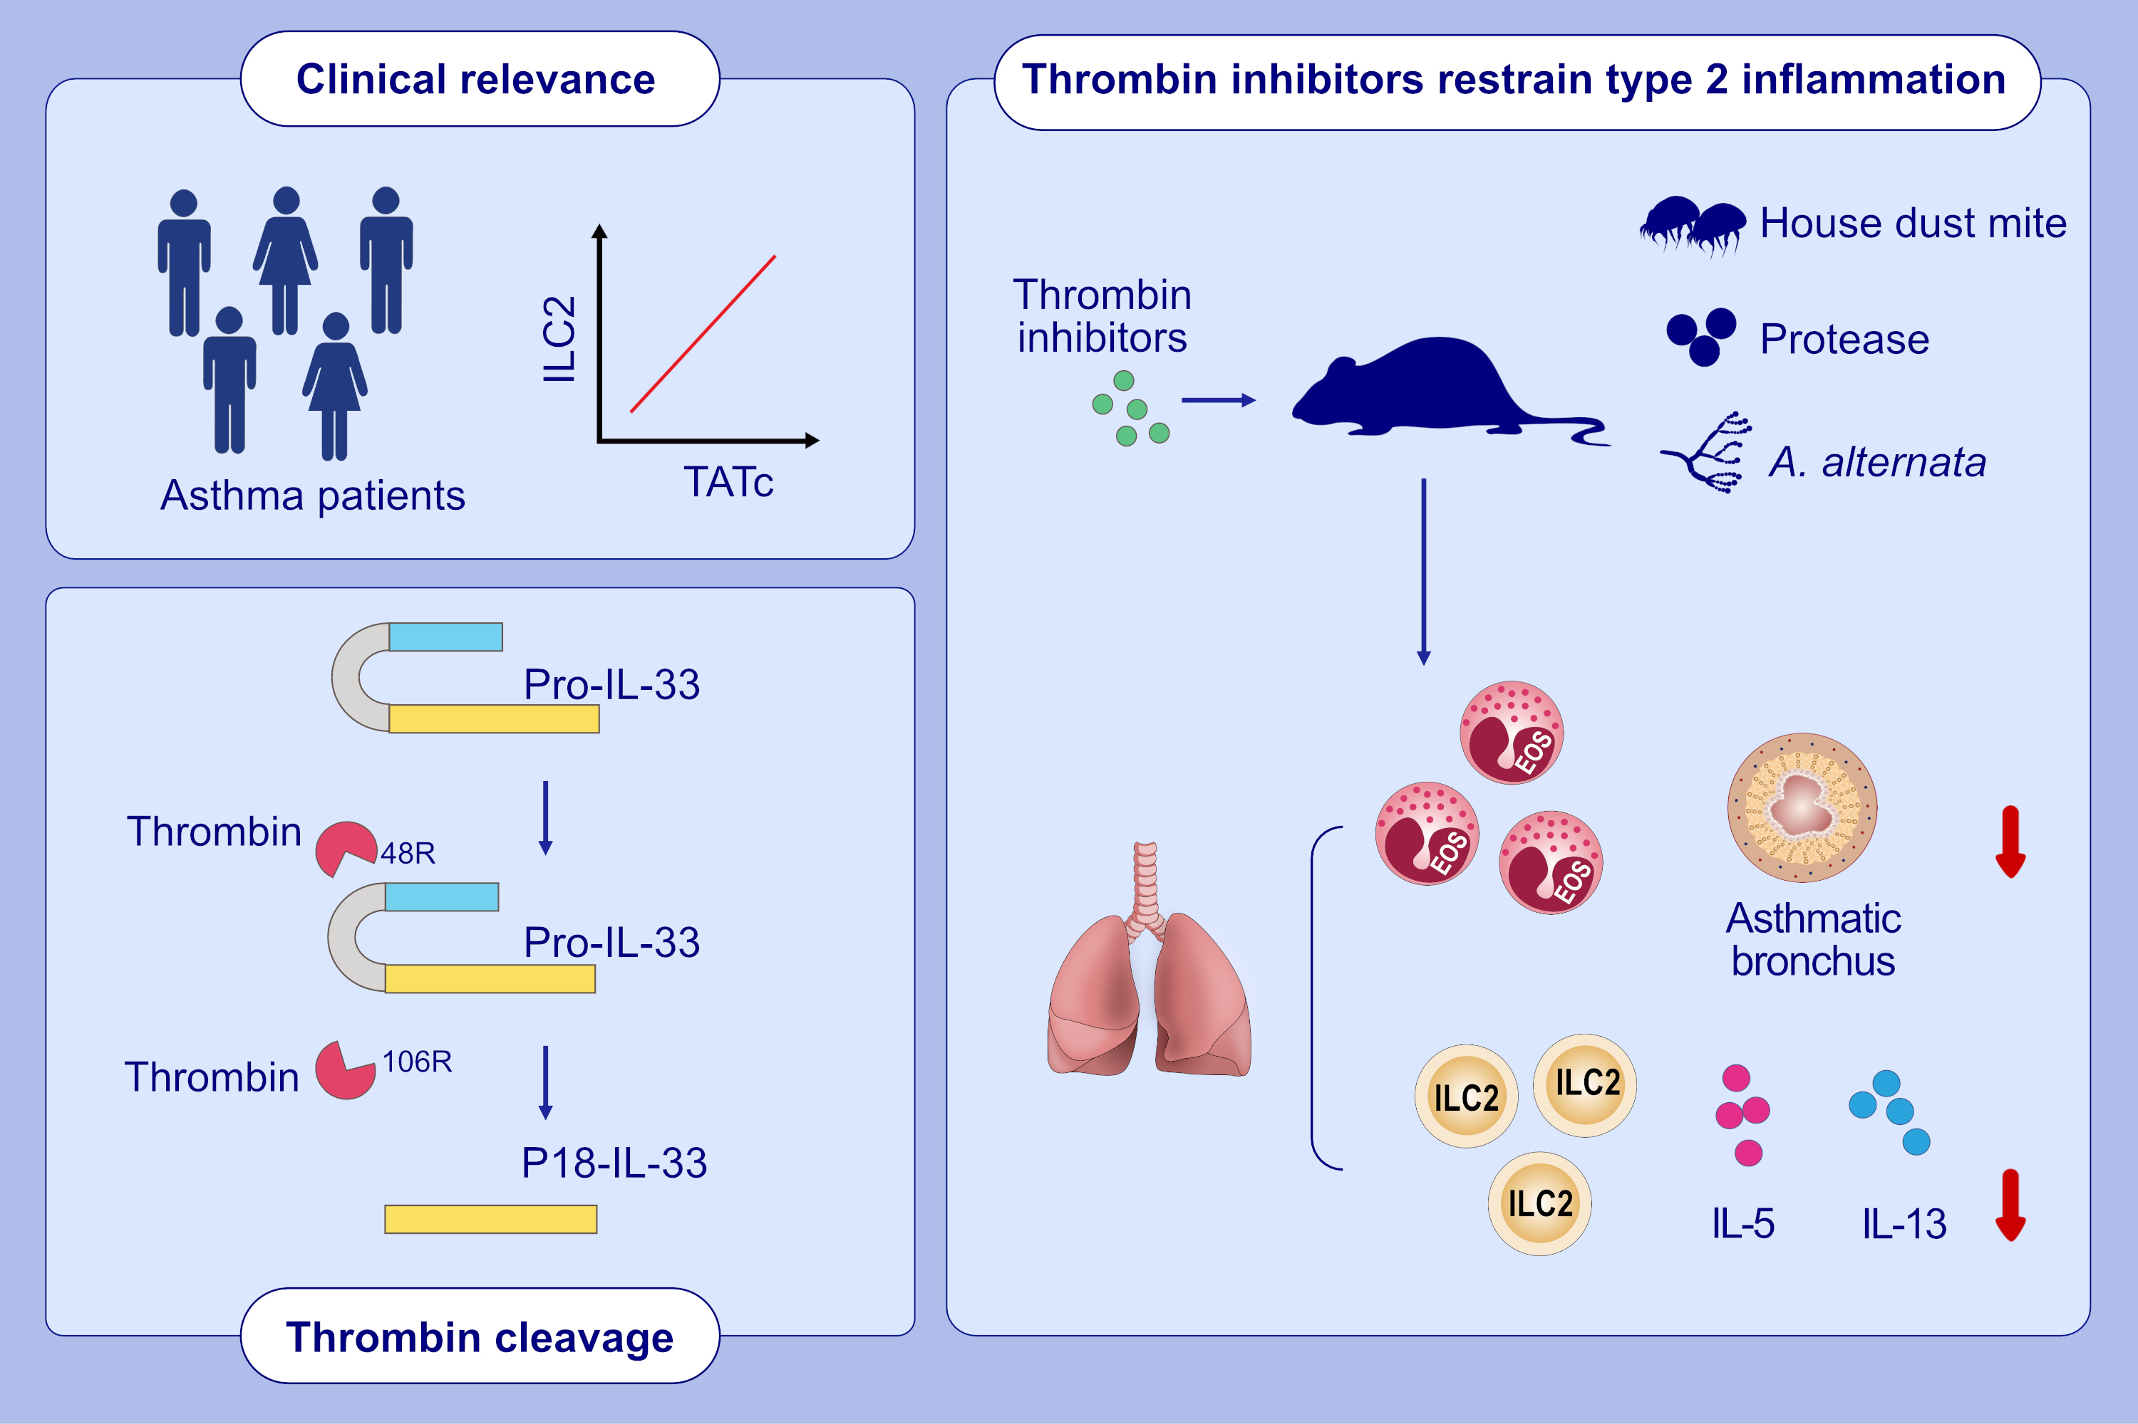
Thrombin cleaves IL-33 and modulates IL-33-activated allergic lung inflammation
Yuying Huang, Xuezhen Li, Lin Zhu, Chunrong Huang, Wen Chen, Zhiyang Ling, et al.
Allergy. 2022; 2104-2120 https://doi.org/10.1111/all.15210
© 2019 EAACI and John Wiley and Sons A/S. Published by John Wiley and Sons Ltd.
Notes:
HIGHLIGHTS
Thrombin cleavage leads to IL-33 activation by targeting conserved thrombin consensus site.
Thrombin inhibitors can restrain type 2 inflammation.
Thrombin is associated with ILC2 activation in asthmatic patients
Abbreviations: IL, interleukin; ILC2, group 2 innate lymphocytes; TATc, thrombin–antithrombin complex

