Slide 1
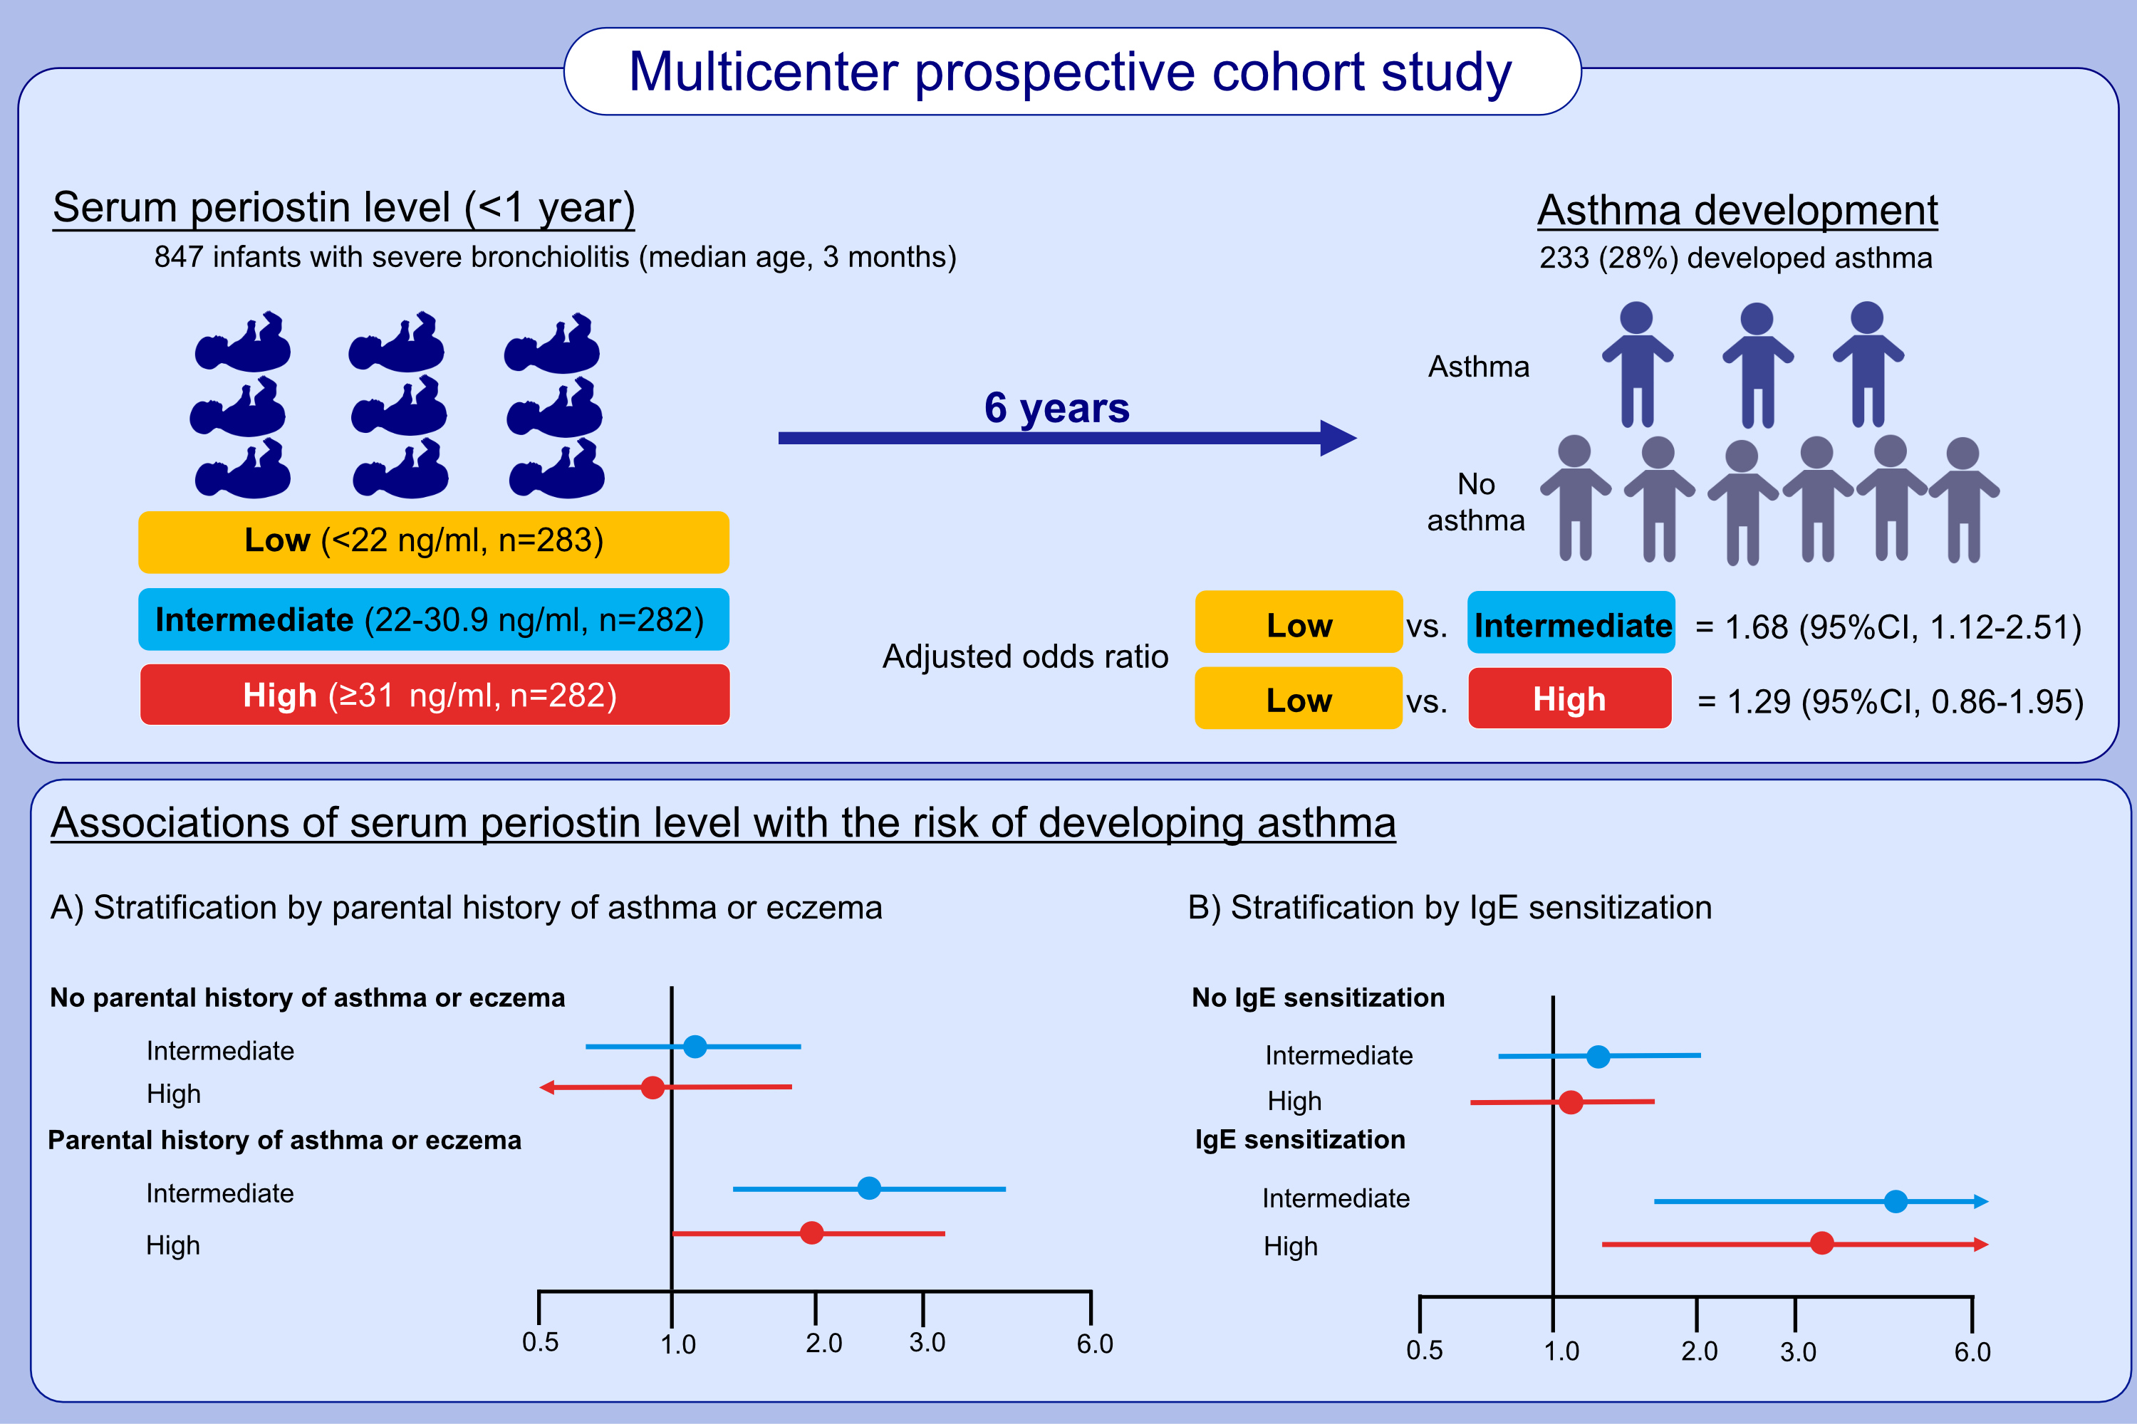
Serum periostin among infants with severe bronchiolitis and risk of developing asthma:
A prospective multicenter cohort study
Makiko Nanishi, Michimasa Fujiogi, Robert J. Freishtat, Claire E. Hoptay, Cindy S. Bauer, et al.
Allergy. 2022; 2121-2130 https://doi.org/10.1111/all.15216
© 2019 EAACI and John Wiley and Sons A/S. Published by John Wiley and Sons Ltd.
Notes:
HIGHLIGHTS
In this study, a higher serum periostin level at bronchiolitis hospitalization was associated with a greater risk for subsequently developing asthma.
The longitudinal relationship was observed mainly in infants with an allergic predisposition.
Our findings not only provide an evidence base for early identification of children at high risk for asthma but also offer potential opportunities for early preventive interventions.
Abbreviation: CI, confidence interval; IgE, immunoglobulin E

