Slide 1
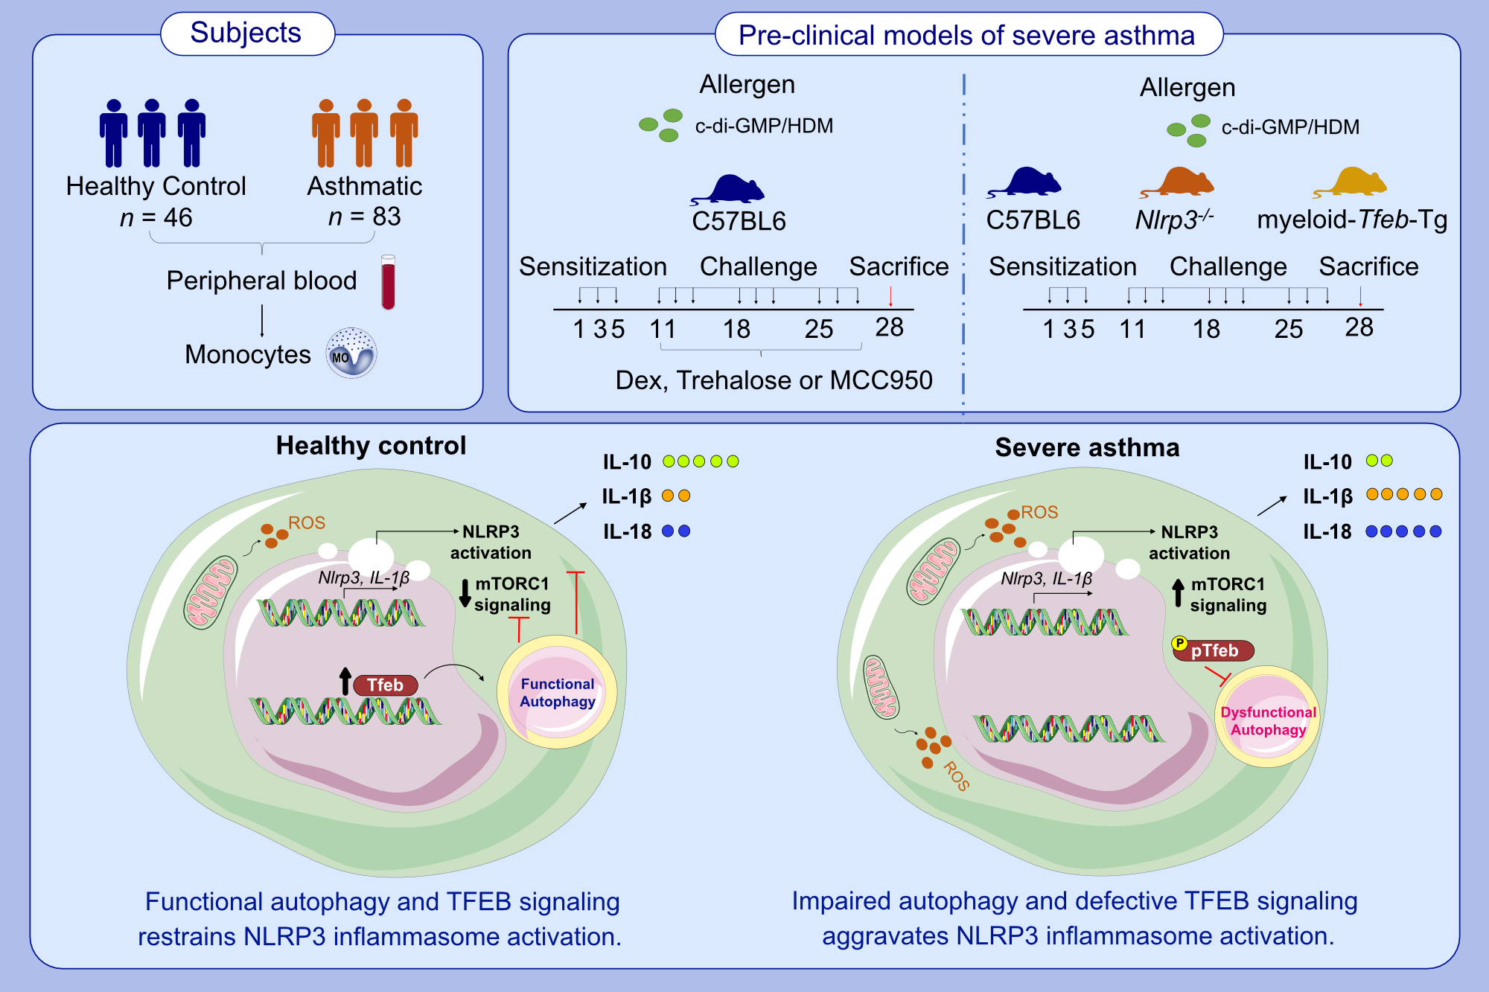
TFEB signaling attenuates NLRP3-driven inflammatory responses in severe asthma
Efthymia Theofani, Maria Semitekolou, Konstantinos Samitas, Annie Mais, Ioanna E. Galani, et al.
Allergy. 2022; 2131-2146, https://doi.org/10.1111/all.15221
© 2019 EAACI and John Wiley and Sons A/S. Published by John Wiley and Sons Ltd.
Notes:
HIGHLIGHTS
We investigate whether activation of autophagy and TFEB signaling suppress inflammatory monocyte responses in asthmatic individuals.
Our studies reveal a dysregulation of NLRP3 inflammasome and autophagy responses in monocytes from asthmatics that correlate with disease severity.
In vivo activation of the autophagy inducer, TFEB, through trehalose administration or myeloid cell-specific TFEB overexpression, restrains pulmonary inflammation and attenuates asthma features, uncovering TFEB as a novel therapeutic target.
Abbreviations: c-di-GMP/HDM, cyclic di-guanosine monophosphate/house dust mite; Dex, dexamethasone; MCC950, NLRP3 inhibitor; mTORC1, mammalian target of rapamycin complex 1; NLRP3, NLR family, pyrin domain-containing 3; TFEB, transcription factor EB; Tg, transgenic

