Slide 1
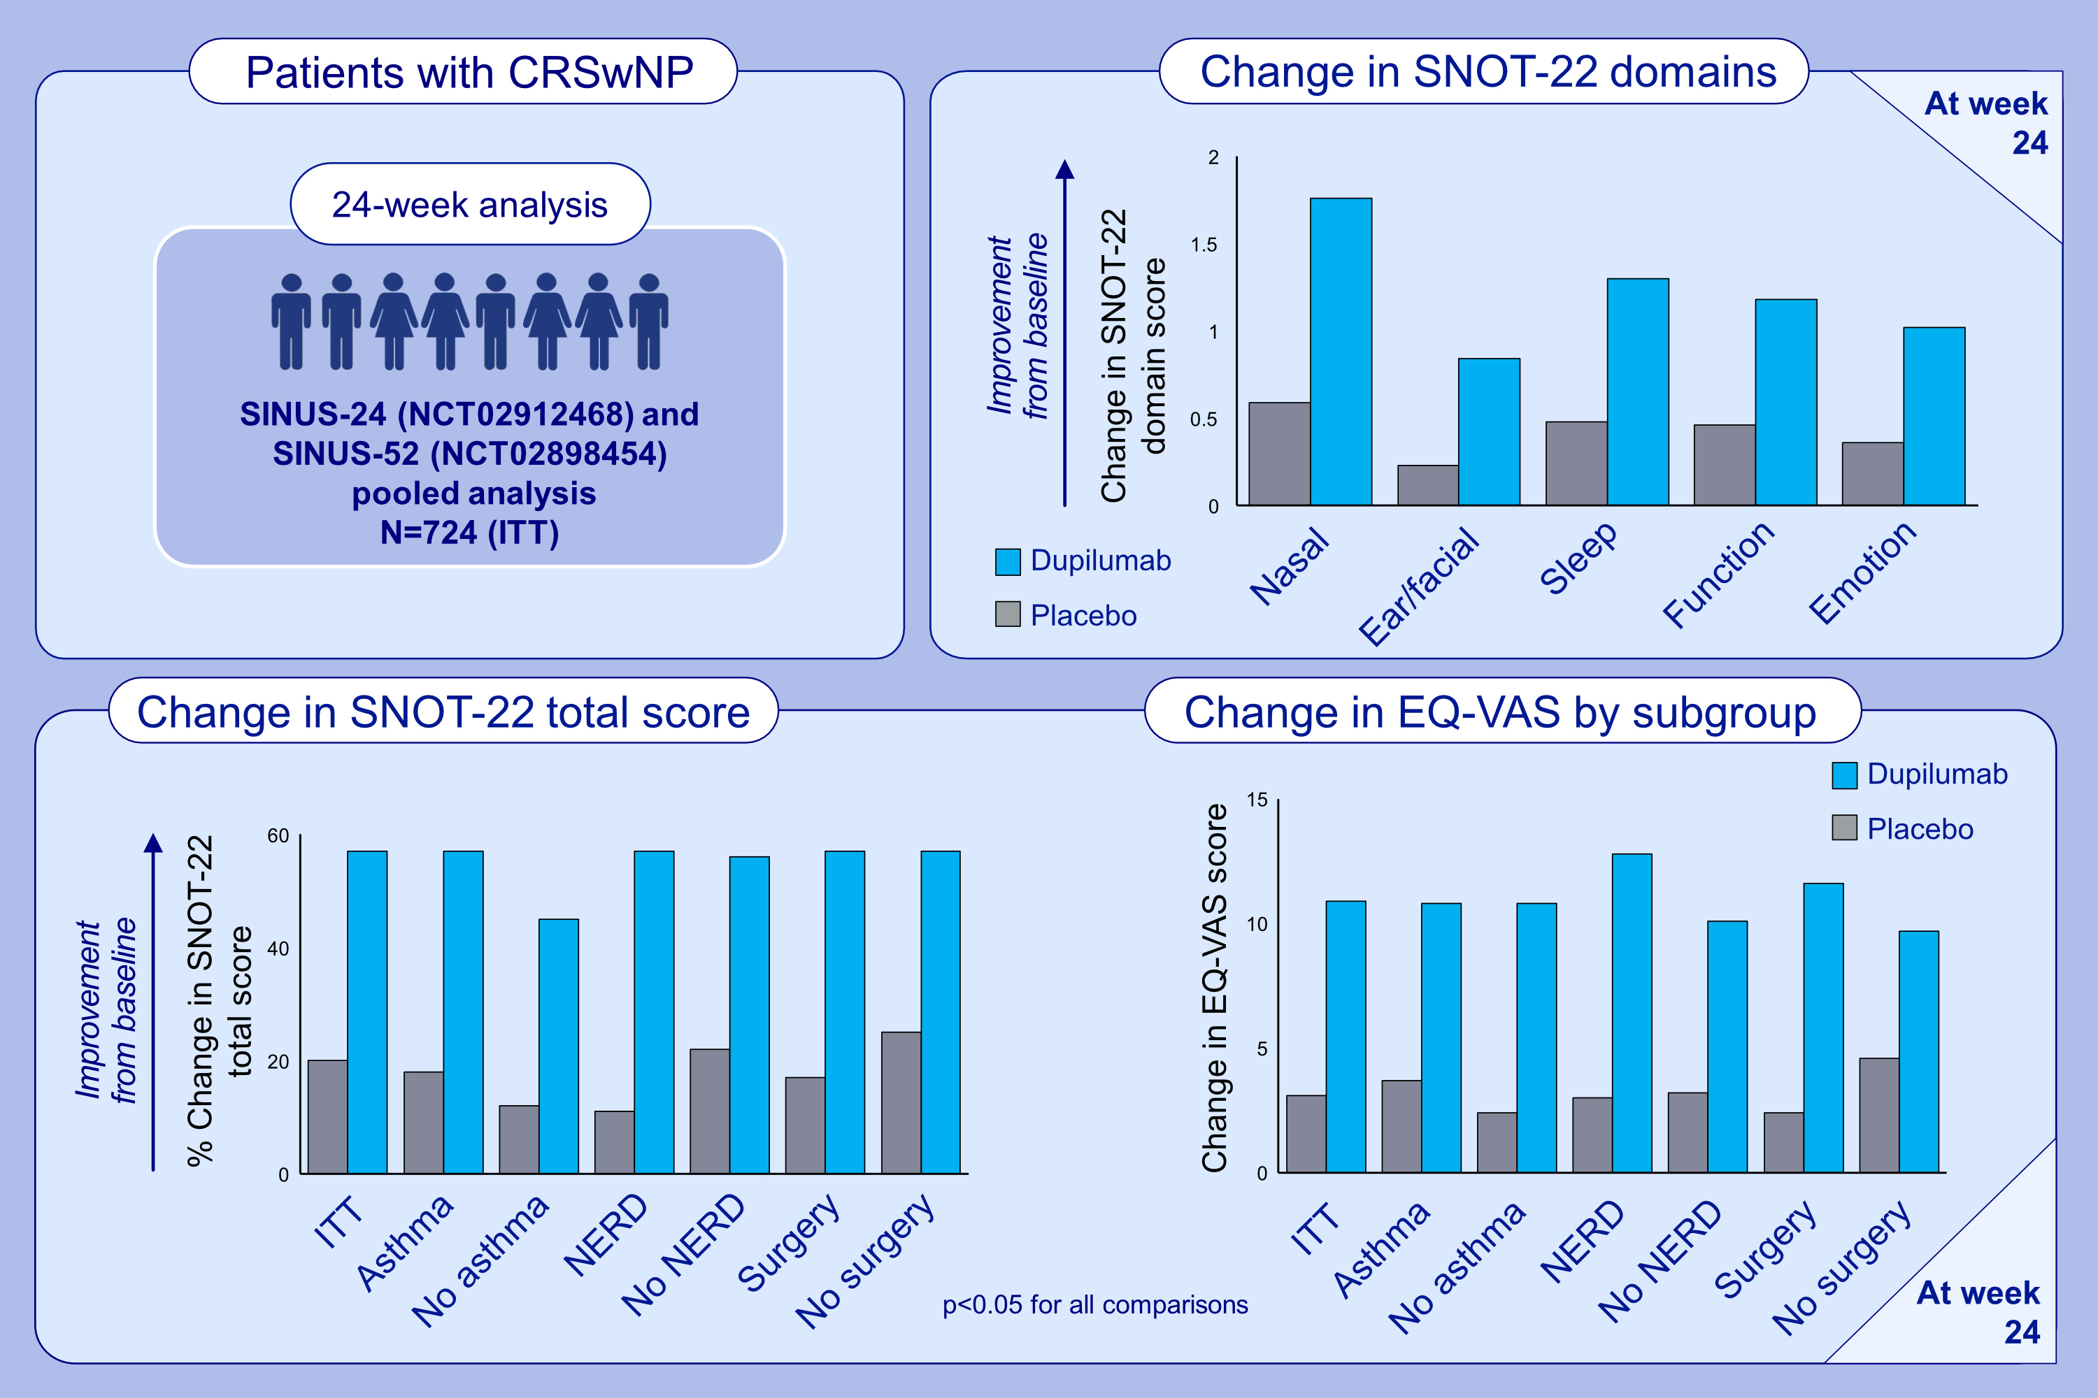
Dupilumab improves health-related quality of life in severe chronic rhinosinusitis with nasal polyps
Stella E. Lee, Claire Hopkins, Joaquim Mullol, Jérôme Msihid, Isabelle Guillemin, et al.
Allergy. 2022; 2211-2221 https://doi.org/10.1111/all.15222
© 2019 EAACI and John Wiley and Sons A/S. Published by John Wiley and Sons Ltd.
Notes:
HIGHLIGHTS
CRSwNP is a predominantly type 2-mediated inflammatory disease with high symptom burden that impacts HRQoL.
In the SINUS-24 and SINUS-52 studies, patients with CRSwNP were randomized to dupilumab or placebo.
Dupilumab led to significant clinically meaningful improvements across all aspects of disease-specific HRQoL and general health status in patients with CRSwNP, irrespective of comorbid asthma, NSAID-ERD, or prior NP surgery.
Abbreviations: CRSwNP, chronic rhinosinusitis with nasal polyps; EQ-VAS, EuroQoL-visual analog scale; HRQoL, health-related quality of life; ITT, intent to treat; NSAID-ERD, non-steroidal anti-inflammatory drug-exacerbated respiratory disease; NP, nasal polyp; SINUS-24 and SINUS-52, two placebo-controlled clinical studies assessing dupilumab in patients with chronic rhinosinusitis with nasal polyps over 24 and 52 weeks, respectively; SNOT-22, 22-item Sino-Nasal Outcome Test

