Slide 1
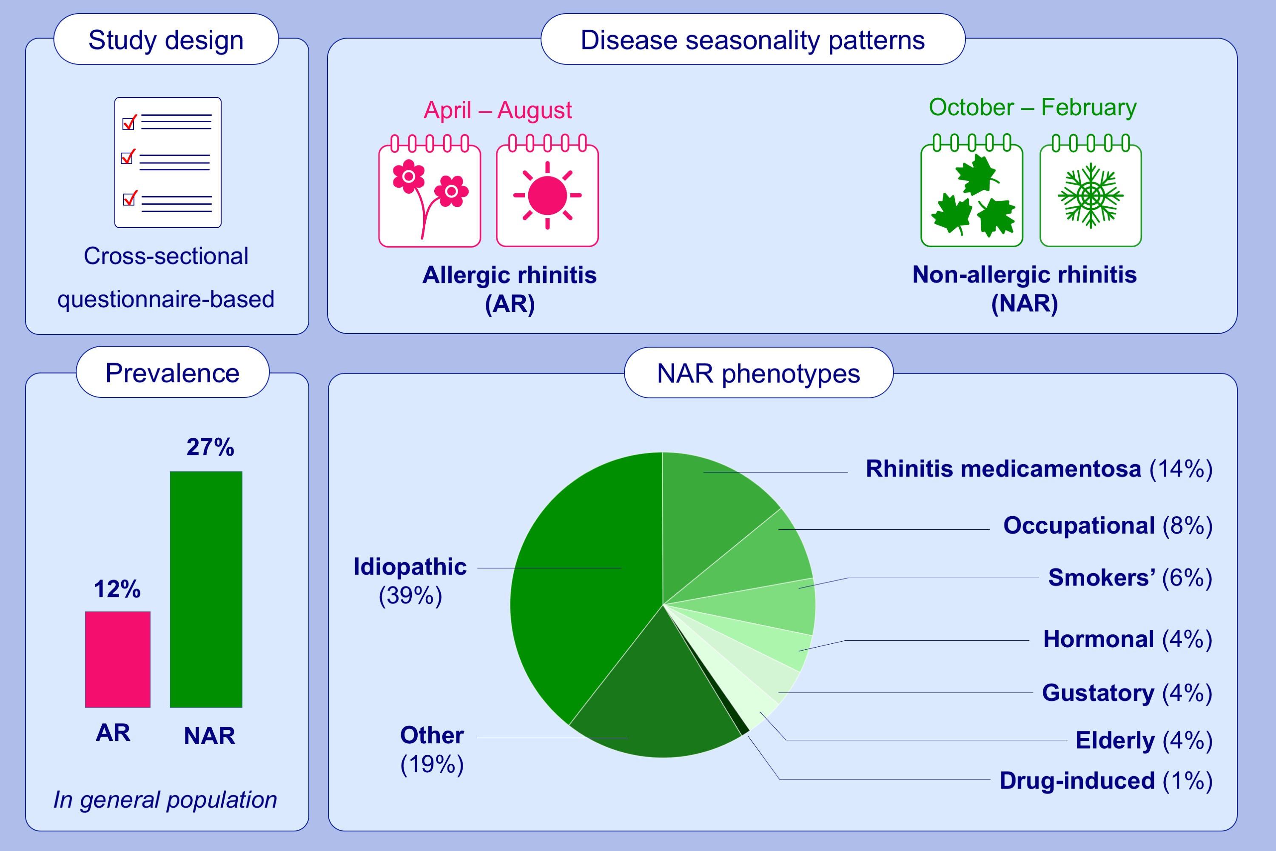
The prevalence of non-allergic rhinitis phenotypes in the general population: a cross-sectional study
Klementina S. Avdeeva, Wytske J. Fokkens, Christine L. Segboer, Sietze Reitsma
Allergy. 2022; 2163-2174 https://doi.org/10.1111/all.15223
© 2019 EAACI and John Wiley and Sons A/S. Published by John Wiley and Sons Ltd.
Notes:
HIGHLIGHTS
The prevalence of NAR and AR in general population: 27% and 12%.
AR symptoms get worse in spring/ summer, NAR symptoms in autumn/winter.
The prevalences of NAR phenotypes: idiopathic 39%, rhinitis medicamentosa 14%, occupational 8%, smokers’ 6%, hormonal 4%, rhinorrhoea of the elderly 4%, gustatory 4% and drug-induced 1%. Nineteen percent could not be defined in neither of the phenotypes.
Abbreviations: AR, allergic rhinitis; NAR, non-allergic rhinitis

