Slide 1
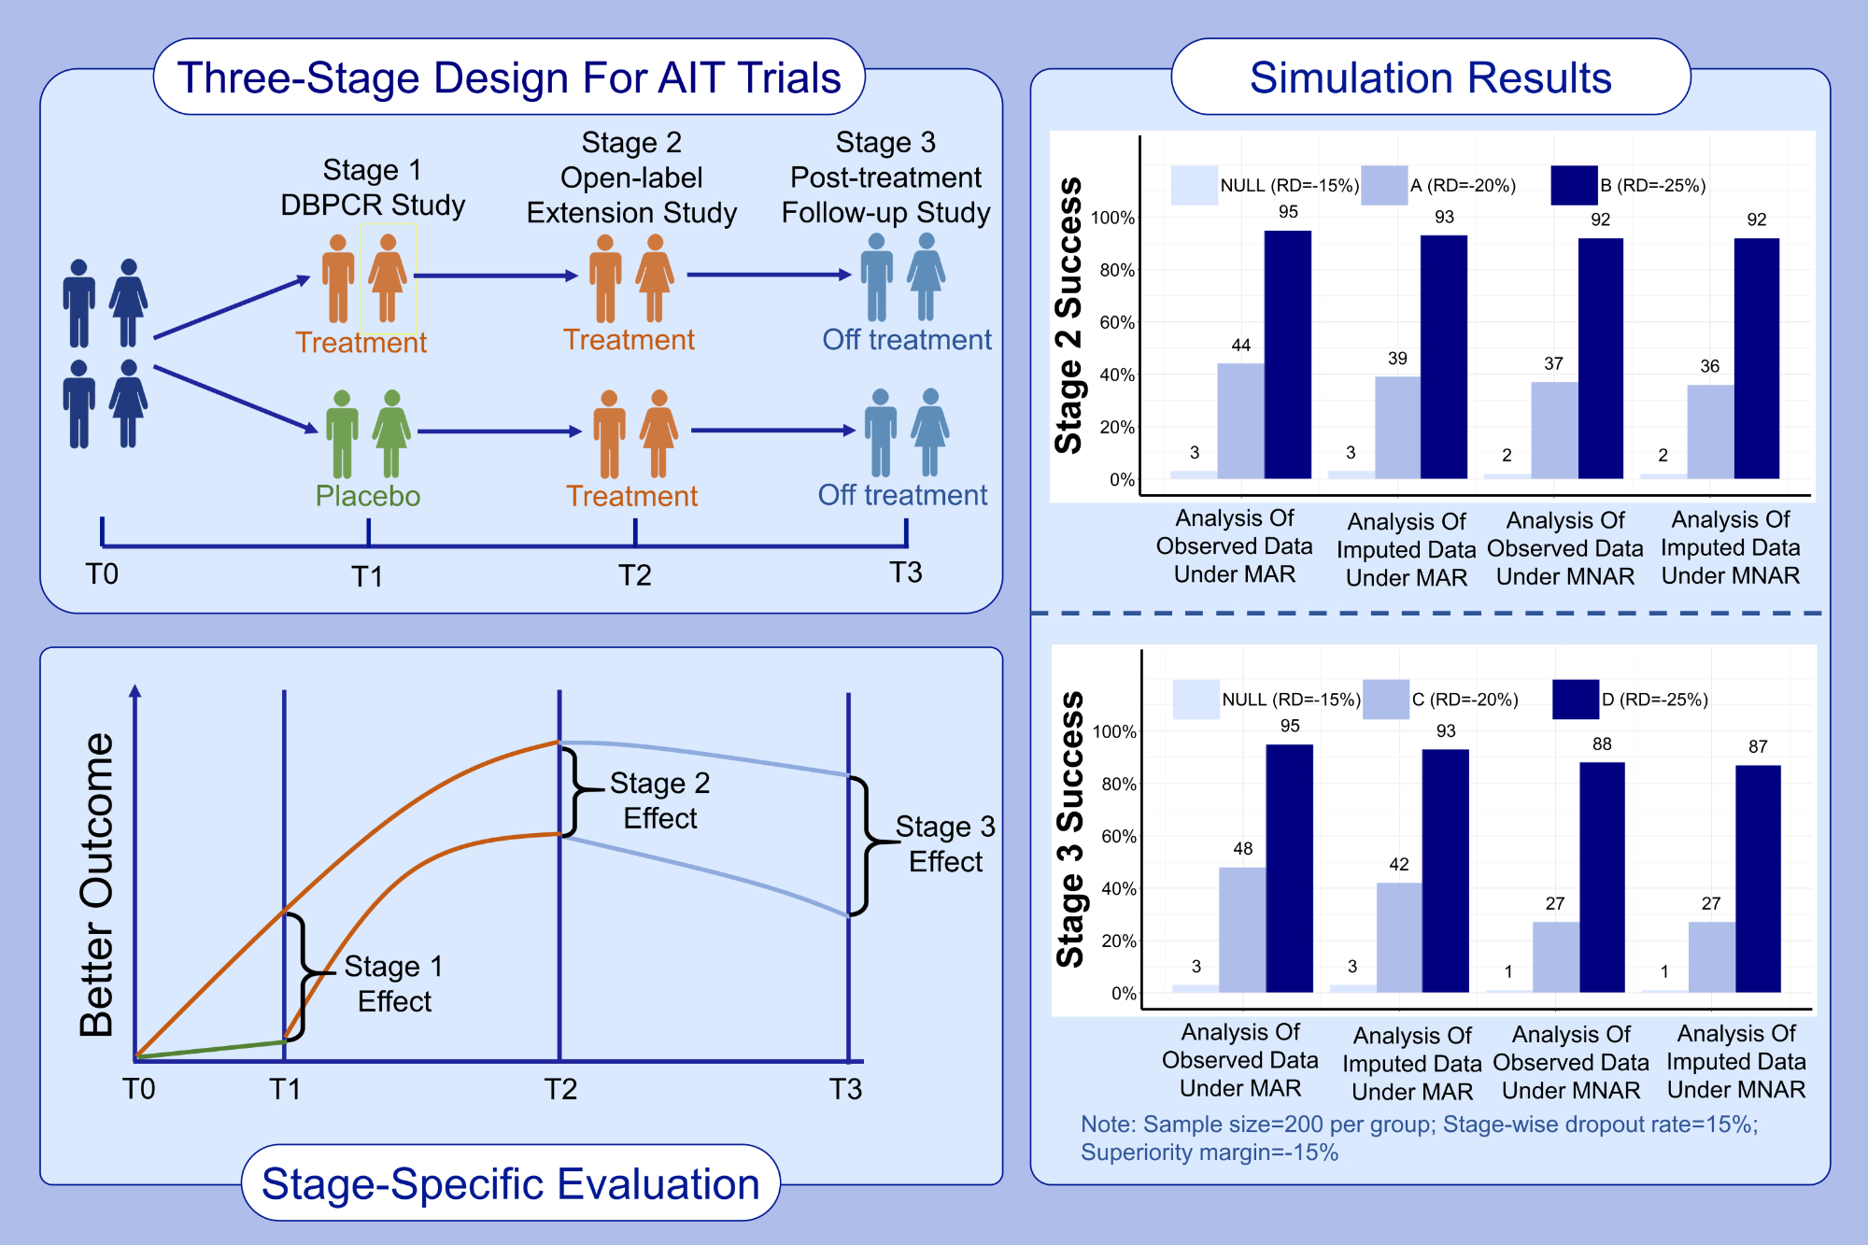
A three-stage design for allergen immunotherapy trials
Xinyu Tang, Ronald L. Rabin, Lihan K. Yan
Allergy. 2022; pages: 1835-1842 https://doi.org/10.1111/all.15117
© 2019 EAACI and John Wiley and Sons A/S. Published by John Wiley and Sons Ltd.
Notes:
HIGHLIGHTS
We introduce a three-stage design to characterize the effects of an AIT product through stage-wise statistical evaluations.
These effects include initial treatment effect (Stage 1), effect associated with time of introduction and length of treatment (Stage 2), and sustained effect after treatment is withdrawn (Stage 3).
Simulations illustrated the statistical properties (bias and power) under various scenarios.
Abbreviations: A, stage 2 scenario; AIT, allergen immunotherapy; B, stage 2 scenario; DBPCR, double-blind placebo-controlled randomized; MAR, missing at random; MNAR, missing not at random; NULL, stage 2/3 scenario; RD, relative difference

