Slide 1
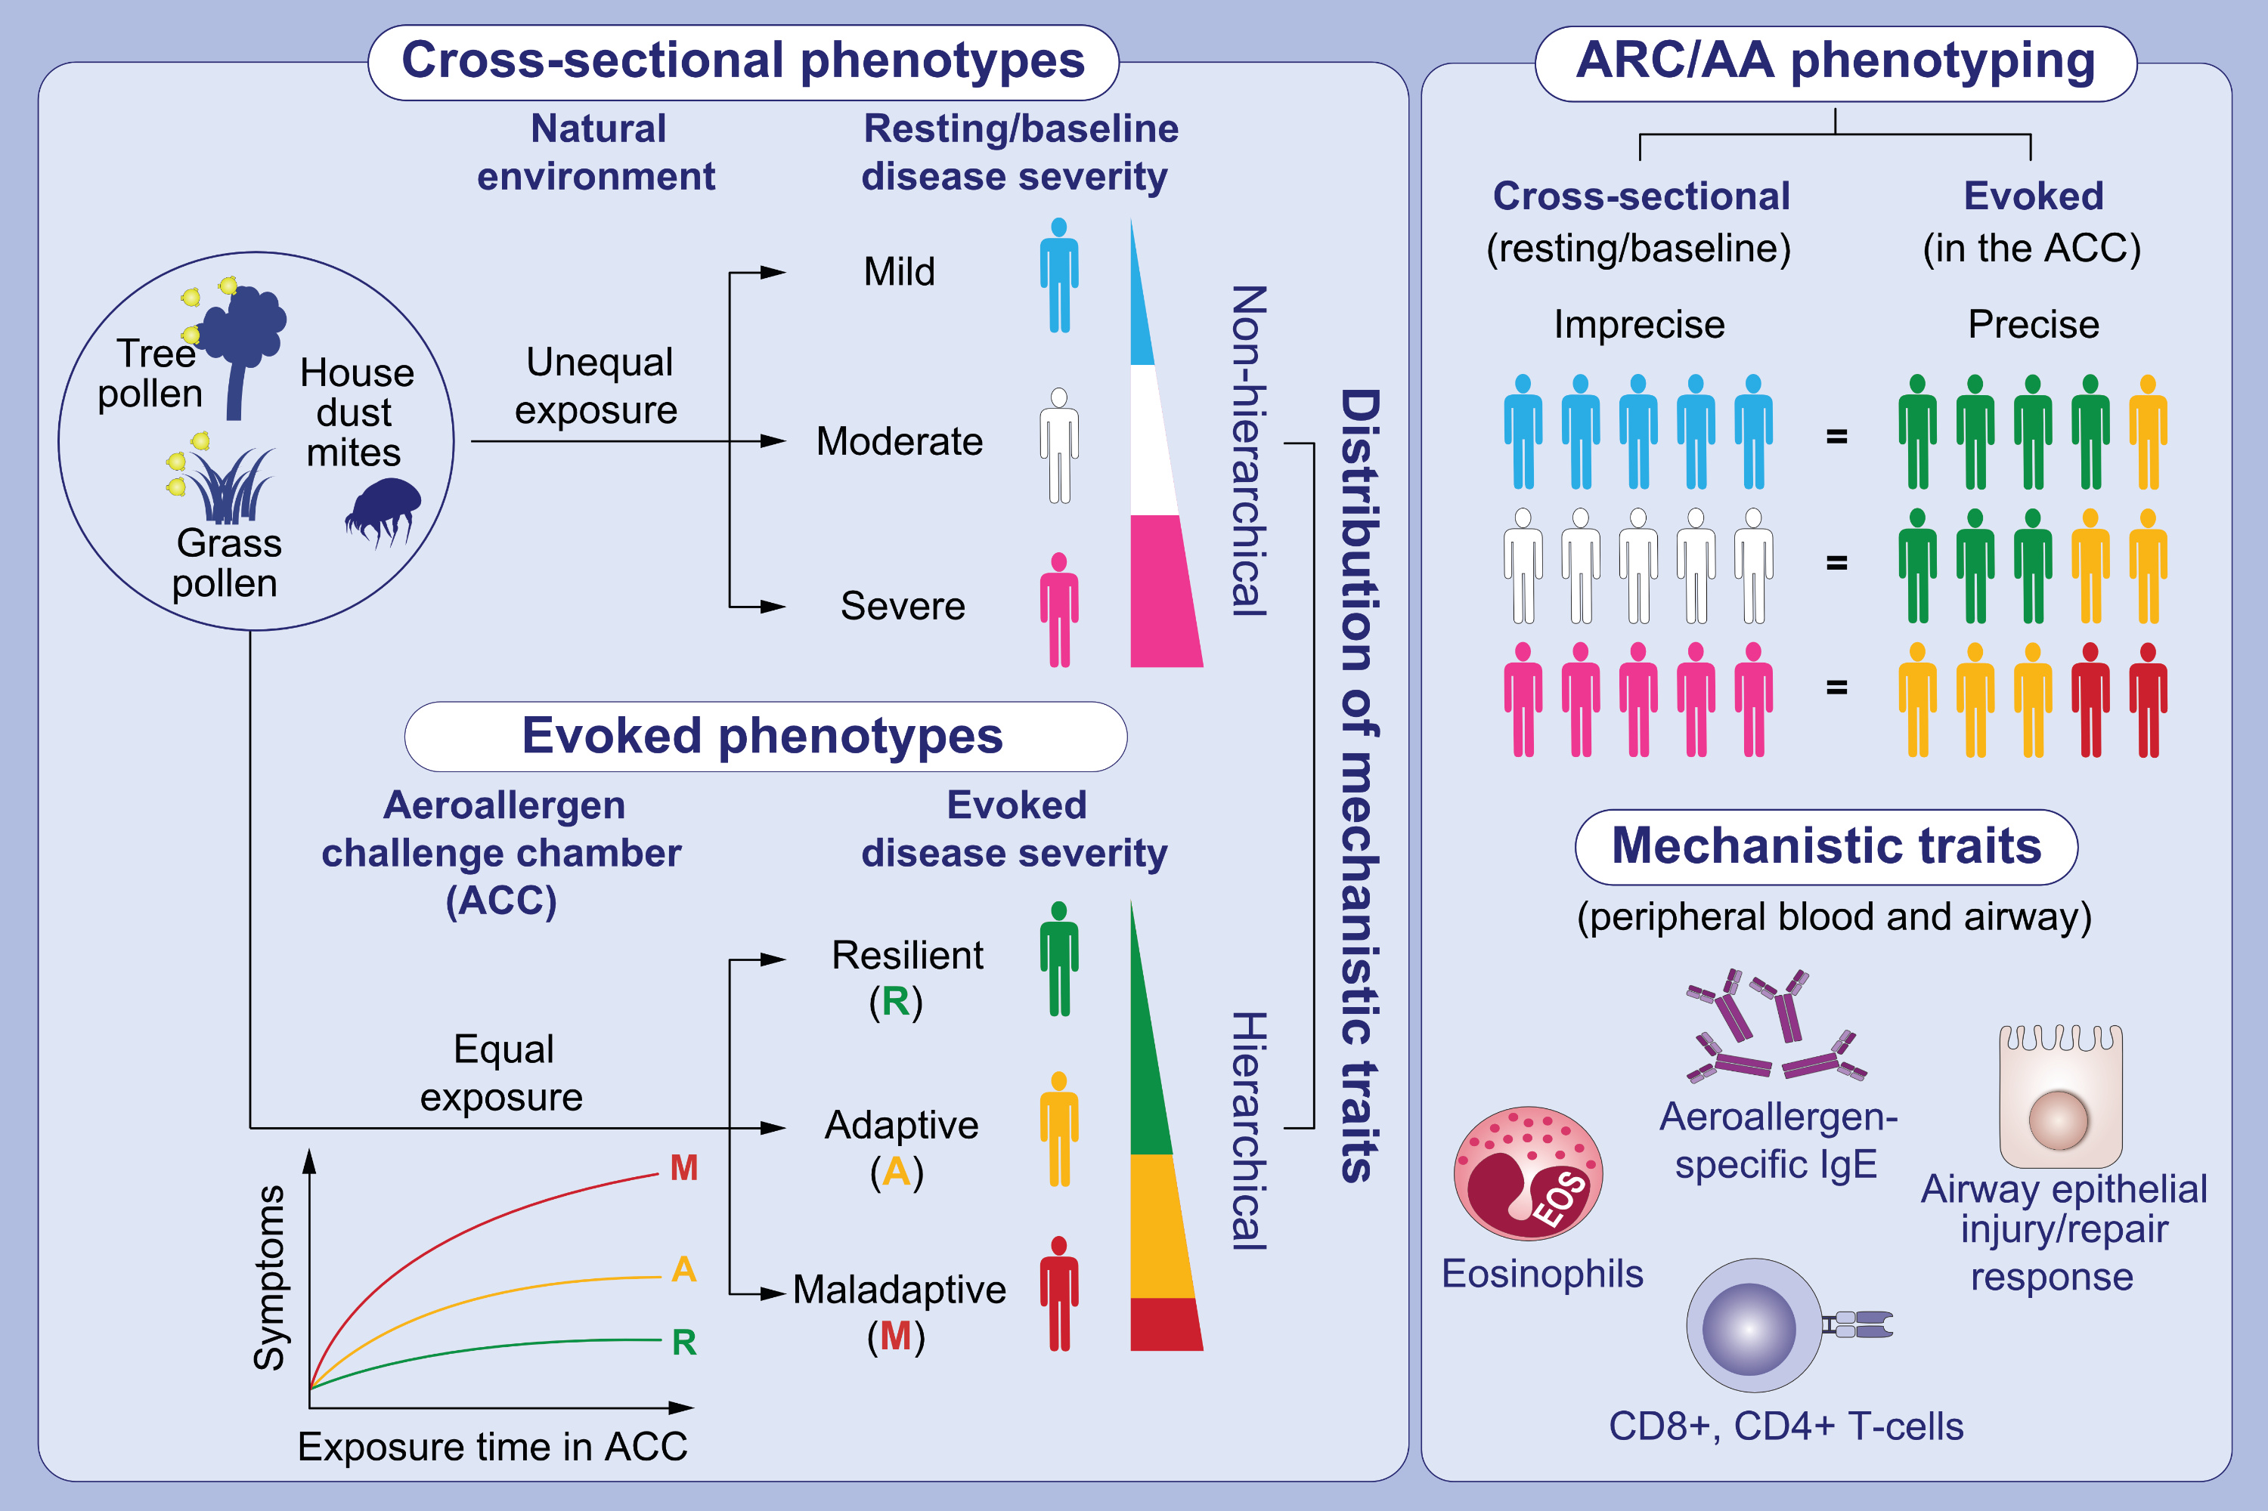
Large-scale provocation studies identify maladaptive responses to ubiquitous aeroallergens as a correlate of severe allergic rhinoconjunctivitis and asthma
Alisha M. Smith, Robert M. Ramirez, Nathan Harper, Fabio Jimenez, Anne P. Branum, et al.
Allergy. 2022;pages: 1797-1814 https://doi.org/10.1111/all.15124
© 2019 EAACI and John Wiley and Sons A/S. Published by John Wiley and Sons Ltd.
Notes:
HIGHLIGHTS
In contrast to cross-sectional phenotyping in the natural environment, use of an ACC to control for level of exposure to an aeroallergen allows for identification of evoked phenotypes that track individuals with distinct symptom responsiveness.
Cross-sectional phenotypes omit host responsiveness to aeroallergens and conflate persons with different evoked phenotypes.
Mechanistic traits are more precisely aligned with evoked versus cross-sectional phenotypes.
Abbreviations: AA, allergic asthma; ACC, aeroallergen challenge chamber; ARC, allergic rhinoconjunctivitis; IgE, immunoglobulin E

