Slide 1
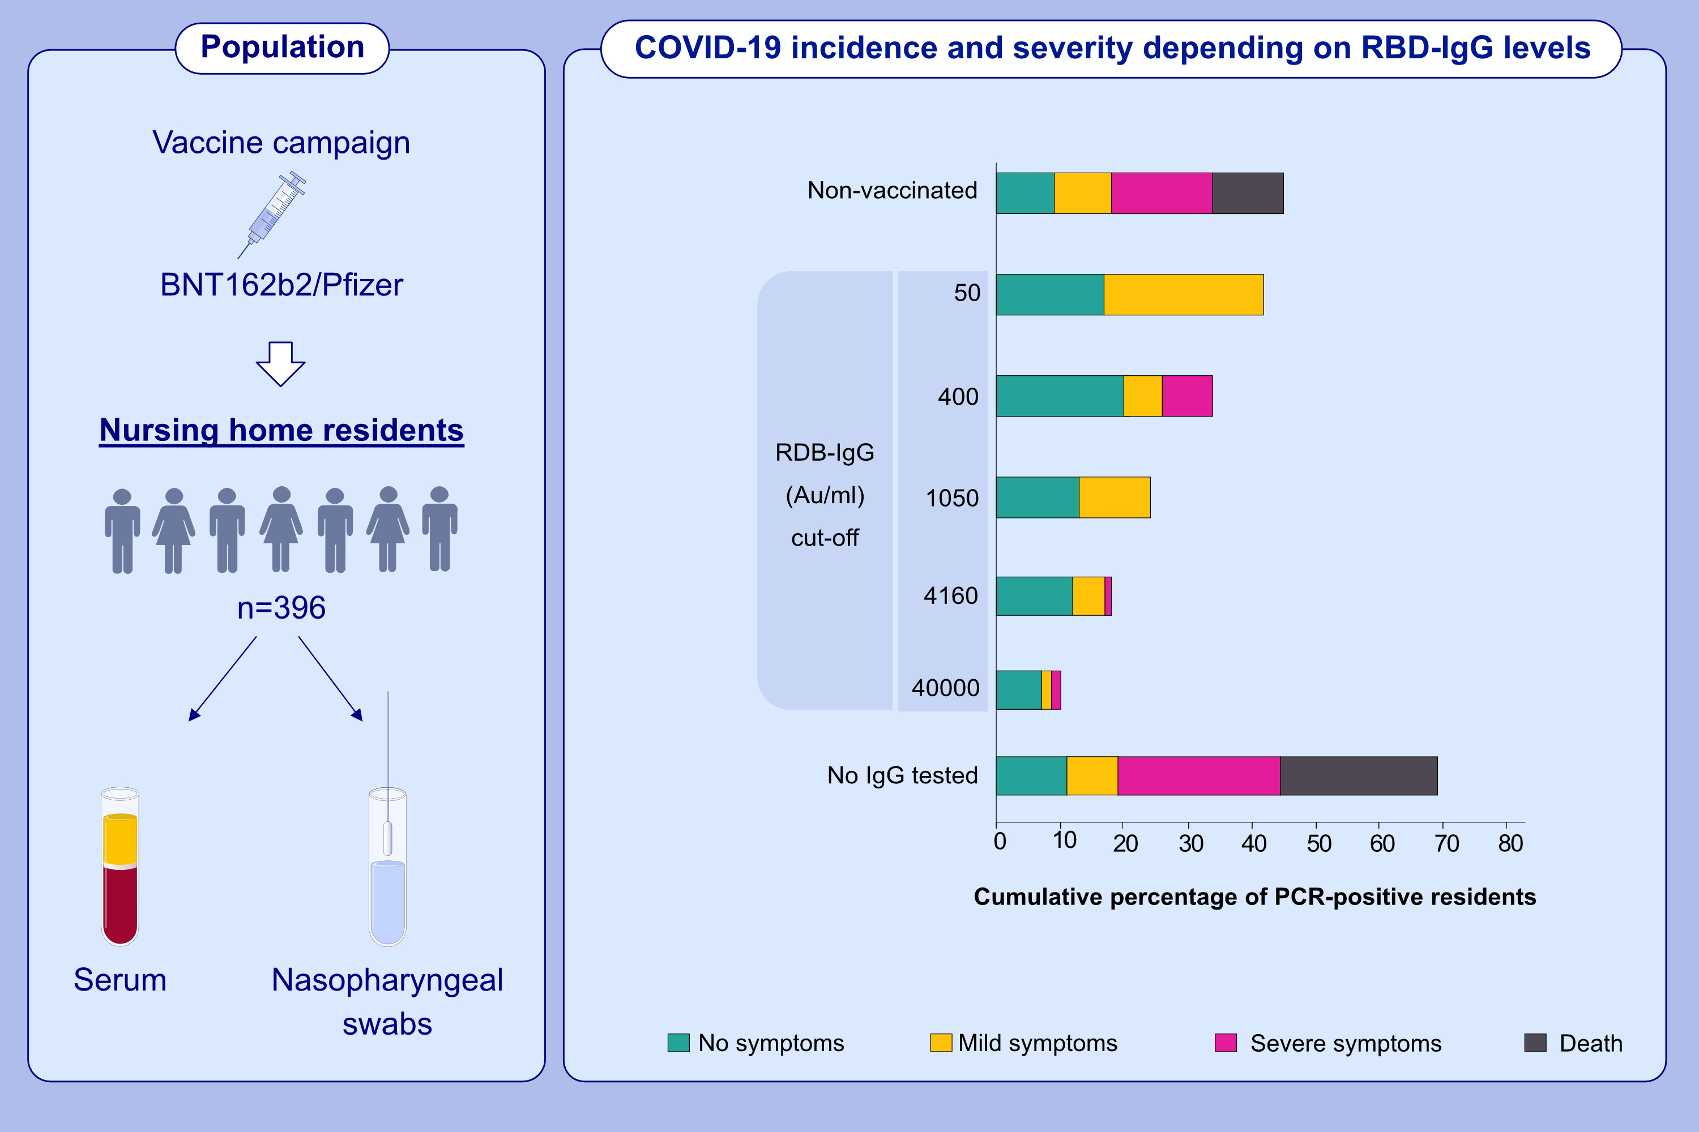
Receptor binding domain-IgG levels correlate with protection in residents facing SARS-CoV-2 B.1.1.7 outbreaks
Hubert Blain, Edouard Tuaillon, Lucie Gamon, Amandine Pisoni, Stéphanie Miot, et al.
Allergy. 2022; 1885-1894 https://doi.org/10.1111/all.15142
© 2019 EAACI and John Wiley and Sons A/S. Published by John Wiley and Sons Ltd.
Notes:
HIGHLIGHTS
This study assesses the incidence of positive SARS-CoV-2 B.1.1.7 by RT-qPCR results according to the vaccination status in nursing home residents facing a VOC-α outbreak.
Two BNT162b2/Pfizer doses are associated with a major reduction of SARS-CoV-2 B.1.1.7 incidence and COVID-19.
Post-vaccine RBD-IgG levels correlate with protection in this population.
Abbreviations: AU/ml, arbitrary units per milliliter; AU/ml, arbitrary units per milliliter; COVID-19, coronavirus disease 2019; RBD, receptor-binding domain; RT-qPCR, real-time reverse-transcriptase polymerase chain reaction; SARS-CoV-2, severe respiratory syndrome coronavirus 2; VOC, variant of concern

