Slide 1
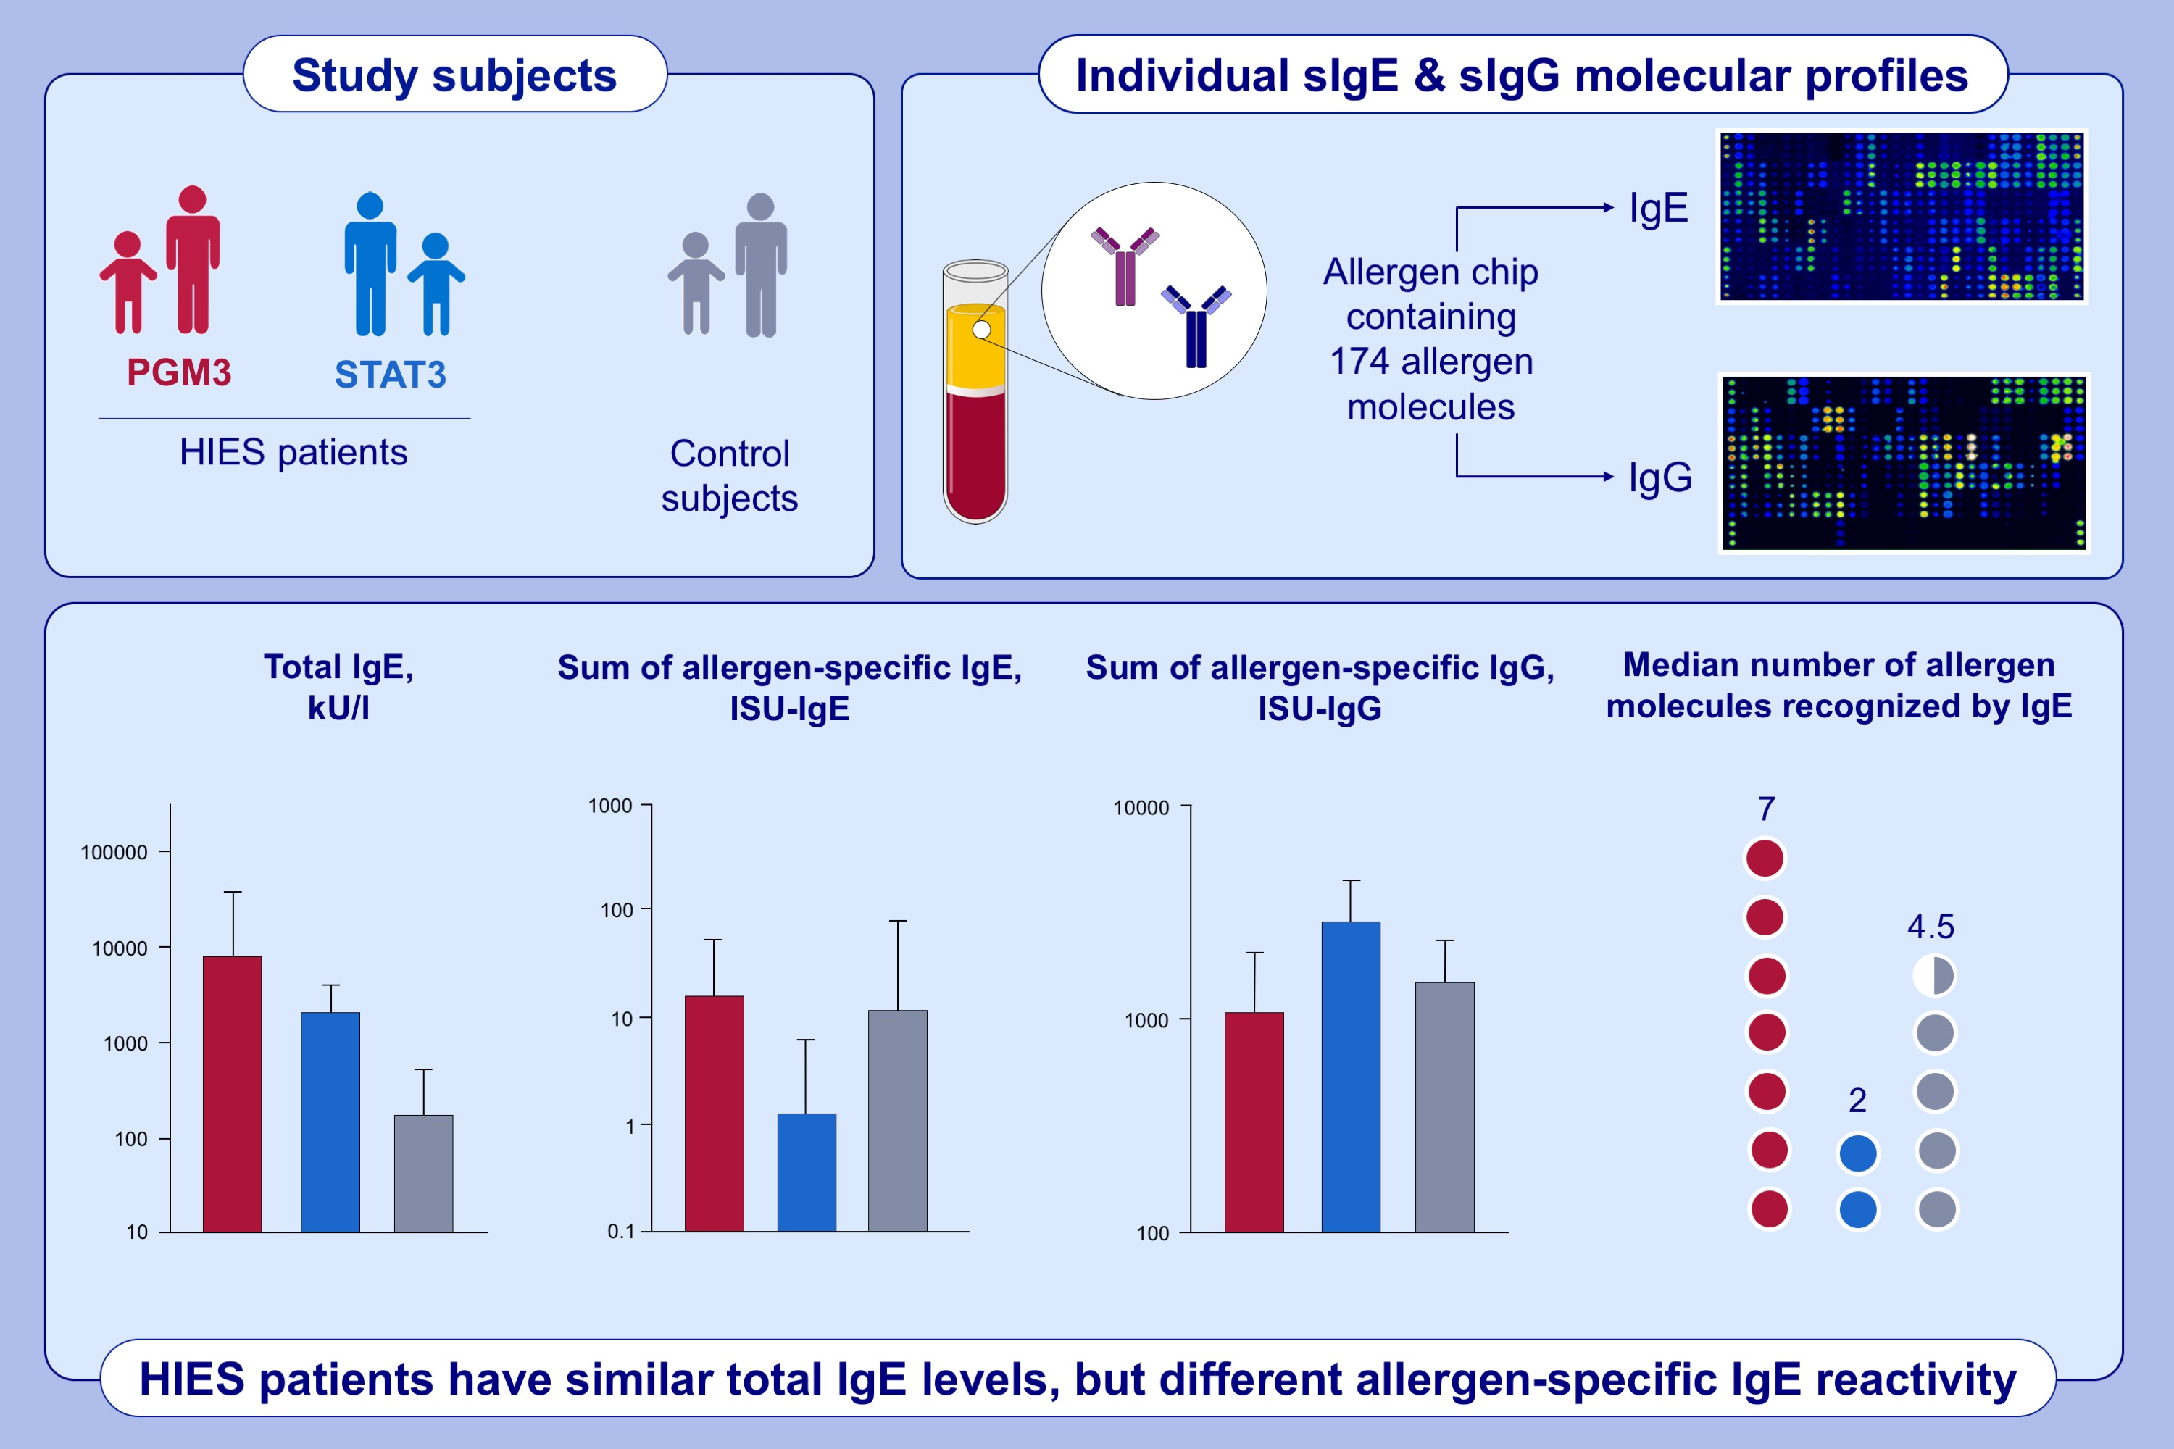
Profound differences in IgE and IgG recognition of micro-arrayed allergens
in hyper IgE syndromes
Victoria Garib, Meriem Ben-Ali, Michael Kundi, Mirela Curin, Roukaya Yaakoubi, et al.
Allergy. 2022; 1761-1771 https://doi.org/10.1111/all.15143
© 2019 EAACI and John Wiley and Sons A/S. Published by John Wiley and Sons Ltd.
Notes:
HIGHLIGHTS
This study assesses IgE and IgG antibody specificities in HIES patients using a comprehensive panel of allergen molecules.
Median total IgE levels are significantly lower in the sensitized control group as compared to PGM3 and STAT3 patients.
PGM3 patients have significantly higher allergen-specific IgE levels and are sensitized to a large number of allergen molecules as compared to STAT3 patients.
Abbreviations: IEI, inborn errors of immunity; ISU, ISAC standardized unit; HIES, hyper-IgE-syndrome; kU/L, kilo unit per liter; PGM3, autosomal recessive phosphoglucomutase-3 deficiency; sIgE/sIgG, specific immunoglobulin E/specific immunoglobulin G; STAT3, signal transducer and activator of transcription 3

