Slide 1
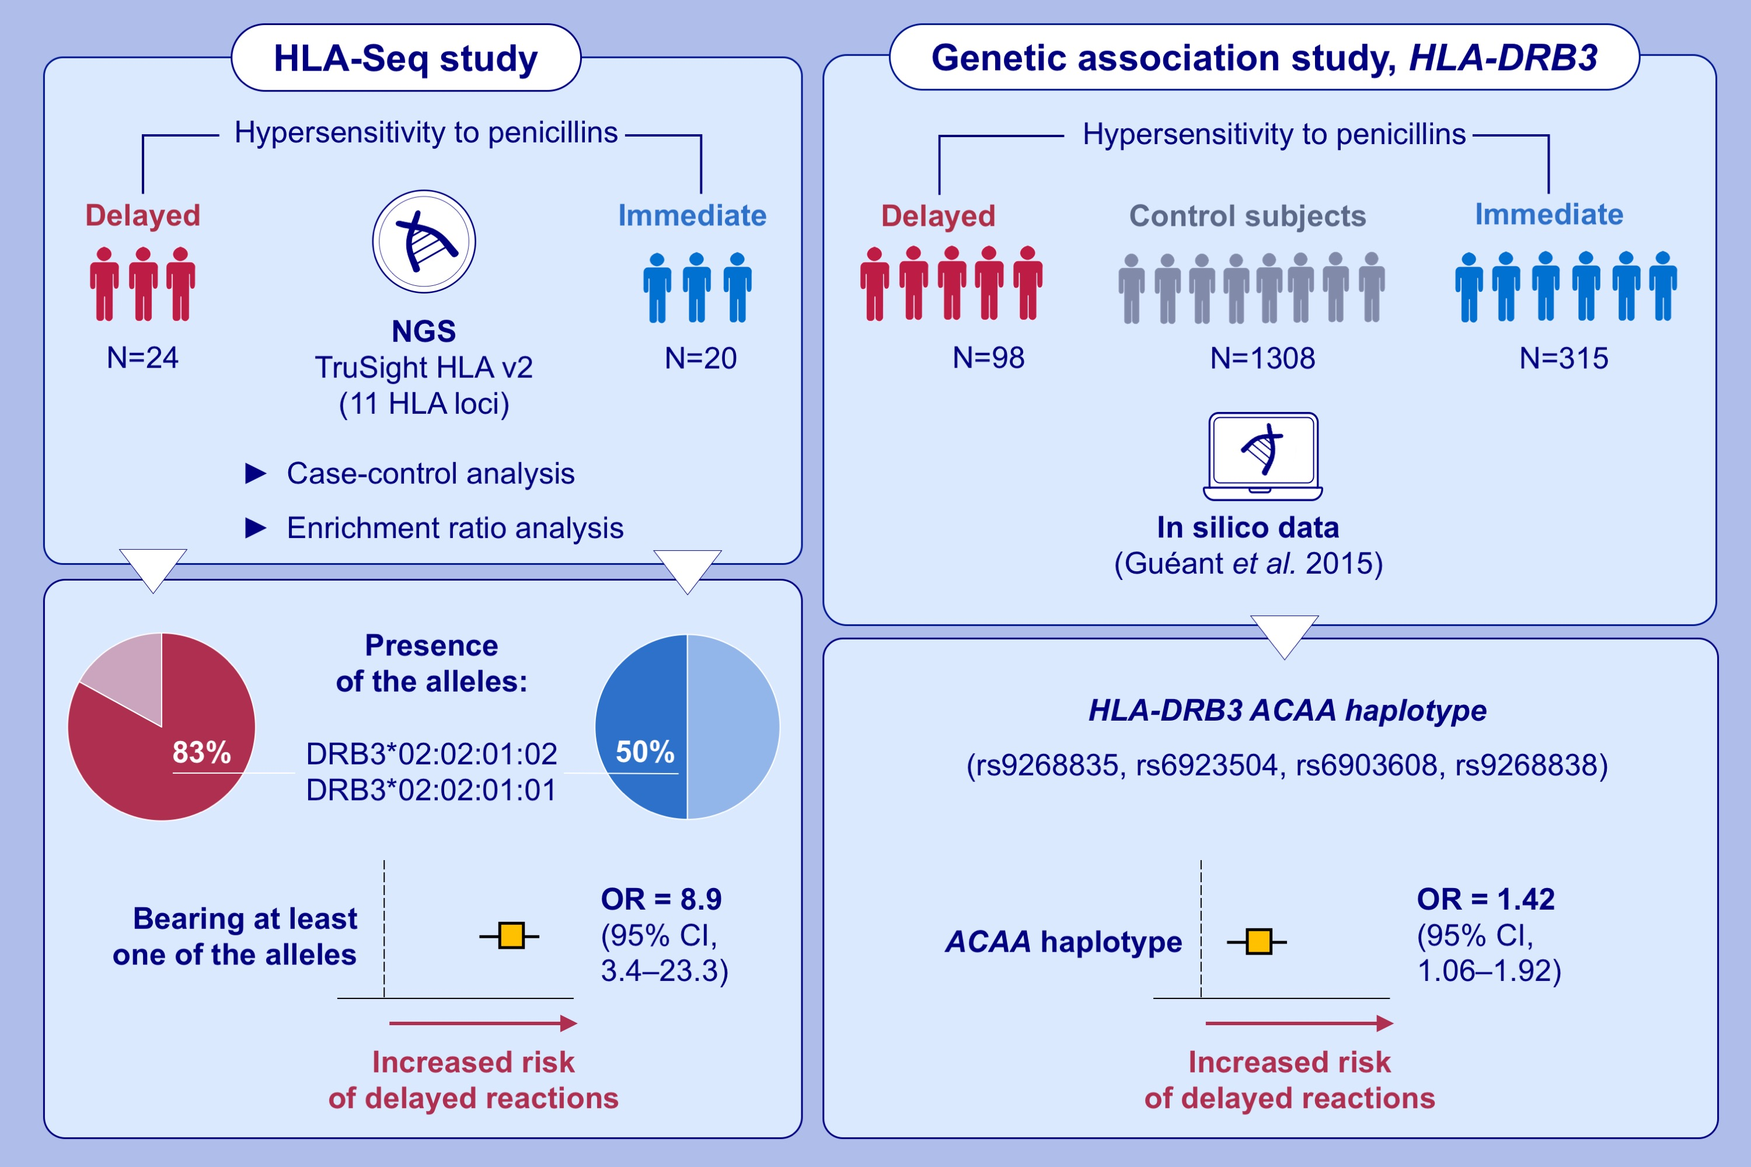
Next-Generation Sequencing and Genotype Association Studies Reveal the Association of HLA-DRB3*02:02 With Delayed Hypersensitivity to Penicillins
Antonino Romano, Abderrahim Oussalah, Celine Chery, Rosa-Maria Guéant-Rodriguez, Francesco Gaeta, et al.
Allergy. 2022; 1827-1834 https://doi.org/10.1111/all.15147
© 2019 EAACI and John Wiley and Sons A/S. Published by John Wiley and Sons Ltd.
Notes:
HIGHLIGHTS
We demonstrate a strong association between HLA-DRB3 locus and the risk of delayed hypersensitivity to penicillins.
Bearing at least one of the two alleles DRB3*02:02:01:02 and DRB3*02:02:01:01 increases the risk of delayed reactions compared to immediate reactions.
The HLA-DRB3 ACAA haplotype is significantly associated with the risk of delayed hypersensitivity to penicillins.
Abbreviations: Cl; confidence interval; HLA, human leukocyte antigen; NGS, next-generation sequencing; OD, odds ratio; seq, sequencing

