Slide 1
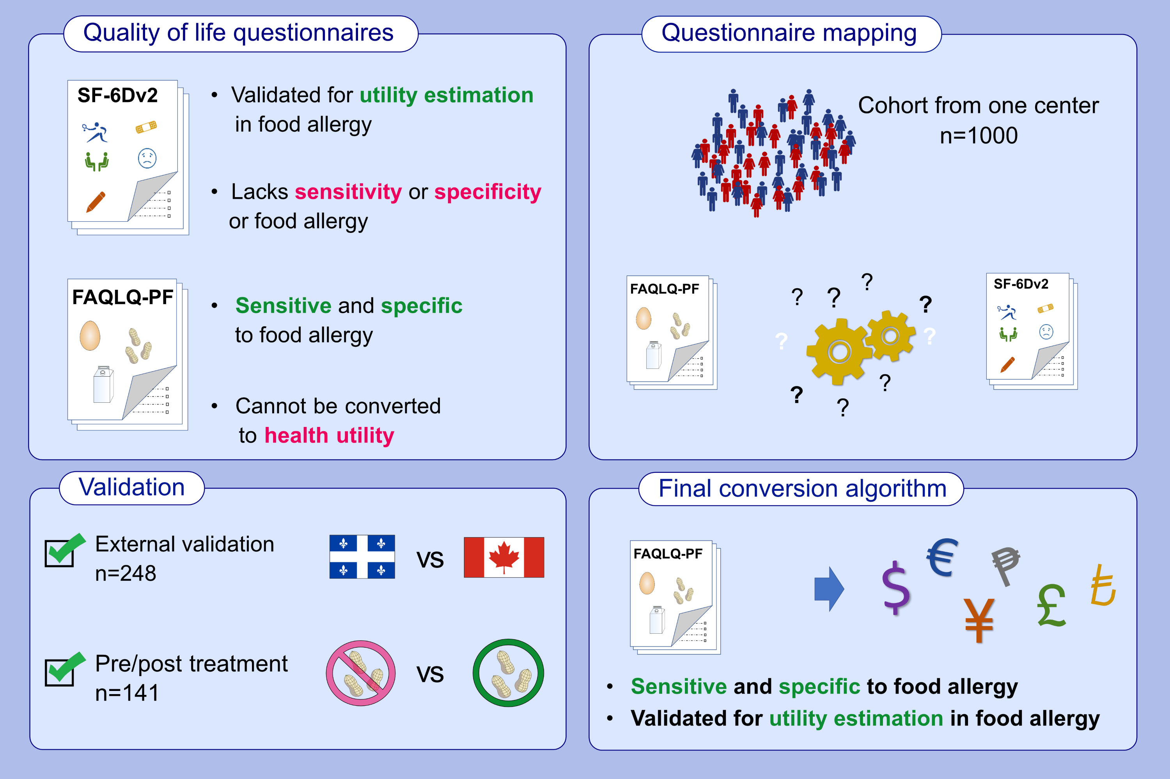
Mapping the Food Allergy Quality of Life Questionnaire Parent Form onto the SF-6Dv2
Yan Watts, Élise Dufresne, Kathryn Samaan, François Graham, Roxane Labrosse, et al.
Allergy. 2022; 1815-1826 https://doi.org/10.1111/all.15190
© 2019 EAACI and John Wiley and Sons A/S. Published by John Wiley and Sons Ltd.
Notes:
HIGHLIGHTS
The FAQLQ-PF was mapped onto the SF-6Dv2 using the food allergy value set.
The algorithm was validated in an independent cohort as well as in patients undergoing oral immunotherapy.
Health utility values can now be derived directly from FAQLQ-PF questionnaires used in clinical trials.
Abbreviations: FAQLQ-PF, The Food Allergy Quality of Life Questionnaire Parent Form; SG-6Dv2, The Short-Form Six-Dimensions version 2

