Slide 1
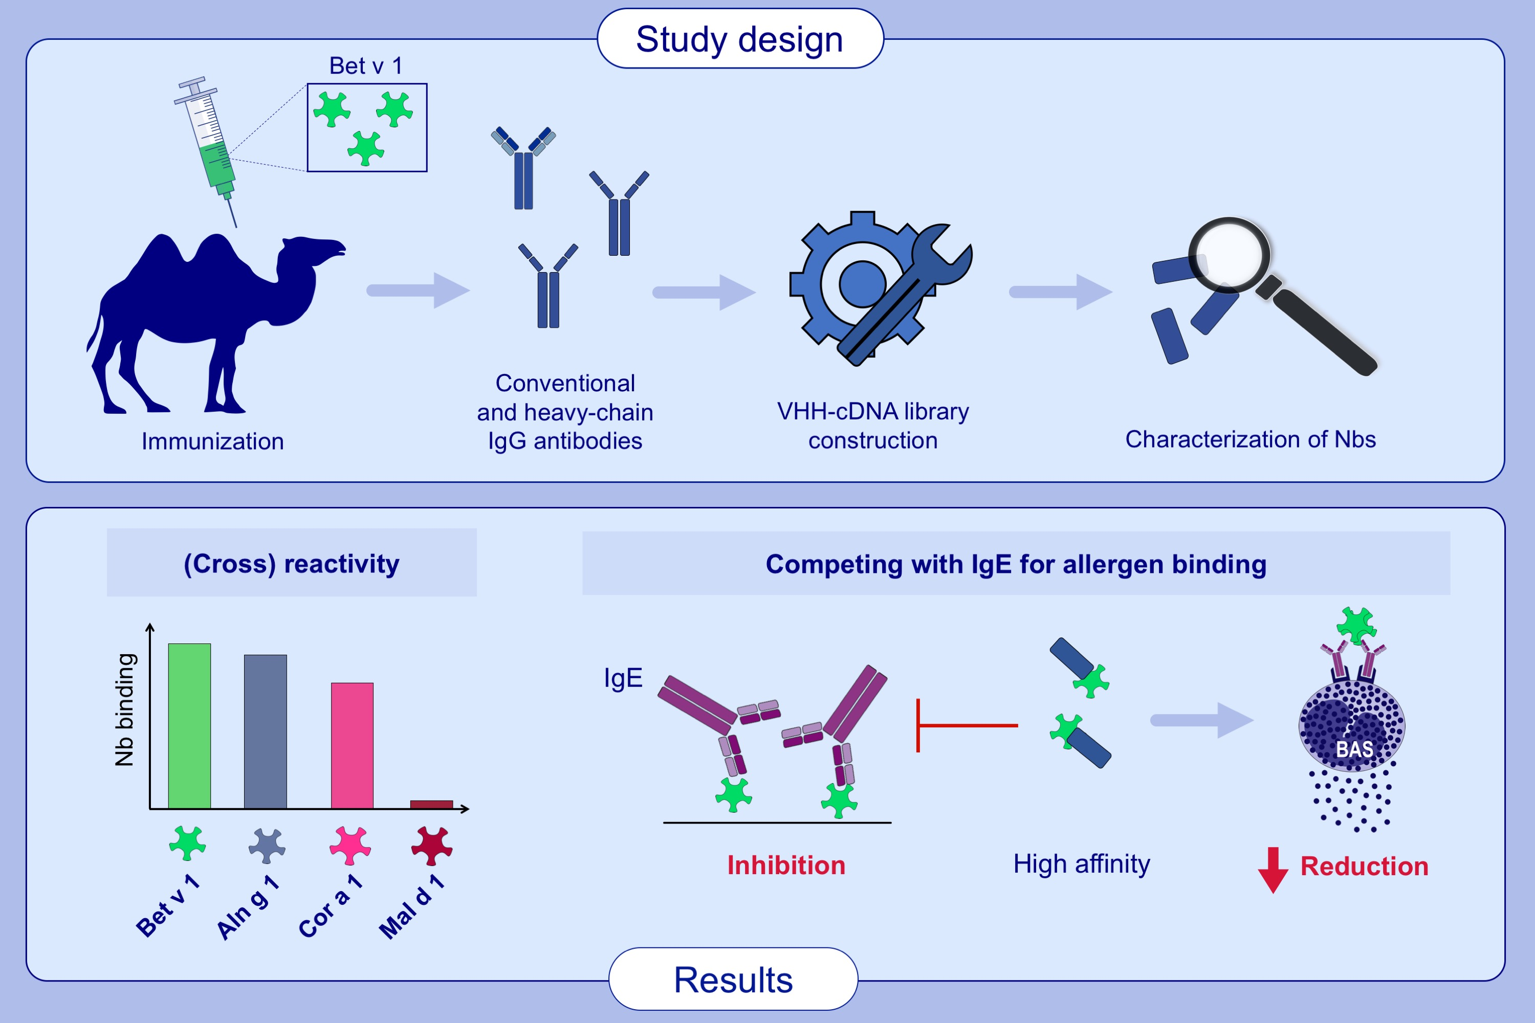
Isolation of nanobodies with potential to reduce patients´ IgE binding to Bet v 1
Ines Zettl, Tatiana Ivanova, Maria R. Strobl, Christina Weichwald, et al.
Allergy. 2022; 1751-1760, https://doi.org/10.1111/all.15191
© 2019 EAACI and John Wiley and Sons A/S. Published by John Wiley and Sons Ltd.
Notes:
HIGHLIGHTS
For the first time Bet v 1-specific nanobody encoding sequences from an immunized camel were isolated.
Generated Nbs bind Bet v 1 with high affinity and cross-react with Bet v 1 homologous allergens from alder and hazel.
Nbs reduce polyclonal IgE binding to Bet v 1 and cross-reactive allergens, and partially decrease Bet v 1-induced IgE-mediated basophil activation.
Abbreviation: Nbs, nanobodies; VHH, variable domain of a heavy chain antibody

