Slide 1
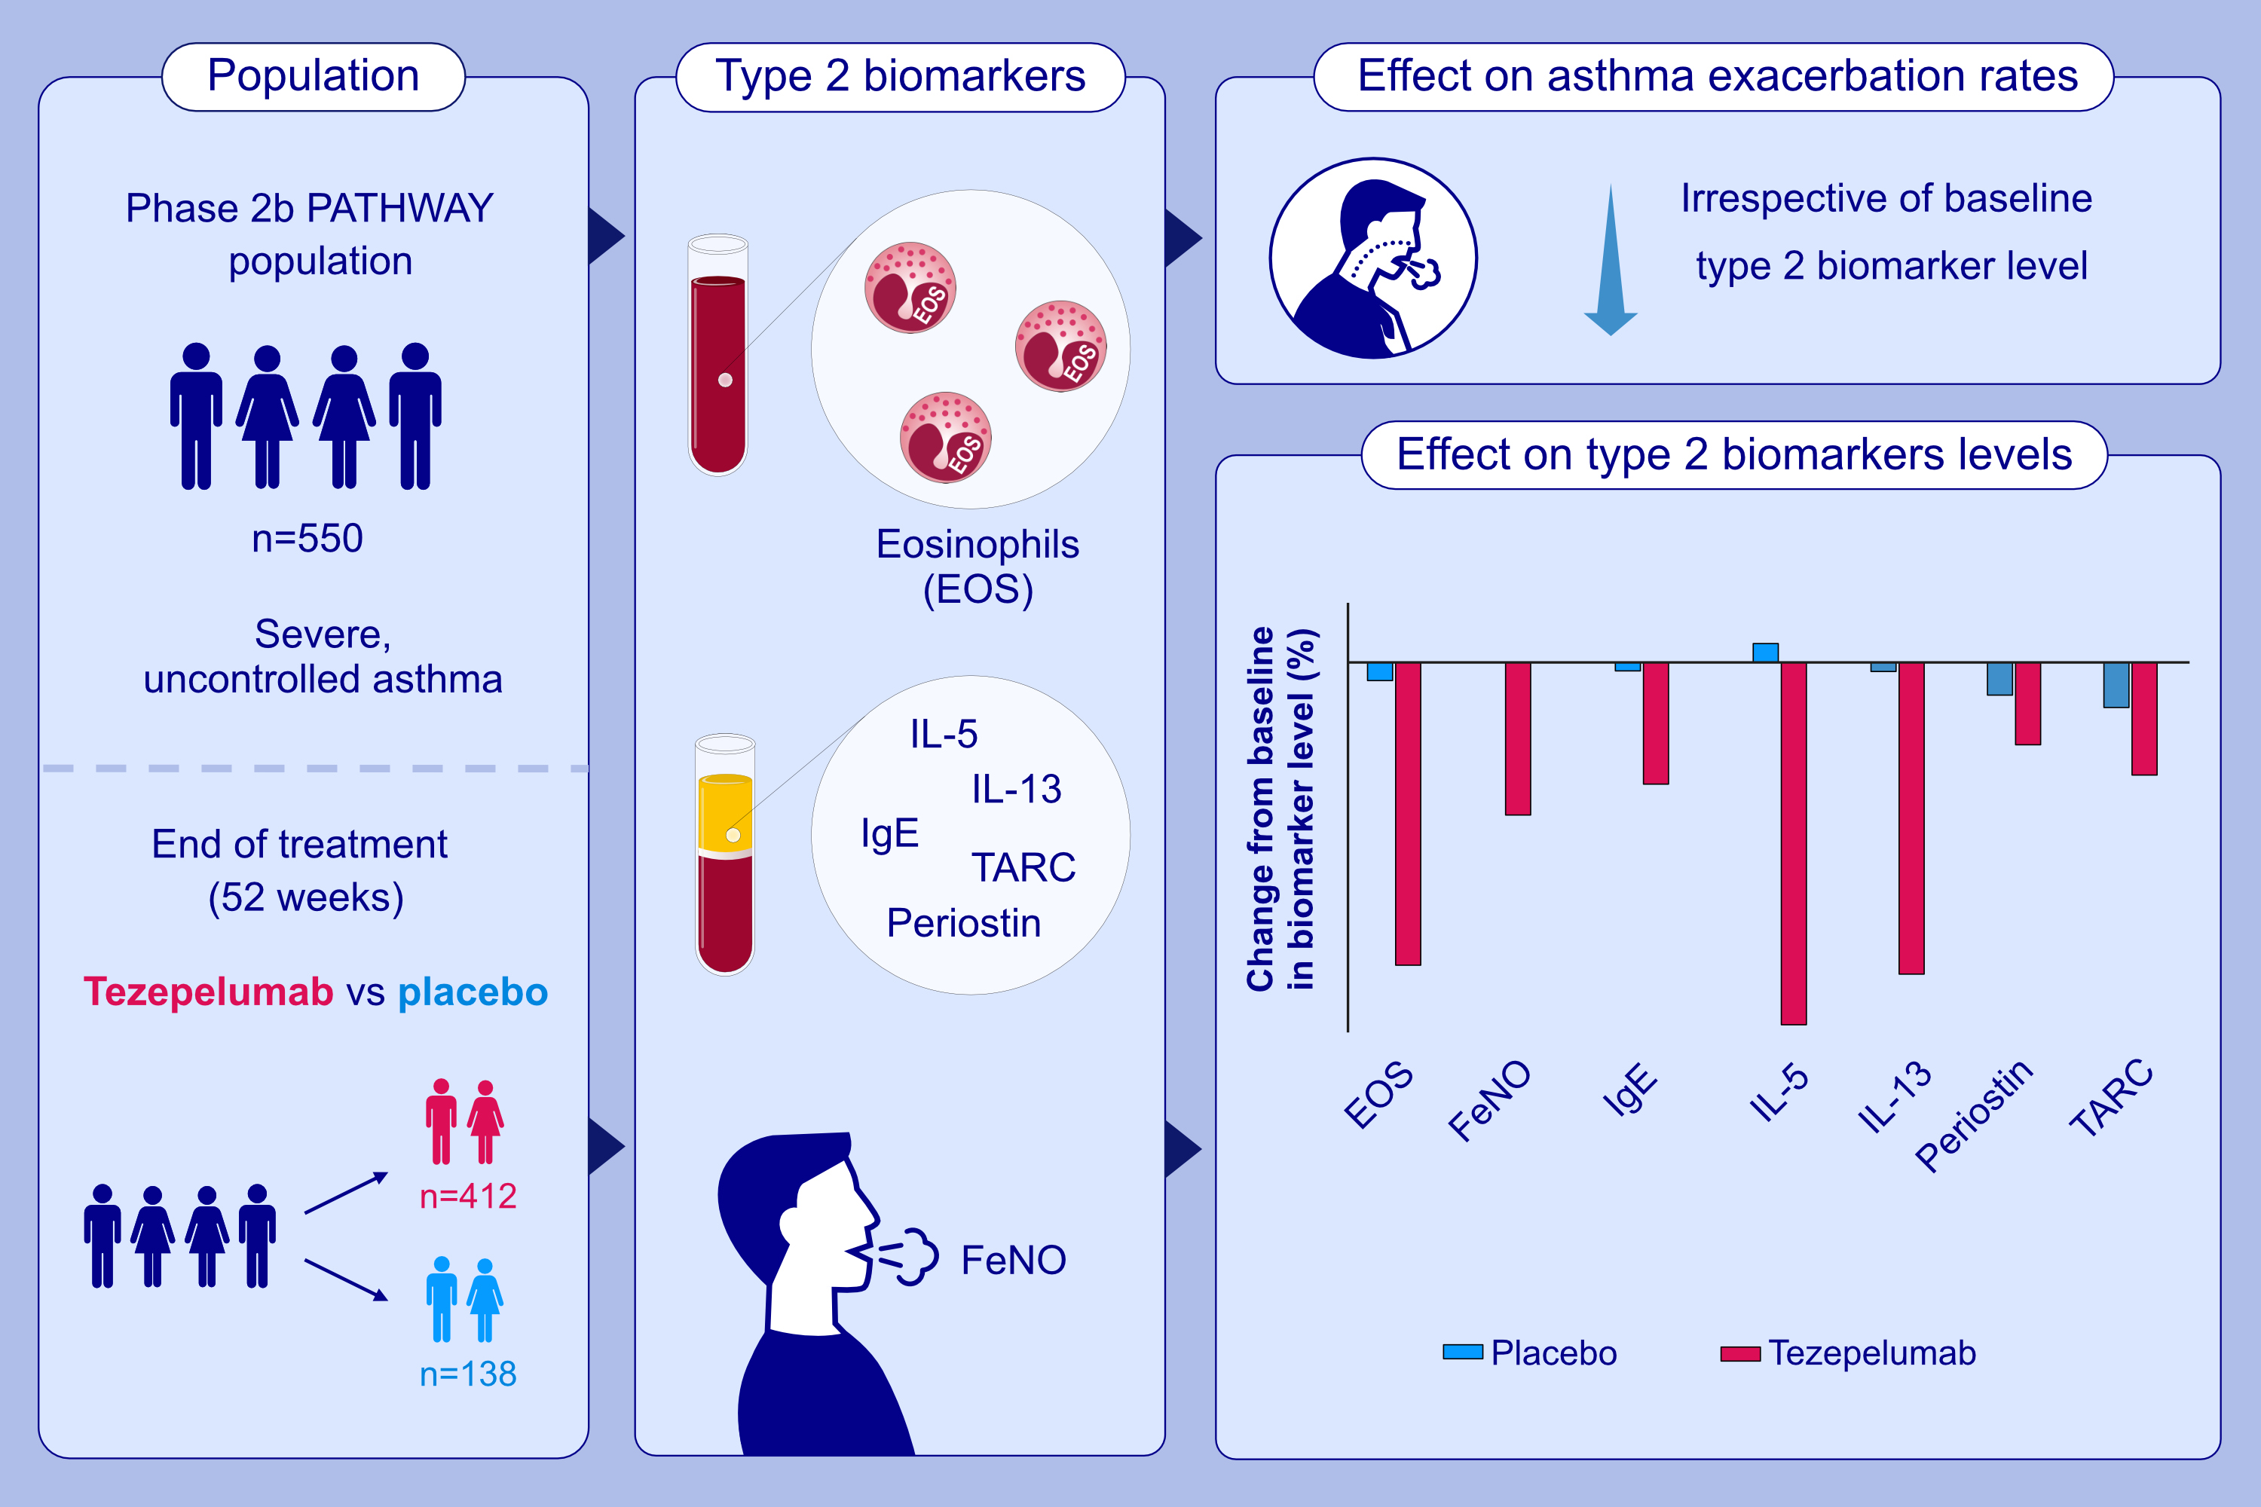
Baseline type 2 biomarker levels and response to tezepelumab in severe asthma
Jonathan Corren, Tuyet-Hang Pham, Esther Garcia Gil, Kinga Sałapa, et al.
Allergy. 2022; 1786-1796 https://doi.org/10.1111/all.15197
© 2019 EAACI and John Wiley and Sons A/S. Published by John Wiley and Sons Ltd.
Notes:
HIGHLIGHTS
This phase IIb, randomized, double-blind, placebo-controlled clinical trial evaluates the effects of tezepelumab in reducing type 2 inflammatory biomarkers and the relationship between baseline biomarker levels and annualized asthma exacerbation rates.
Exacerbations are reduced by 55-83% in the pooled tezepelumab cohort compared to placebo, irrespective of baseline type 2 biomarker levels.
At week 52, treatment with tezepelumab reduces the levels of all measured biomarkers.
Abbreviations: FeNO, fractional exhaled nitric oxide; IgE, immunoglobulin E; IL, interleukin; TARC, thymus and activation-regulated chemokine; TSLP, thymic stromal lymphopoietin

