Slide 1
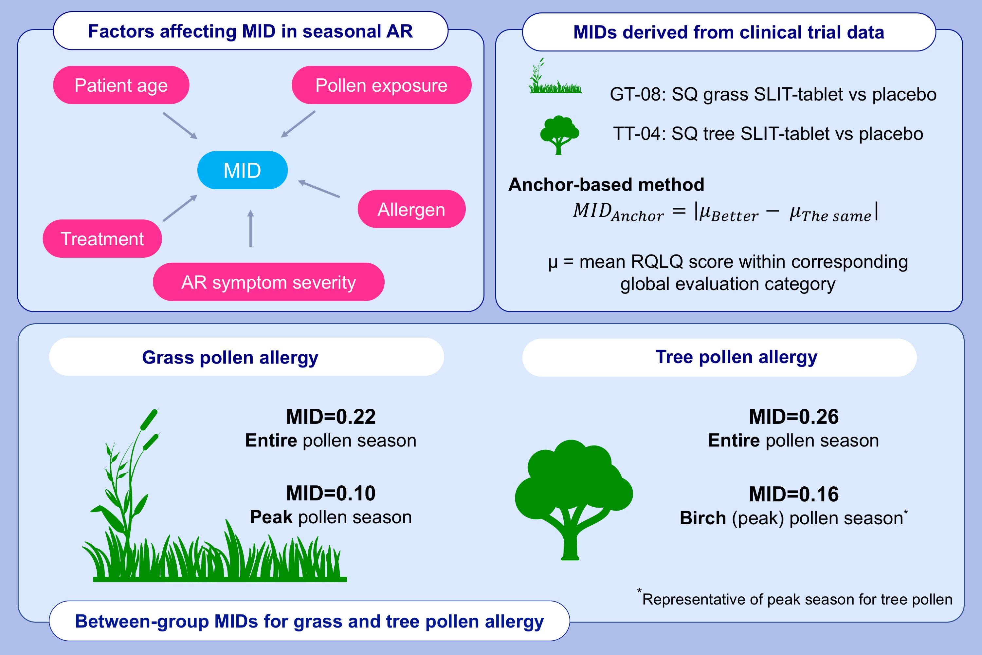
Determining the minimal important difference in the RQLQ score with grass and tree allergy immunotherapy versus placebo in adults with moderate-to-severe allergy
Michael S. Blaiss, Ruta Gronskyte Juhl, Leonard Q.C. Siew, Eva Hammerby, Philippe Devillier
Allergy. 2022; 1843-1851 https://doi.org/10.1111/all.15207
© 2019 EAACI and John Wiley and Sons A/S. Published by John Wiley and Sons Ltd.-
Notes:
HIGHLIGHTS
The RQLQ evaluates QoL in trials of AR; MID for the RQLQ represents a clinically meaningful difference in QoL between treatment groups.
There is no single MID that applies to all seasonal allergies and severity of disease.
These analyses provide an estimation of between-group MIDs for the RQLQ in grass and tree pollen-induced AR, considering different pollen exposures.
Abbreviations: AR, allergic rhinitis; MID, minimal important difference; QoL, quality of life; RQLQ, rhinoconjunctivitis quality of life questionnaire; SLIT, sublingual immunotherapy

