Slide 1
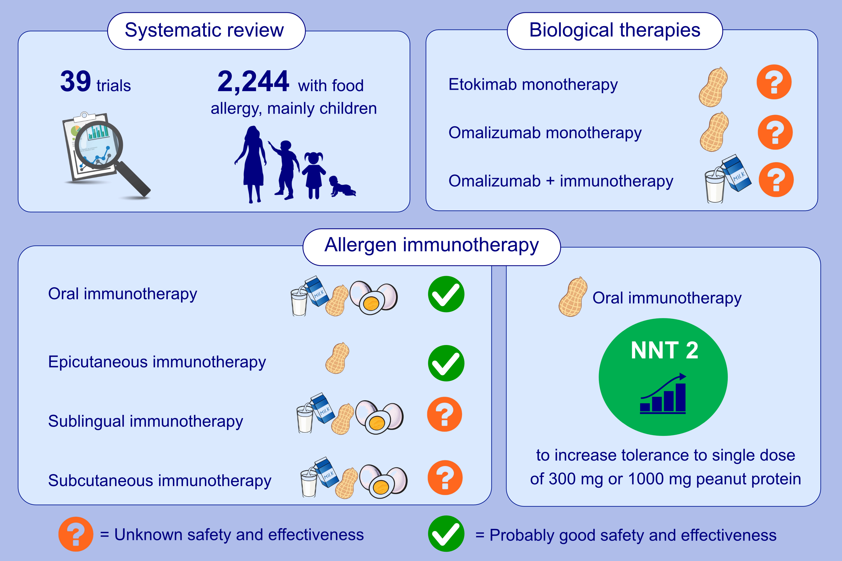
Allergen immunotherapy and/or biologicals for IgE-mediated food allergy:
systematic review and meta-analysis
Debra de Silva, Pablo Rodríguez del Río, Nicolette W. de Jong, Ekaterina Khaleva, Chris Singh, et al.
Allergy. 2022; 1852-1862 https://doi.org/10.1111/all.15211
© 2019 EAACI and John Wiley and Sons A/S. Published by John Wiley and Sons Ltd.
Notes:
HIGHLIGHTS
We systematically reviewed 39 randomised controlled trials about allergen-specific immunotherapy and/or biologicals in 2244 people with IgE-mediated food allergy, mostly children.
We found that oral immunotherapy is probably safe and effective in peanut, milk and egg allergy.
The number needed to treat (NNT) to increase tolerance to a single dose of 300 mg or 1000 mg peanut protein was 2.
Abbreviation: NNT, number needed to treat

