Slide 1
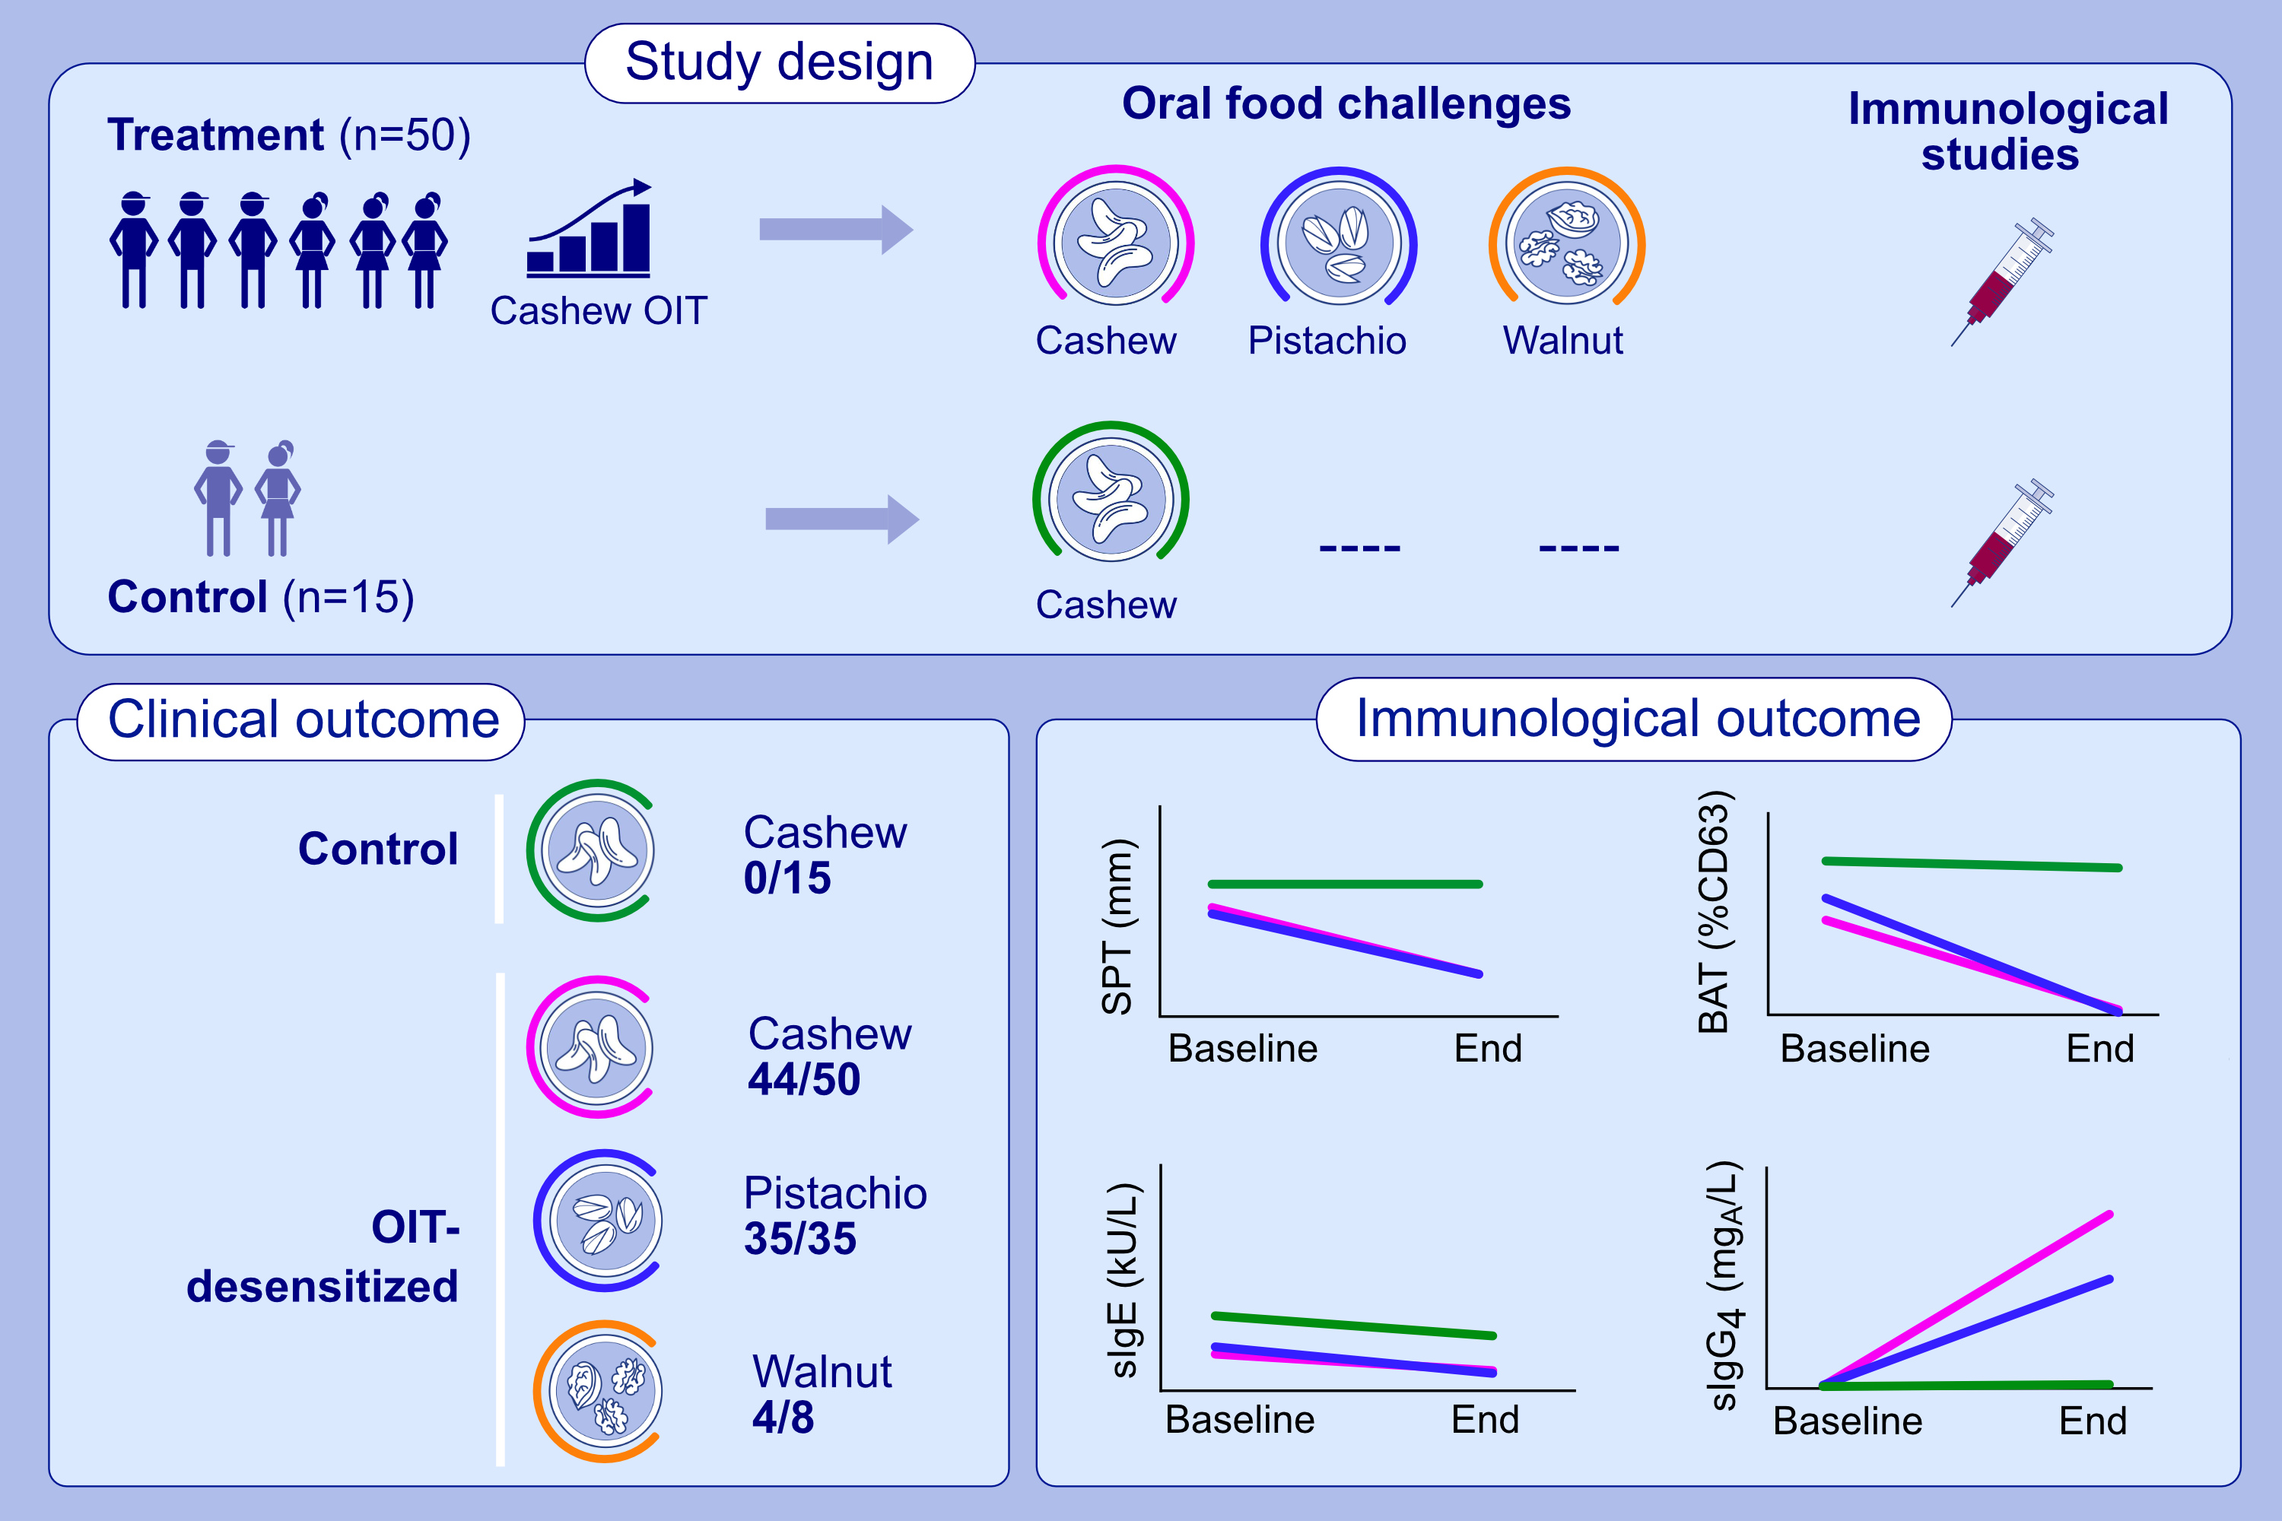
Cashew Oral Immunotherapy for Desensitizing Cashew-Pistachio Allergy (Nut CRACKER Study)
Arnon Elizur, Michael Y. Appel, Liat Nachshon, Michael B. Levy, Naama Epstein-Rigbi, et al.
Allergy. 2022; 1863-1872 https://doi.org/10.1111/all.15212
© 2019 EAACI and John Wiley and Sons A/S. Published by John Wiley and Sons Ltd.
Notes:
HIGHLIGHTS
Fifty cashew-allergic patients underwent cashew OIT and 15 served as observational controls. Pistachio and walnut cross-desensitization was examined.
44/50 OIT-treated patients, but no controls, were desensitized to cashew. 35/35 pistachio and 4/8 walnut co-allergic patients were cross-desensitized.
Cashew and pistachio SPT, basophil reactivity and sIgE decreased and sIgG4 increased only in desensitized patients.
Abbreviations: BAT, basophil activation test; mg_{A}/L, milligram of antibody per liter; OIT, oral immunotherapy; SPT, skin prick test.

