Slide 1
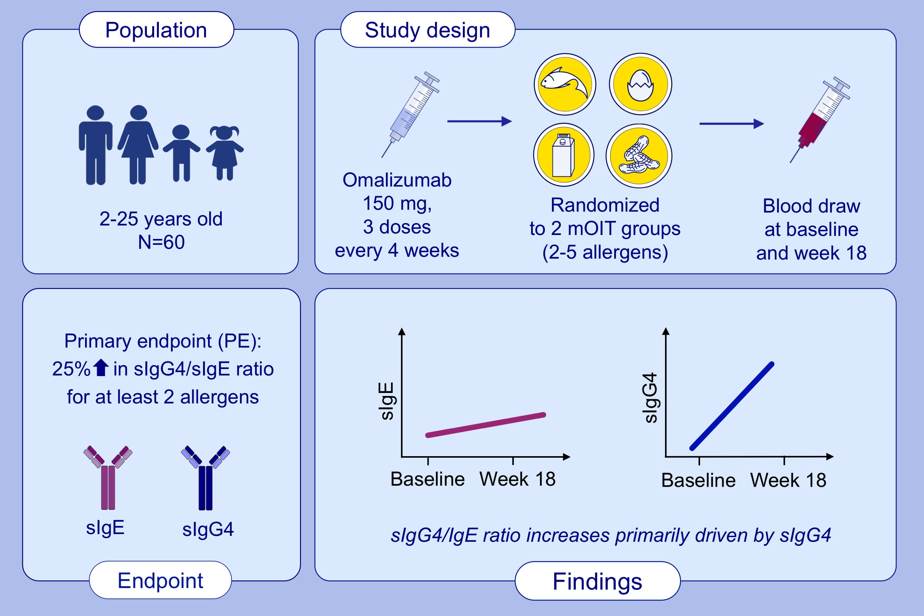
Phase 2, randomized multi oral immunotherapy with Omalizumab ‘real life’ study
Sayantani B. Sindher, Divya Kumar, Shu Cao, Natasha Purington, Andrew Long, et al.
Allergy. 2022; 1863-1872 https://doi.org/10.1111/all.15217
© 2019 EAACI and John Wiley and Sons A/S. Published by John Wiley and Sons Ltd.
Notes:
HIGHLIGHTS
We conducted a phase 2 mOIT pilot study to assess feasibility, safety, and immunological changes associated with low maintenance doses preceded by fixed dose omalizumab.
Our findings show that the change in sIgE/sIgG4 ratio is driven primarily by an increase in sIgG4, with an increase in ratio by 25% in 70% of participants.
Data suggests that plasma marker changes are induced earlier and at a lower dose of total protein than previously tested.
Abbreviations: mOIT, multi-food OIT; sIgE, specific IgE; sIgG4, specific IgG4

