Slide 1
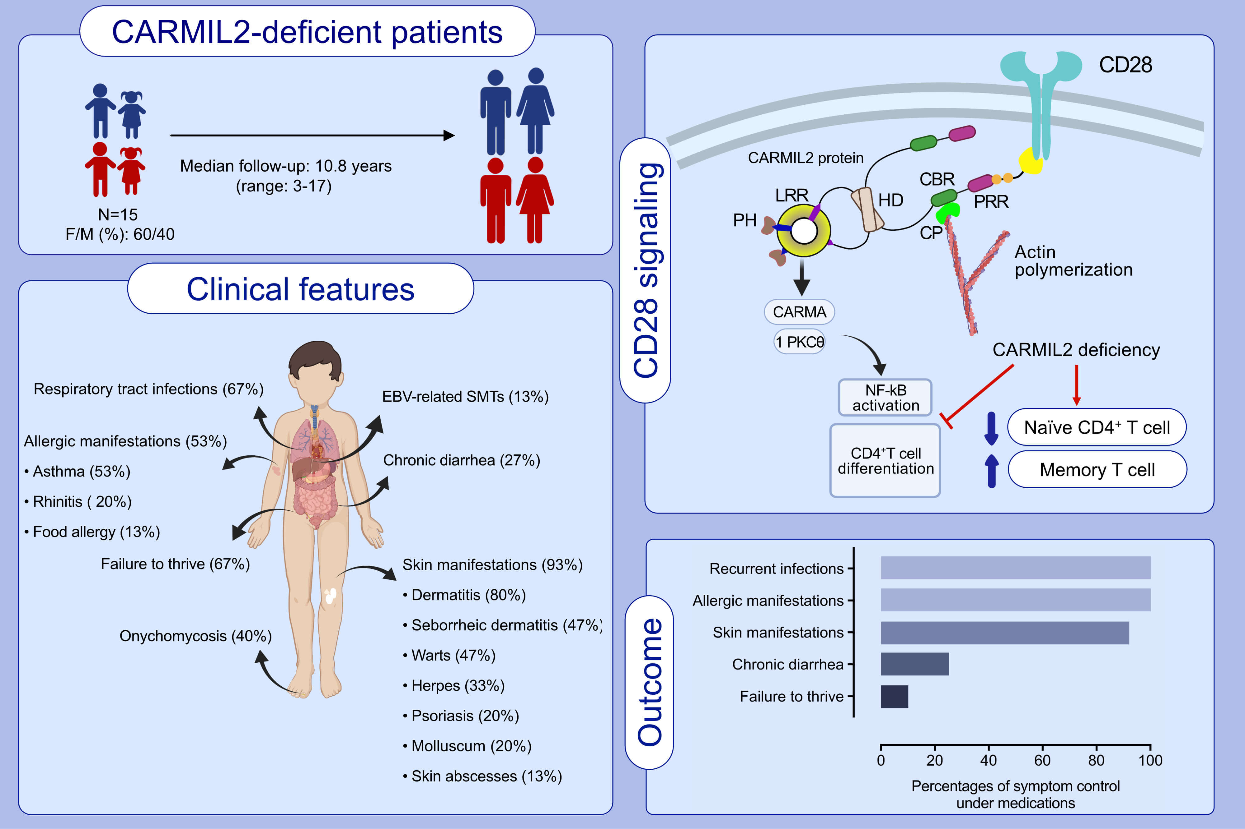
Evolution and long-term outcomes of combined immunodeficiency due to CARMIL2 deficiency
Burcu Kolukisa,, Dilek Baser,, Bengu Akcam,, Jeffrey Danielson,, Sevgi Bilgic Eltan,, et al.
Allergy. 2022; 1004-1019 https://doi.org/10.1111/all.15010
© 2019 EAACI and John Wiley and Sons A/S. Published by John Wiley and Sons Ltd.
Notes:
HIGHLIGHTS
CARMIL2 deficiency results in variable phenotypes encompassing skin disease, combined immune deficiency, early-onset inflammatory bowel disease, and allergic manifestations.
Patients have impaired differentiation of mainly CD4⁺ T cells, resulting in elevated naïve CD4⁺ T cells.
Gastrointestinal involvement and EBV-related smooth muscle tumors are major determinants of poor prognosis.
Abbreviations: CARMA, CARD-Containing MAGUK Protein; CARMIL, capping protein regulator and myosin 1 linker 2; CBR, C-terminal domain including a capping protein binding region; CP, capping protein; HD, homodimerization domain; EBV, Epstein-Barr virus; LRR, leucine-rich repeat; NF-κB, nuclear factor kappa B; PH, pleckstrin homolog; PKCθ, protein kinase C theta; PRR, proline-rich region; SMT, smooth muscle tumor

