Slide 1
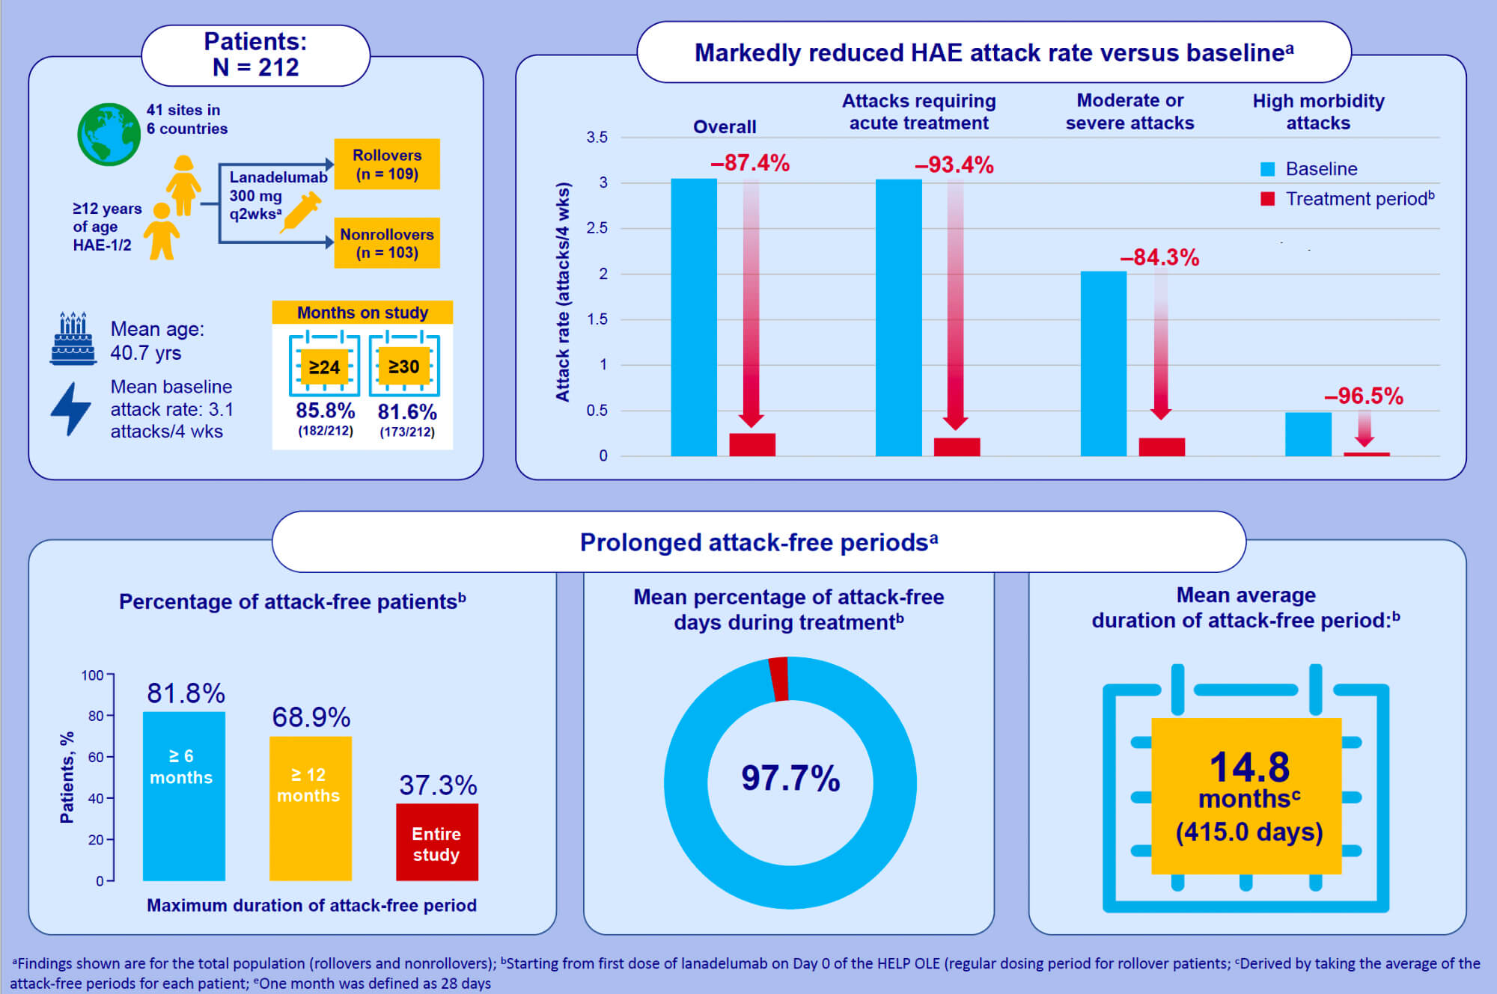
Long-term prevention of hereditary angioedema attacks with lanadelumab: The HELP OLE Study
Aleena Banerji,, Jonathan A. Bernstein,, Douglas T. Johnston,, William R. Lumry,, Markus Magerl,, et al.
Allergy. 2022; 979-990 https://doi.org/10.1111/all.15011
© 2019 EAACI and John Wiley and Sons A/S. Published by John Wiley and Sons Ltd.
Notes:
HIGHLIGHTS
Lanadelumab markedly reduced mean HAE attack rates versus baseline.
Most patients were exposed to lanadelumab for an extended time and experienced prolonged attack-free intervals.
The final results from the HELP OLE further support the long-term tolerability of lanadelumab 300 mg q2wks previously shown in the HELP Study and confirm the sustained benefit of treatment for long-term prevention of HAE attacks.
Abbreviations: HAE, hereditary angioedema; q2wks,every 2 weeks, OLE, open label extension

