Slide 1
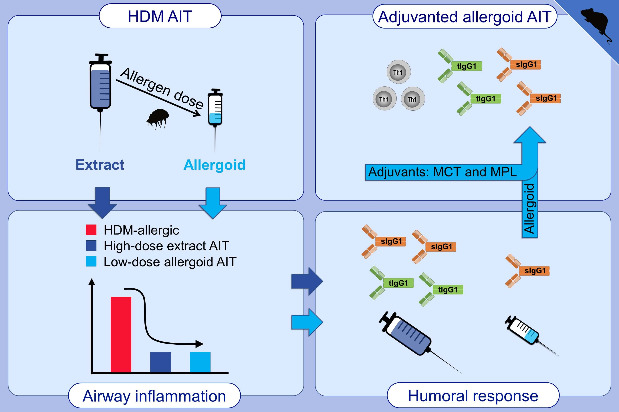
Immunological effects of adjuvanted low-dose allergoid allergen-specific immunotherapy in experimental murine house dust mite allergy
Alexander Heldner,, Francesca Alessandrini,, Dennis Russkamp,, Sonja Heine,, Benjamin Schnautz,, et al.
Allergy. 2022; 907-919 https://doi.org/10.1111/all.15012
© 2019 EAACI and John Wiley and Sons A/S. Published by John Wiley and Sons Ltd.
Notes:
HIGHLIGHTS
In experimental HDM AIT, a 220-fold reduced allergen dose is equally effective in control of allergic inflammation when HDM allergoids instea of extracts are applied.
Low-dose non-adjuvanted allergoid AIT is less effective in inducing a potentially protective IgG1 response.
Combining low-dose allergoid AIT with the adjuvant MCT or the adjuvant system MCT+MPL promotes Th1-inducing mechanisms and robust B-cell activation.
Abbreviations: AIT, allergen-specific immunotherapy; HDM, house dust mite; MCT, microcrystalline tyrosine; MPL, monophosphoryl lipid A; sIgG, specific immunoglobulin G; tIgG, total immunoglobulin G

