Slide 1
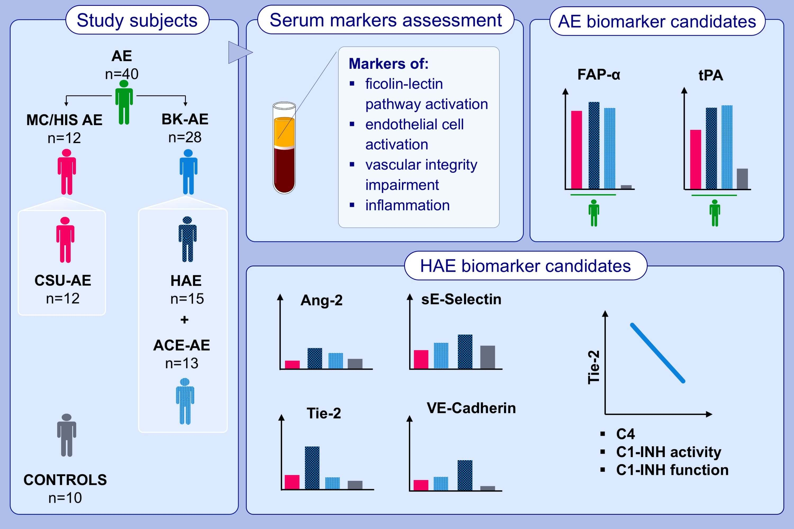
Identification of novel biomarkers to distinguish bradykinin-mediated angioedema from mast cell-/histamine-mediated angioedema
Gesa Bindke,, Manuela Gehring,, Dorothea Wieczorek,, Alexander Kapp,, Timo Buhl,, et al.
Allergy. 2022; 946-955 https://doi.org/10.1111/all.15013
© 2019 EAACI and John Wiley and Sons A/S. Published by John Wiley and Sons Ltd.
Notes:
HIGHLIGHTS
Biomarker candidates for angioedema in general are FAP-α and tPA and for BK-AE Ang-2 and sE-Selectin.
In HAE compared to CSU-AE and compared to ACE-AE, sE-Selectin, Tie-2, and VE-Cadherin were significantly increased, whereas for Ang-2 the difference was significant compared to CSU-AE only.
Tie-2 is a biomarker candidate for HAE and correlated significantly negative with C4, C1-INH activity and -function.
Abbreviations: AE, angioedema; ACE-AE, angiotensin-converting enzyme inhibitor induced AE; Ang-2, angiopoietin 2; BK-AE, bradykinin AE; C1-INH, C1 inhibitor; C4, C4 complement; CSU-AE, AE in chronic spontaneous urticaria without wheals; FAP-α, fibroblast activation protein alpha; HAE, hereditary AE; MC/Hist-AE, mast cell-/histamine AE; sE-Selectin, serum endothelial-Selectin; Tie-2, tyrosine kinase with immunoglobulin and epidermal growth factor homology domains 2; tPA, tissue-type plasminogen activator; VE-cadherin, vascular endothelial-cadherin.

