Slide 1
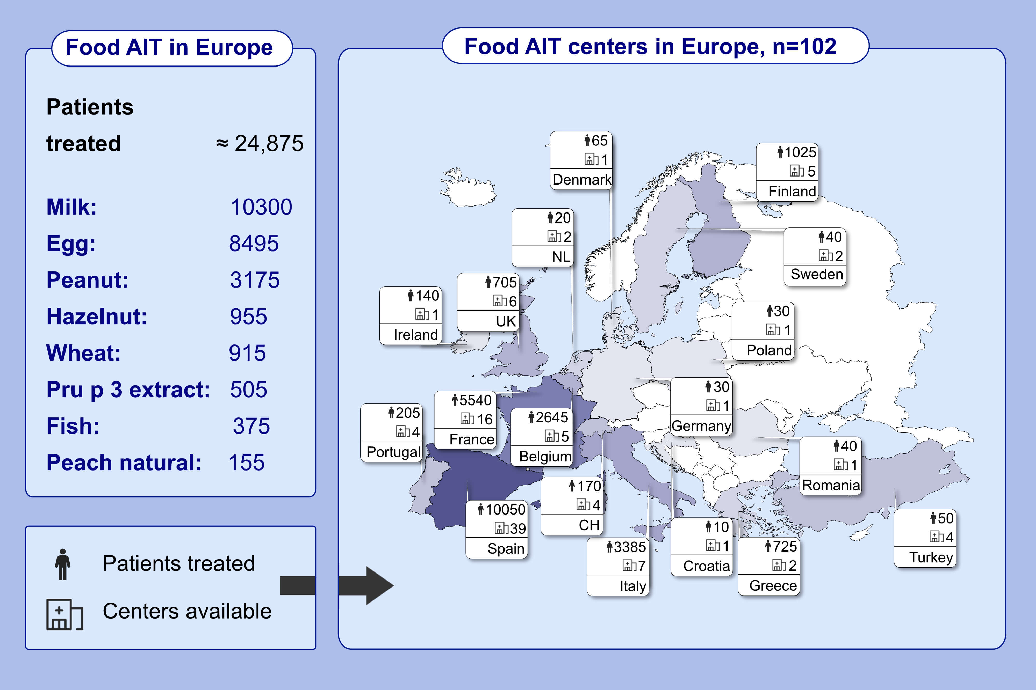
Food immunotherapy practice: Nation differences across Europe, the FIND project
Pablo Rodríguez del Río,, Alberto Alvarez-Perea,, Katharina Blumchen,, Davide Caimmi,, Jean Christoph Caubet,, et al.
Allergy. 2022; 920-932 https://doi.org/10.1111/all.15016
© 2019 EAACI and John Wiley and Sons A/S. Published by John Wiley and Sons Ltd.
Notes:
HIGHLIGHTS
Food AIT in Europe is mostly given in clinical practice.
There is a significant heterogeneity throughout countries in treatment availability and administration patterns.
There is a significant gap between a growing treatment demand and clinical food-AIT providers able to deliver the treatment that represents a challenge for all stakeholders.
Abbreviations: AIT, allergen immunotherapy; CH, Switzerland; n, number; NL, Netherlands; UK, United Kingdom

