Slide 1
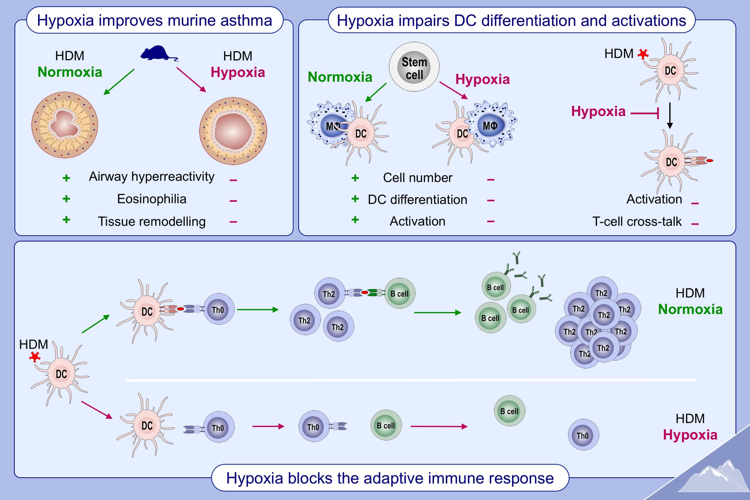
Low oxygen levels decrease adaptive immune responses and ameliorate experimental asthma in mice
Mathias Hochgerner,, Eva M. Sturm,, Diana Schnoegl,, Grazyna Kwapiszewska,, Horst Olschewski,, et al.
Allergy. 2022; 870-882 https://doi.org/10.1111/all.15020
© 2019 EAACI and John Wiley and Sons A/S. Published by John Wiley and Sons Ltd.
Notes:
HIGHLIGHTS
Hypoxia ameliorates allergic asthma in vivo.
Hypoxia impairs differentiation of APCs.
Hypoxia blocks adaptive immune response by interfering with APC/T-cell cross-talk.
Abbreviations: APC, antigen presenting cell; HDM, house dust mite

