Slide 1
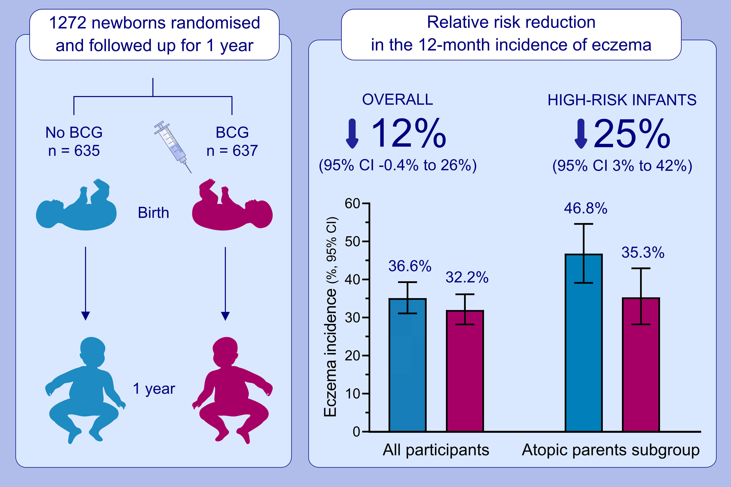
Prevention of infant eczema by neonatal Bacillus Calmette-Guérin vaccination: The MIS BAIR randomized controlled trial
Laure F. Pittet,, Nicole L. Messina,, Kaya Gardiner,, Bridget Freyne,, Veronica Abruzzo,, et al.
Allergy. 2022; 956-965 https://doi.org/10.1111/all.15022
© 2019 EAACI and John Wiley and Sons A/S. Published by John Wiley and Sons Ltd.
Notes:
HIGHLIGHTS
In this RCT, a modest reduction in the 12-month cumulative incidence
of eczema was observed in infants vaccinated with BCG-Denmark at birth compared with non-BCG-vaccinated infants in the control group.
This reduction was greater in high-risk infants (two atopic parents).
The risk difference in high-risk infants was 11.5% (95%CI -21.9% to -1.2%) with a NNT 8.7 (95%CI 4.6 to 83.3).
Abbreviations: BCG, Bacille Calmette-Guérin; CI, confidence interval; NNT, number needed to treat; RCT, randomised controlled trial

