Slide 1
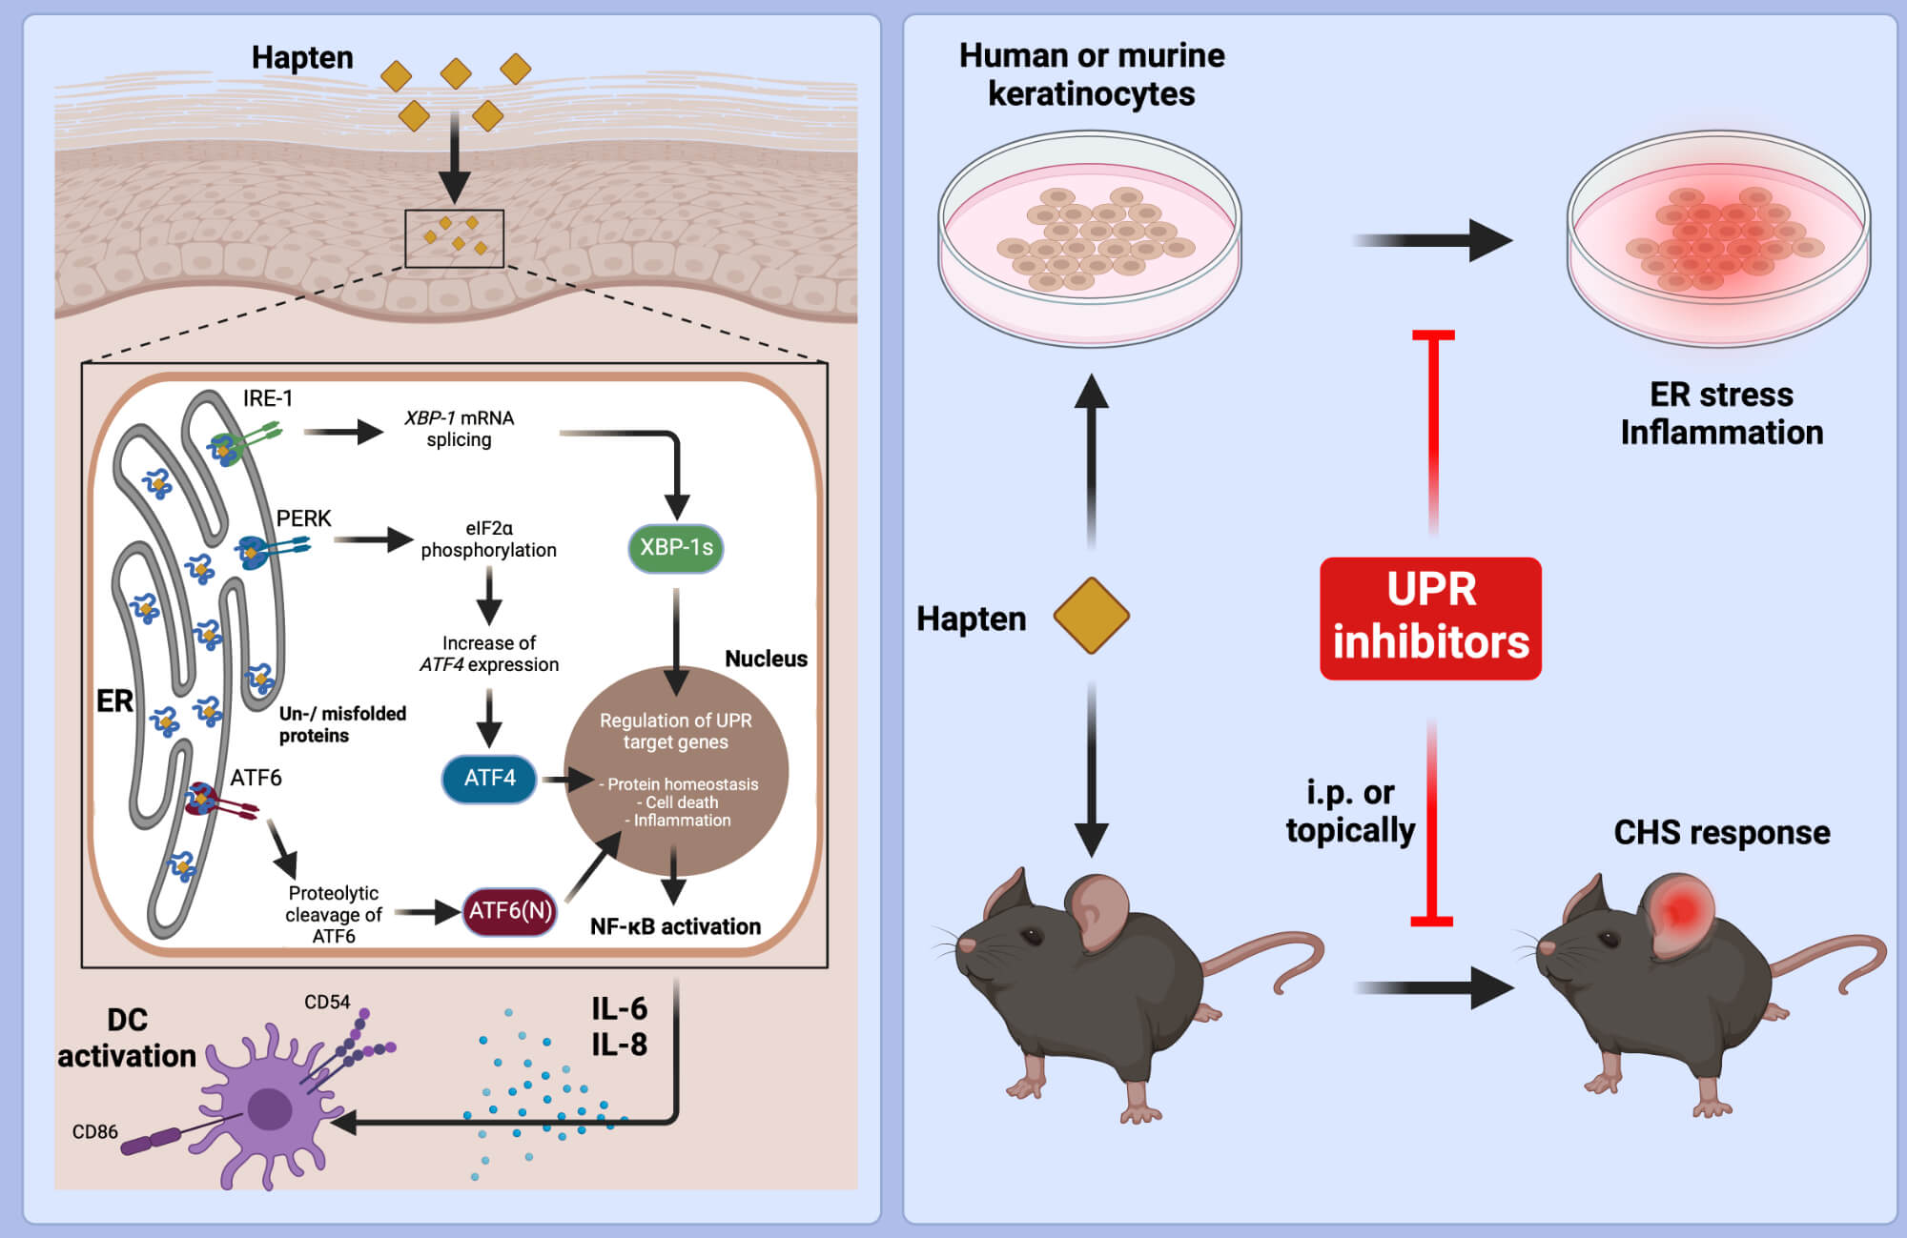
IRE1 and PERK signaling regulates inflammatory responses in a murine model of contact hypersensitivity
Fabian Gendrisch,, Lukas Völkel,, Melanie Fluck,, Petya Apostolova,, Robert Zeiser,, et al.
Allergy. 2022; 966-978 https://doi.org/10.1111/all.15024
© 2019 EAACI and John Wiley and Sons A/S. Published by John Wiley and Sons Ltd.
Notes:
HIGHLIGHTS
UPR in murine and human keratinocytes is activated by contact sensitizers and irritants; combining weak sensitizers results in synergistic effects.
UPR inhibition reduces NF-kB activation and pro-inflammatory cytokine production thereby preventing ER-stress-mediated DC activation in a keratinocyte/DC co-culture assay in vitro.
Systemic or topical inhibitor application prevents CHS; UPR pre-activation enhances CHS
to the weak allergen/tolerogen DNTB.
Abbreviations: ATF-4 /-6, activating transcritption factor 4/ -6; CHS, contact hypersensitivity;
DC, dendritic cell; DNTB, 2,4-dinitrothiocyanobenzene; eIF2, elongation initiation factor 2; ER, endoplasmic reticulum; i.p., intraperitoneal; IRE, inositol-requiring transmembrane kinase/endonuclease; PERK, protein kinase RNA-like ER kinase; UPR, unfolded protein response; XBP-1, X-box binding protein 1

