Slide 1
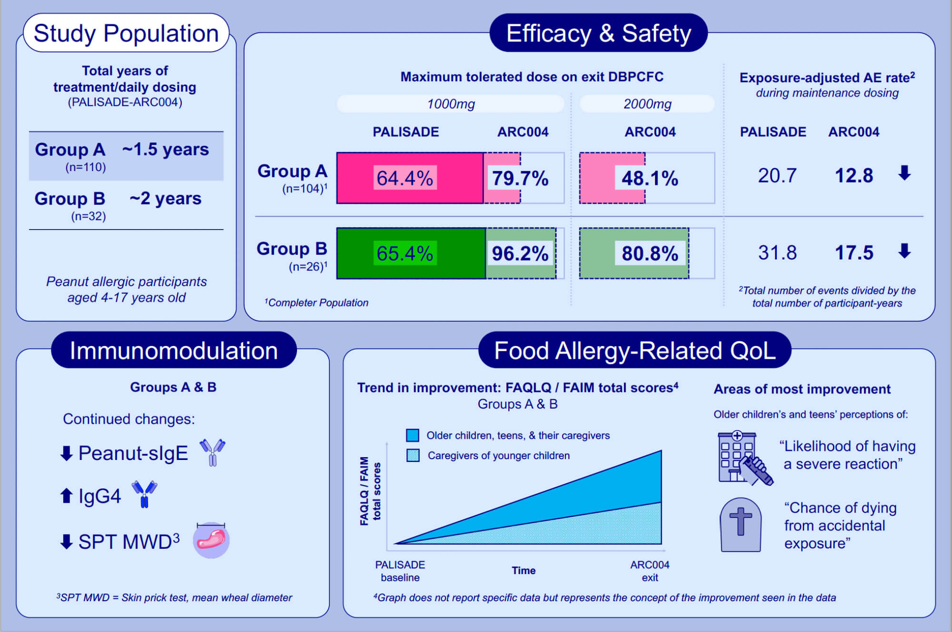
Open-label follow-on study evaluating the efficacy, safety, and quality of life with extended daily oral immunotherapy in children with peanut allergy
Montserrat Fernandez-Rivas,, Andrea Vereda,, Brian P. Vickery,, Vibha Sharma,, Caroline Nilsson,, et al.
Allergy. 2022; 991-1003 https://doi.org/10.1111/all.15027
© 2019 EAACI and John Wiley and Sons A/S. Published by John Wiley and Sons Ltd.
Notes:
HIGHLIGHTS
Daily administration of Peanut (Arachis hypogaea) Allergen Powder-dnfp (formerly AR101) beyond the one-year PALISADE trial (total treatment of ~1.5 or ~2 years) increased participants’ ability to tolerate peanut protein.
This was paralleled by a pattern of immunomodulation consistent with desensitisation and an improved safety/tolerability profile.
Treatment beyond one-year was associated with clinically-meaningful improvements in self-reported and caregiver-reported food allergy-related quality of life.
­
Abbreviations: AE, adverse event; ARC004, PALISADE Follow-on Study; DBPCFC, double-blind placebo-controlled food challenge; FAIM, Food Allergy Independent Measure; FAQLQ, Food Allergy Quality of Life Questionnaire; MWD, mean wheal diameter; PALISADE, Peanut Allergy Oral Immunotherapy Study of AR101 for Desensitization in Children and Adults; PTAH, Peanut (Arachis hypogaea) Allergen Powder-dnfp; QoL, quality of life; SPT, skin prick test.

