Slide 1
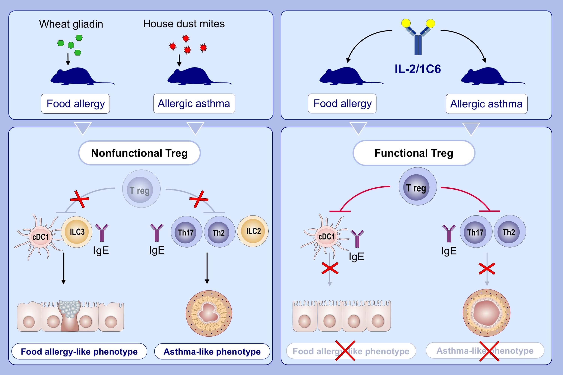
Engineering a safe monoclonal anti-human IL-2 that is effective in a murine model of food allergy and asthma
Martin Klein,, Barbara Misme-Aucouturier,, Marie-Aude Cheminant,, Marion De Carvalho,, Marie Wauters,, et al.
Allergy. 2022; 933-945 https://doi.org/10.1111/all.15029
© 2019 EAACI and John Wiley and Sons A/S. Published by John Wiley and Sons Ltd.
Notes:
HIGHLIGHTS
Using mouse models, we investigate the therapeutic potential of the IL-2/1C6 complex in allergies.
IL-2/1C6 decreases Th2/Th17 responses and innate lymphoid cells, and abrogates asthma and food allergy features in mice.
IL-2/1C6 may restore Treg numbers and function in respiratory and food allergies.
­
Abbreviations: 1C6, anti-IL-2 antibody; cDC1, type 1 conventional dendritic cell; ILC, innate lymphoid cell; Treg, regulatory T cell

