Slide 1
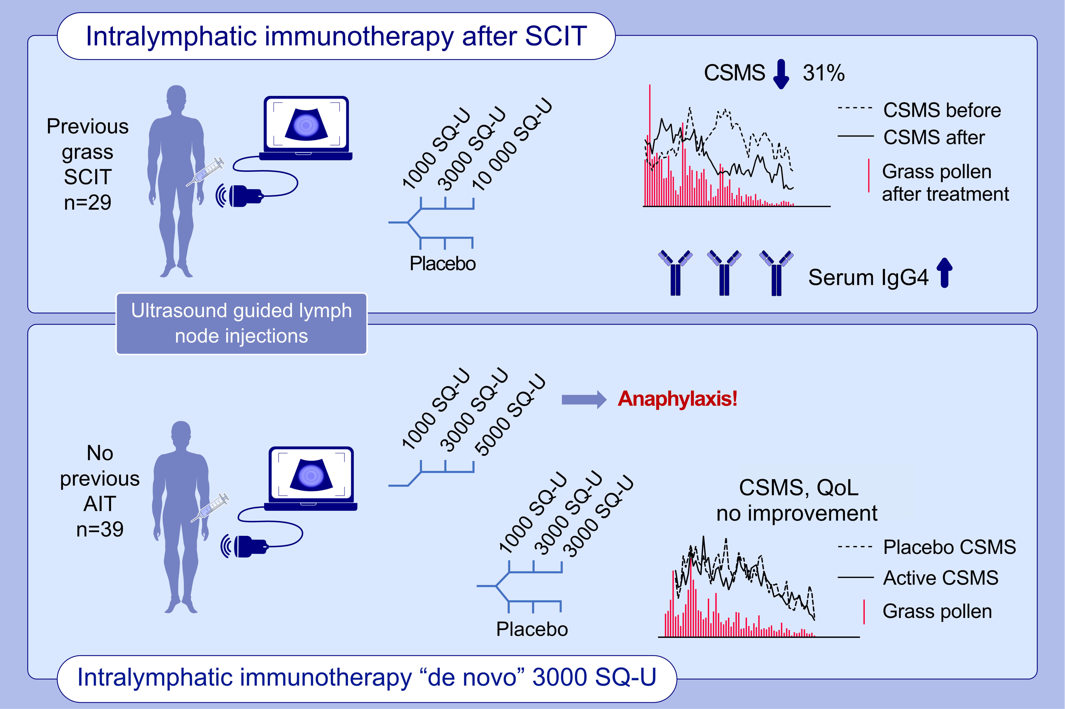
High-dose pollen intralymphatic immunotherapy: Two RDBPC trials question the benefit of dose increase
Laila Hellkvist,, Eric Hjalmarsson,, Dan Weinfeld,, Åslög Dahl,, Agneta Karlsson,, et al.
Allergy. 2022; 883-896 https://doi.org/10.1111/all.15042
© 2019 EAACI and John Wiley and Sons A/S. Published by John Wiley and Sons Ltd.
Notes:
HIGHLIGHTS
Intralymphatic immunotherapy (ILIT) up to 10 000 SQ-U after grass SCIT reduced the CSMS with 31% and doubled the specific IgG4 levels.
ILIT in increasing doses among previously unvaccinated patients provoked anaphylactic reactions at 5000 SQ-U.
Dose escalation to 3000 SQ-U de novo was safe but failed to improve the seasonal symptoms.
Abbreviations: AIT, allergy immunotherapy; CSMS, combined symptoms and mediciation scores; SCIT, subcutaneous immunotherapy; SQ-U, standardized quality units; QoL, quality of life

