Slide 1
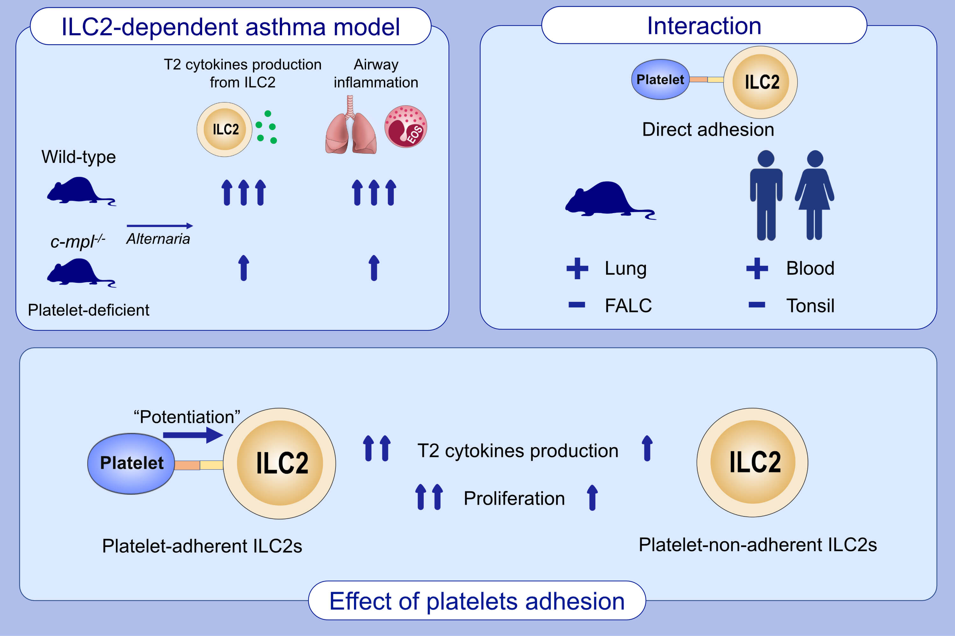
Direct platelet adhesion potentiates group 2 innate lymphoid cell functions
Keisuke Orimo,, Masato Tamari,, Tomohiro Takeda,, Terufumi Kubo,, Beate Rückert,, et al.
Allergy. 2022; 843-855 https://doi.org/10.1111/all.15057
© 2019 EAACI and John Wiley and Sons A/S. Published by John Wiley and Sons Ltd.
Notes:
HIGHLIGHTS
Lung ILC2s from platelet-deficient mice have less capacity to produce T2 cytokines than WT mice, which results in attenuation of ILC2-dependent eosinophilic airway inflammation in those mice.
The degree of platelet adhesion to ILC2s varies depending on the organ in both mice and humans.
Platelet–adherent ILC2s show enhanced proliferation and T2 cytokine production compared with non–platelet–adherent ILC2s.
Abbreviations: FALC, fat-associated lymphoid cluster; ILC2, group 2 innate lymphoid cell; T2, type–2

