Slide 1
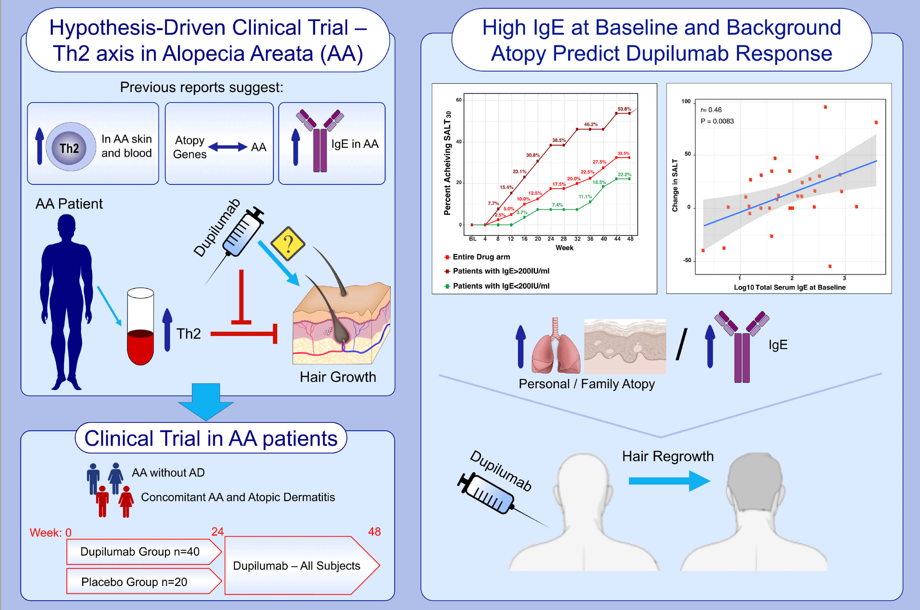
Phase 2a randomized clinical trial of dupilumab (anti-IL-4Rα) for alopecia areata patients
Emma Guttman-Yassky,, Yael Renert-Yuval,, Jennifer Bares,, Margot Chima,, Jason E. Hawkes,, et al.
Allergy. 2022; 897-906 https://doi.org/10.1111/all.15071
© 2019 EAACI and John Wiley and Sons A/S. Published by John Wiley and Sons Ltd.
Notes:
HIGHLIGHTS
Recent evidence supports a role for Th2-immune response in AA. To test these observations, AA patients with and without concomitant atopic dermatitis were randomized to receive dupilumab or placebo.
Patients with personal and/or family atopy and high baseline IgE (≥200IU/ml) exhibited greater efficacy of dupilumab.
This hypothesis-driven trial supports the pathogenic role of Th2 activation in AA.
Abbreviations: AA, alopecia areata; IU/ml, international units per milliliter

