Slide 1
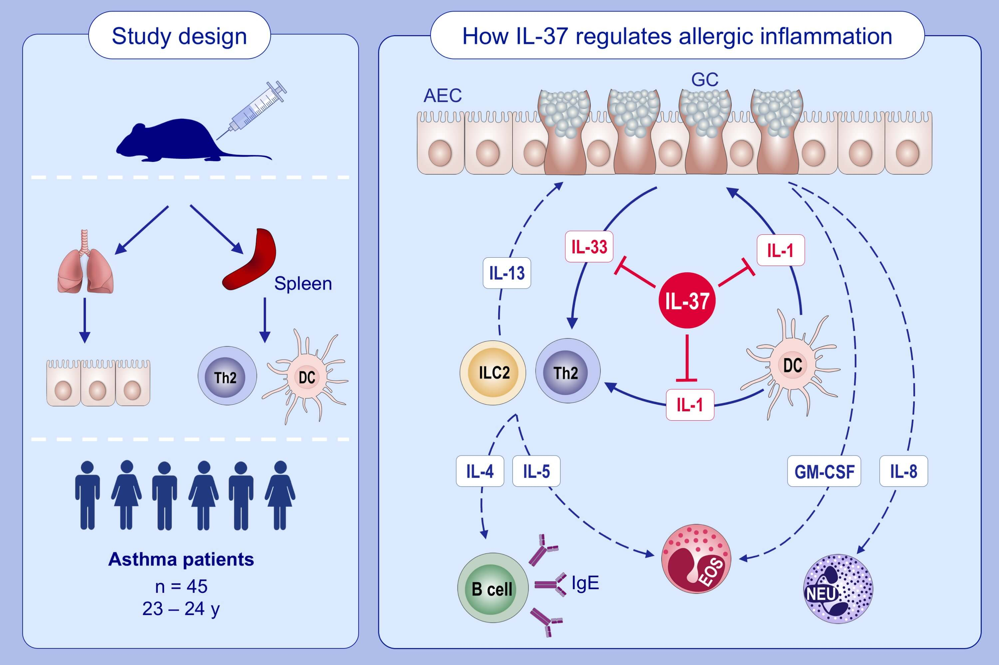
IL-37 regulates allergic inflammation by counterbalancing pro-inflammatory IL-1 and IL-33
Alexandra Schröder,, Lars P. Lunding,, Ulrich M. Zissler,, Christina Vock,, Sina Webering,, et al.
Allergy. 2022; 856-869 https://doi.org/10.1111/all.15072
© 2019 EAACI and John Wiley and Sons A/S. Published by John Wiley and Sons Ltd.
Notes:
HIGHLIGHTS
IL-37 target cells include many cells involved in asthma pathogenesis such as AECs, DCs, ILC2s, and Th2 cells.
IL-37 limits the proinflammatory and disease amplifying effects of IL-1 and IL-33 on these target cells.
Patients with asthma display increased expression/production ratios of both IL-1β and IL-33 to IL-37.
Abbreviations: AEC, airway epithelial cell; DC, dendritic cell; Eos, eosinophil; GC, goblet cell; GM-CSF, granulocyte-macrophage colony-stimulating factor; IL, interleukin; ILC2, innate lymphoid tissue cell 2; Neu, neutrophil; Th2, T helper 2 cell
.

