Slide 1
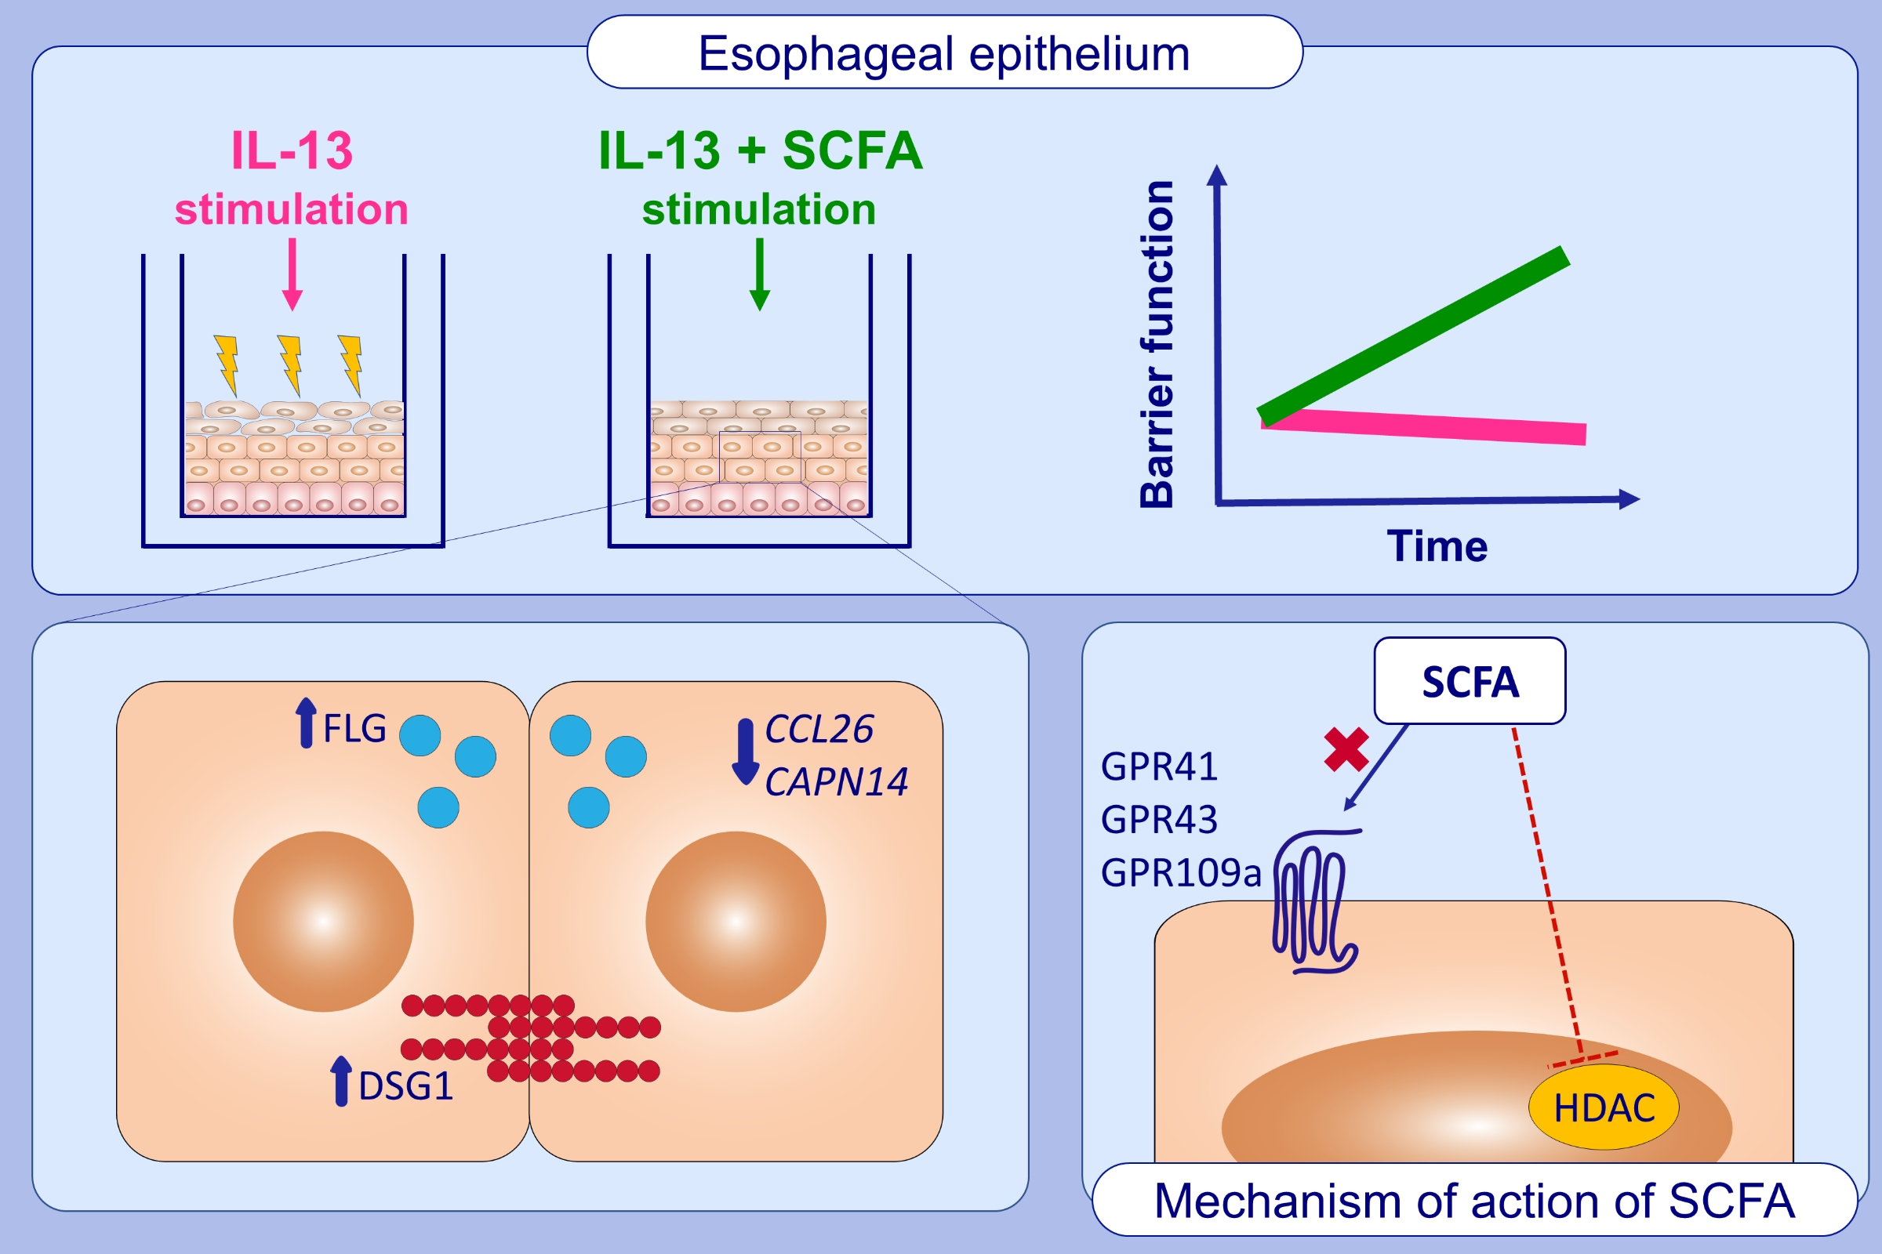
Butyrate and propionate restore interleukin 13-compromised esophageal epithelial barrier function
Mirelle T.A. Kleuskens, Maria L. Haasnoot, Bart M. Herpers, , et al.
Allergy. 2022; 1510-1521, https://doi.org/10.1111/all.15069
© 2019 EAACI and John Wiley and Sons A/S. Published by John Wiley and Sons Ltd.
Notes:
HIGHLIGHTS
The SCFAs butyrate and propionate counteracted the compromising effects of IL-13 on barrier function of human esophageal epithelium cultured under ALI conditions.
The increase in barrier function induced by these SCFAs was associated with restored expression of proinflammatory mediators and esophageal epithelial barrier proteins.
An HDAC antagonist induced similar effects as butyrate and propionate, whereas GPR agonists did not.
Abbreviations: ALI, air-liquid interface; CAPN14, calpain-14; CCL26, (C-C motif) ligand 26; DSG1, desmoglein-1; FLG, filaggrin; GPR, G protein-coupled receptor; HDAC, histone deacetylase; IL-13, interleukin 13; SCFA, short-chain fatty acid.

