Slide 1
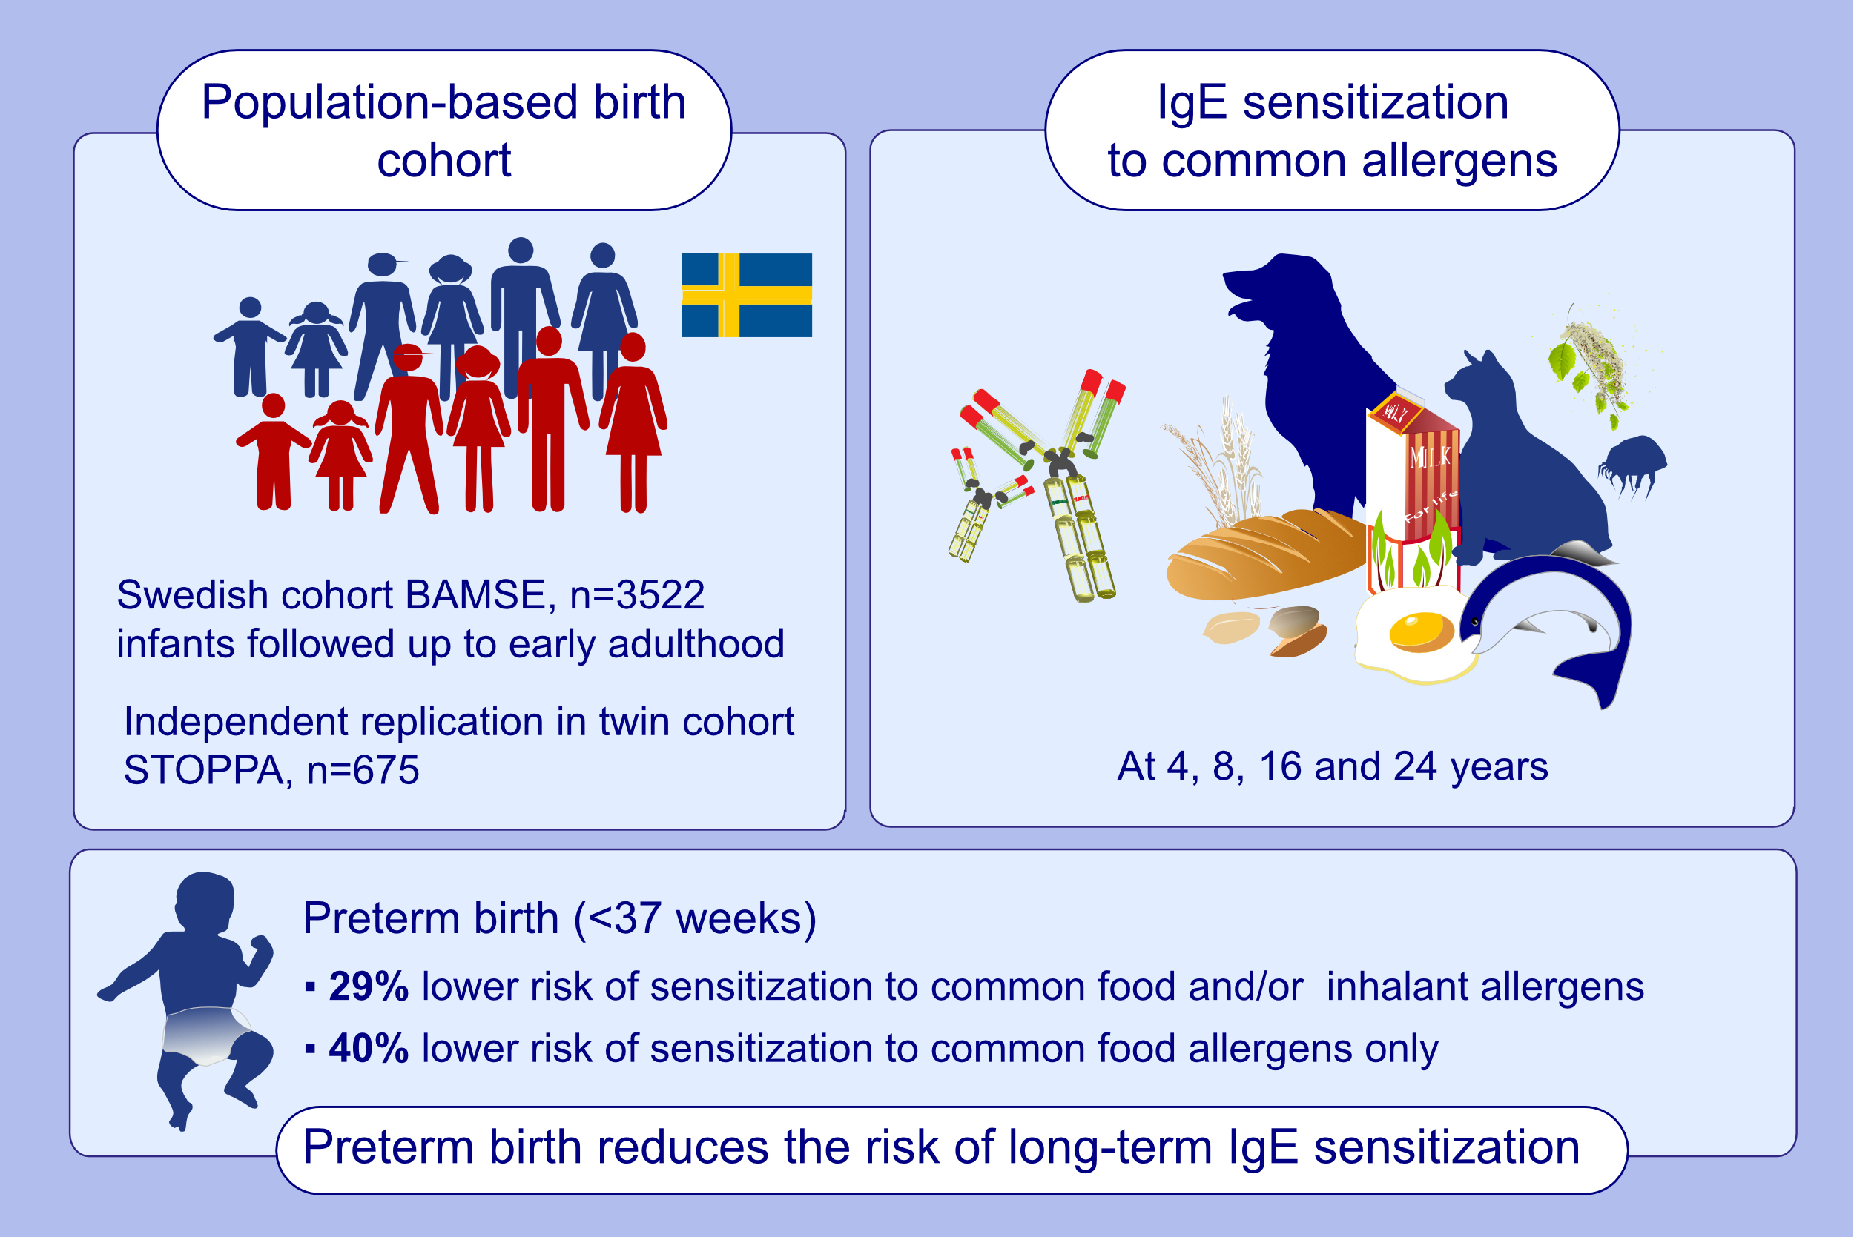
Preterm birth reduces the risk of IgE sensitization up to early adulthood: a population-based birth cohort study
Niki Mitselou, Niklas Andersson, Anna Bergström, Inger Kull, Antonios Georgelis, et al.
Allergy. 2022; 1570-1582 https://doi.org/10.1111/all.15077
© 2019 EAACI and John Wiley and Sons A/S. Published by John Wiley and Sons Ltd.
Notes:
HIGHLIGHTS
This population-based Swedish birth cohort study of 3522 infants followed prospectively up to early adulthood assessed the impact of gestational age on IgE sensitization.
Preterm birth (<37 weeks) was inversely associated with sensitization to common food and/or inhalant allergens and to food allergens separately.
No clear association was found between post-term birth and IgE sensitization up to the age 24 years.
Abbreviations: BAMSE, Barn/Children, Allergy, Milieu, Stockholm, Epidemiology; STOPPA, Swedish Twin study On Prediction and Prevention of Asthma

