Slide 1
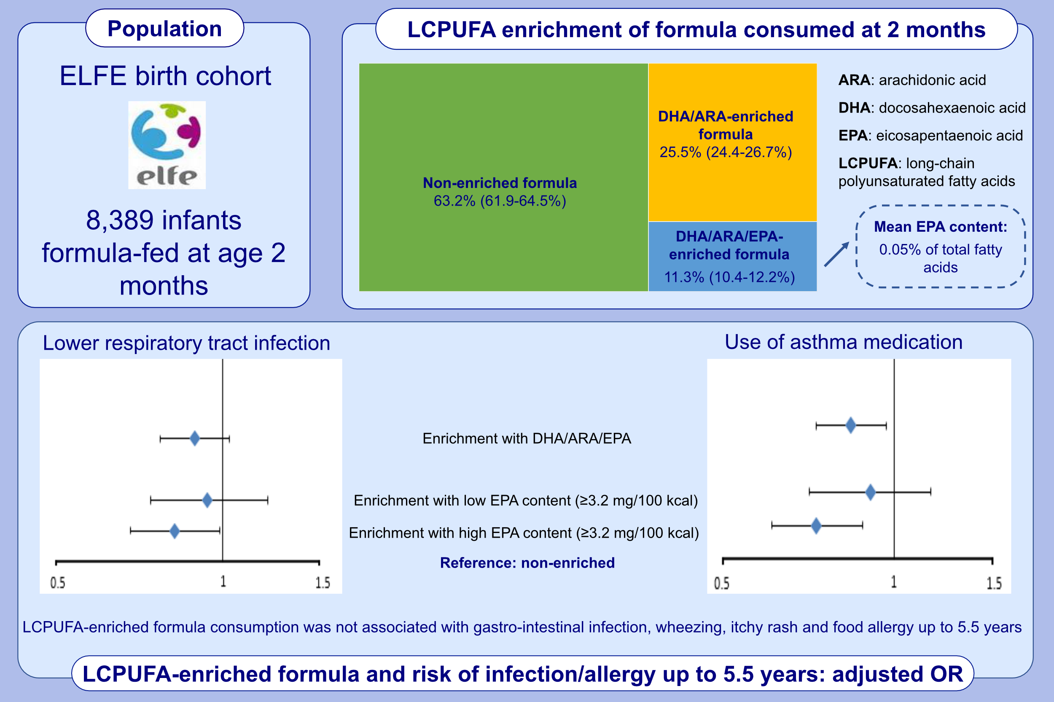
Enrichment of infant formula with long-chain polyunsaturated fatty acids and risk of infection and allergy in the nationwide ELFE birth cohort
Moufidath Adjibade, Camille Davisse-Paturet, Jonathan Y. Bernard, Karine Adel-Patient, Amandine Divaret-Chauveau, et al.
Allergy. 2022; 1522-1533 https://doi.org/10.1111/all.15137
© 2019 EAACI and John Wiley and Sons A/S. Published by John Wiley and Sons Ltd.
Notes:
HIGHLIGHTS
Among formula-fed infants at 2 months, 36% consumed DHA/ARA-enriched formula, and 11% consumed formula additionally enriched with EPA.
DHA/ARA/EPA-enriched formula consumption (especially with high EPA content) was associated with a lower risk of LRTI and lower use of asthma medications up to 5.5 years.
DHA/ARA/EPA-enriched formula consumption was not associated with gastro-intestinal infection, wheezing, itchy rash and food allergy.
Abbreviations: ARA, arachidonic acid; DHA, docosahexaenoic acid; ELFE, birth cohort (Étude longitudinale française depuis l’enfance); EPA, eicosapentaenoic acid; LCPUFA, long-chain polyunsaturated fatty acids; LRTI, lower respiratory tract infection; OR, odds ratio

