Slide 1
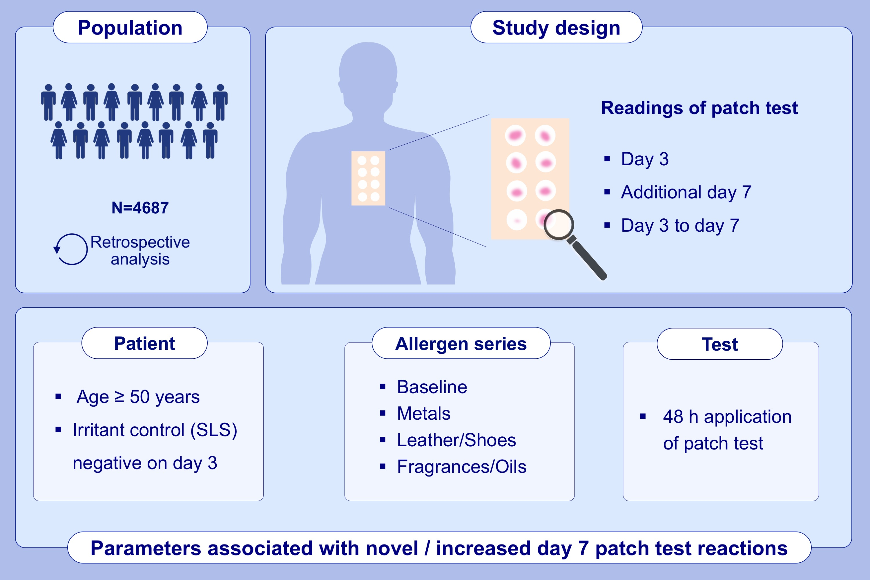
The Benefit of Late Readings in Patch Testing Depends both on Allergen and Patient Characteristics
Susann Forkel, Steffen Schubert, Heinrich Dickel, Michal Gina, Claudia Schröder-Kraft, , et al.
Allergy. 2022; 1477-1485 https://doi.org/10.1111/all.15149
© 2019 EAACI and John Wiley and Sons A/S. Published by John Wiley and Sons Ltd.
Notes:
HIGHLIGHTS
Novel day 7 reactions are most likely in patients over 50 years of age, in patients with negative irritant controls on day 3, or if the patch test application time was 48 hours instead of 24 hours.
Some test series are higher associated with novel day 7 reactions.
Inconclusive patch test results on day 3 should trigger an additional reading on day 7.
Abbreviation: SLS, sodium lauryl sulfate

