Slide 1
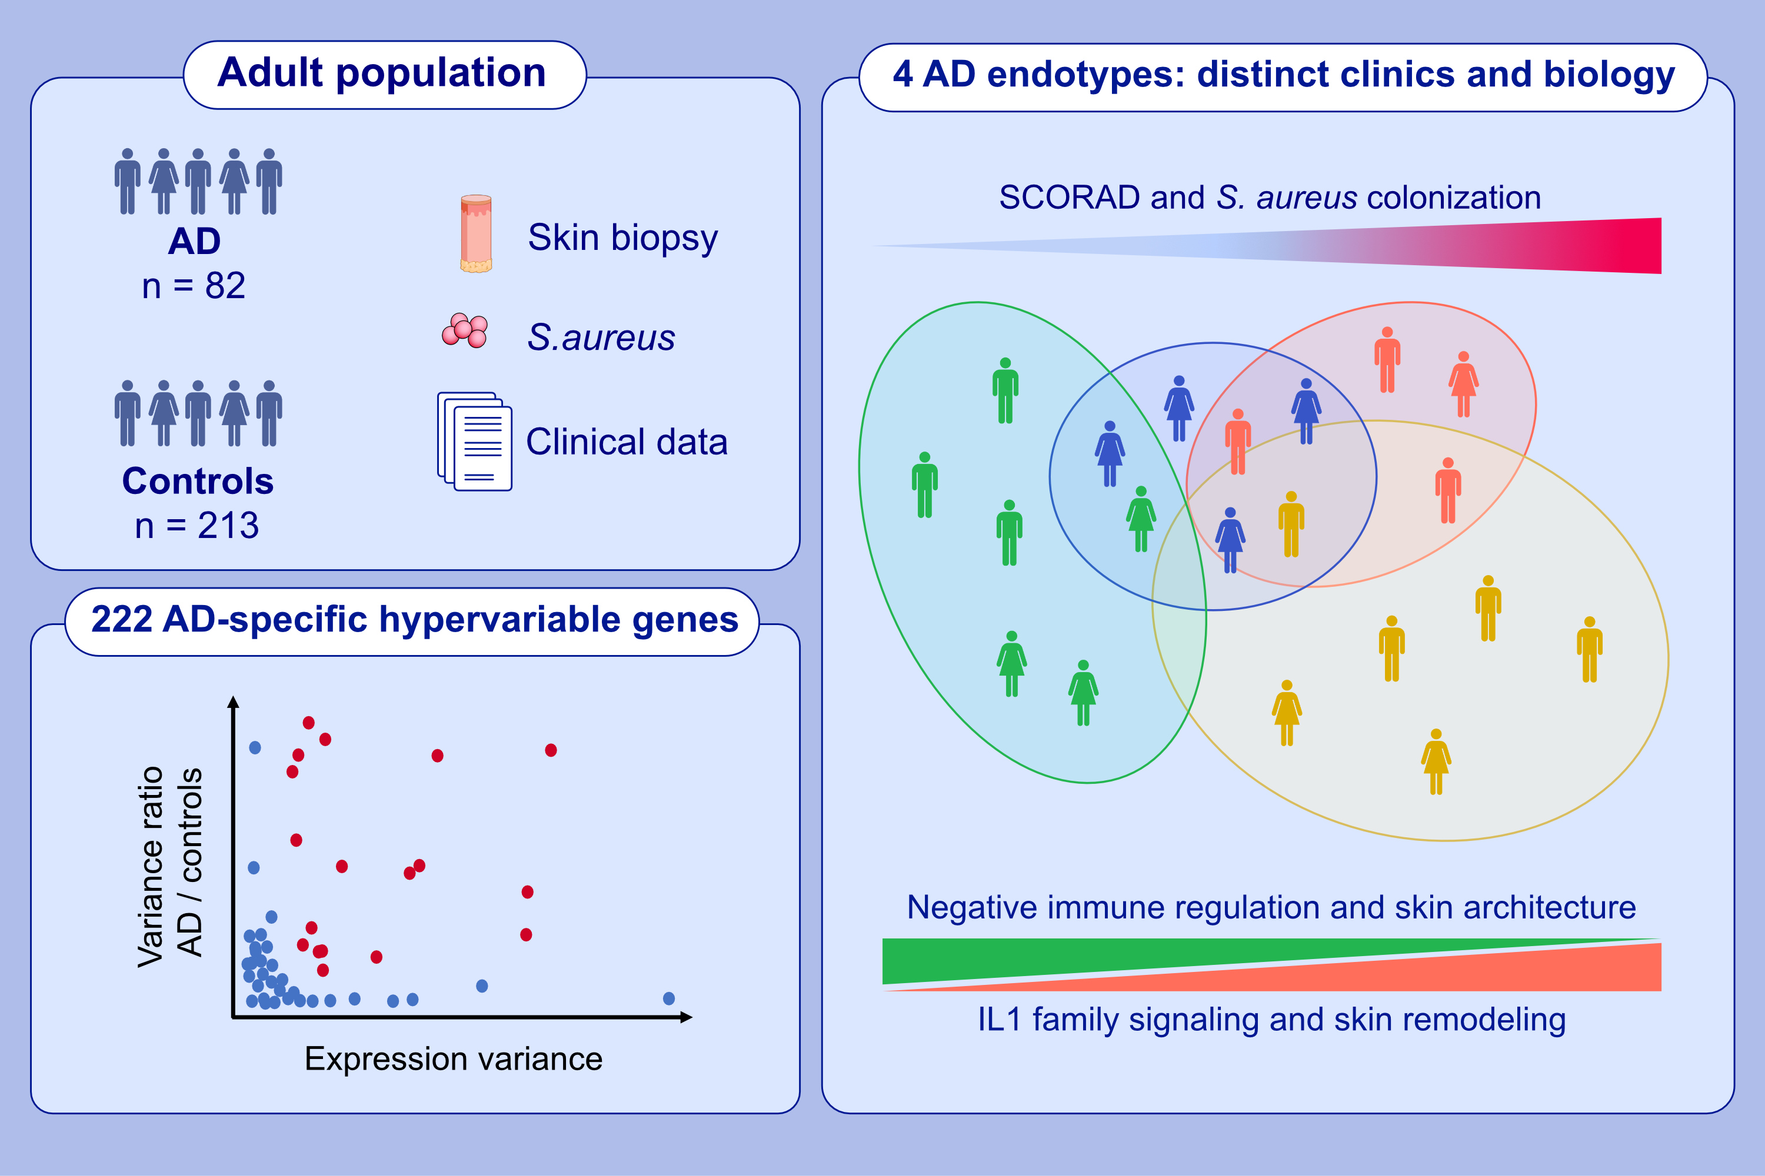
Transcriptome-based identification of novel endotypes in adult atopic dermatitis
Alain Lefèvre-Utile, Melissa Saichi, Péter Oláh, Marc Delord, Bernhard Homey, et al.
Allergy. 2022; 1486-1498 https://doi.org/10.1111/all.15150
© 2019 EAACI and John Wiley and Sons A/S. Published by John Wiley and Sons Ltd.
Notes:
HIGHLIGHTS
We used the largest skin transcriptome cohort including 82 AD patients and 213 healthy control biopsies.
We applied a variance-based gene selection of AD-specific hypervariable genes to reveal disease heterogeneity.
These genes were used for the unsupervised clustering into 4 AD endotypes characterized by distinct biological and clinical features, revealing the duality between pro- and anti-inflammatory mechanisms.
Abbreviations: AD, atopic dermatitis; S. aureus, Staphylococcus aureus; SCORAD, scoring atopic dermatitis

