Slide 1
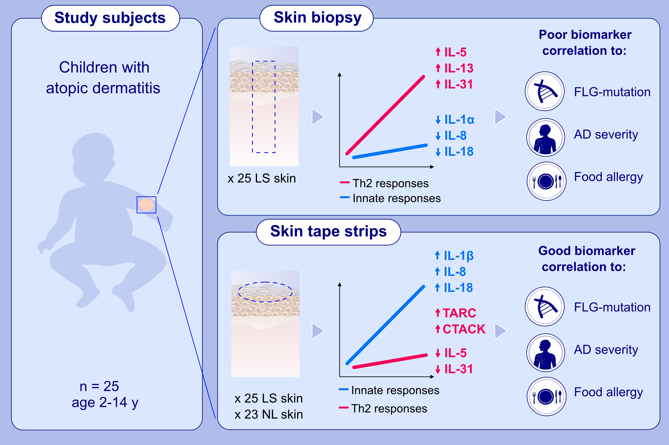
Assessment of biomarkers in pediatric atopic dermatitis by tape strips and skin biopsies
Anna Maria Andersson, Julie Sølberg, Anders Koch, Lone Skov, Ivone Jakasa, et al.
Allergy. 2022; 1499-1509 https://doi.org/10.1111/all.15153
© 2019 EAACI and John Wiley and Sons A/S. Published by John Wiley and Sons Ltd.
Notes:
HIGHLIGHTS
Twenty-five children were examined with skin biopsies from lesional and tape strips from lesional and non-lesional skin.
Skin biopsies showed Th2 response and tape strips showed general innate response.
Tape strips were superior compared to skin biopsies in detecting biomarker differences related to AD severity, FLG mutations, and food allergy.
Abbreviations: AD, atopic dermatitis; CTACK, cutaneous T cell-attracting chemokine; FLG-mutation, children with filaggrin gene mutation; LS, lesional skin; NL, non-lesional skin; TARC, thymus and activation-regulated chemokine

