Slide 1
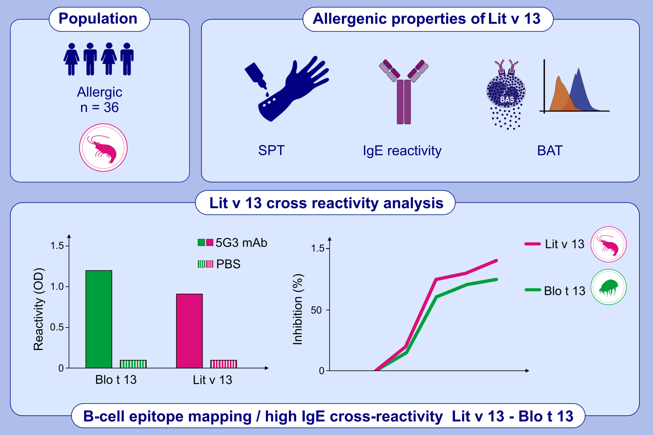
Structural And Allergenic Properties Of The Fatty Acid Binding Protein From Shrimp Litopenaeus vannamei
Marlon Múnera, Dalgys Martínez, Judith Wortmann, Josefina Zakzuk, Walter Keller, et al.
Allergy. 2022; 1534-1544 https://doi.org/10.1111/all.15154
© 2019 EAACI and John Wiley and Sons A/S. Published by John Wiley and Sons Ltd.
Notes:
HIGHLIGHTS
The FABP from shrimp Litopenaeus vannamei (Lit v 13) showed 27% frequency of serum IgE reactivity in shrimp allergic subjects.
The allergenic activity of Lit v 13 was demonstrated by SPT and BAT using flow cytometry.
One B-cell epitope involved in the high IgE cross-reactivity between Lit v13 and Blo t 13 was identified.
Abbreviations: 5G3 mAb, anti-Blo t 3 monoclonal antibodes; BAT, basophil activation test; Blo t 13, Blomia tropicalis allergen of group 13 of house dust mite; FABP, fatty acid binding protein; Lit v 13, FABP from Litopenaeus vannamei; OD, optical density; PBS, phosphate buffer saline; SPT, skin prick test

