Slide 1
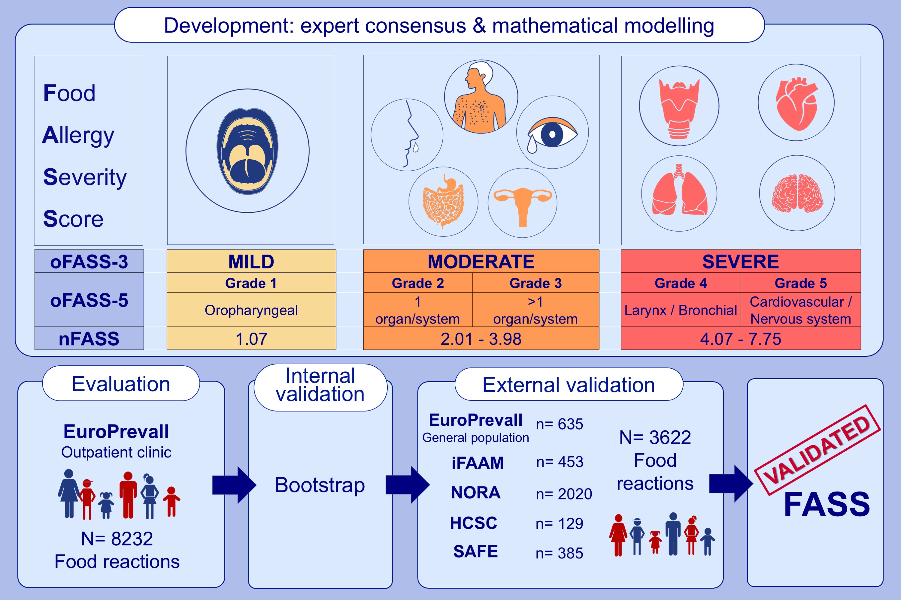
Development and validation of the Food Allergy Severity Score
Montserrat Fernández-Rivas, Ismael Gómez García, Alejandro Gonzalo-Fernández, Manuel Fuentes Ferrer, Sabine Dölle-Bierke, et al.
Allergy. 2022; 1545-1558 https://doi.org/10.1111/all.15165
© 2019 EAACI and John Wiley and Sons A/S. Published by John Wiley and Sons Ltd.
Notes:
HIGHLIGHTS
FASS with ordinal (oFASS-3, oFASS-5) and numerical (nFASS) formats that map consistently, was developed by multidisciplinary experts’ consensus and mathematical modelling.
Following evaluation, internal and external validation, FASS is a validated and reliable method to measure severity of food allergic reactions.
oFASS-3, oFASS-5 and nFASS are suitable for use by different stakeholders in different settings.
Abbreviations: EuroPrevall, Prevalence, Cost and Basis of Food Allergy in Europe; FASS, Food Allergy Severity Score; HCSC, Hospital Clinico San Carlos; iFAAM, European union-funded project Integrated Approaches to Food Allergen and Allergy Risk Management; NORA, Network for Online Registration of Anaphylaxis; oFASS, ordinal FASS; oFASS-3, ordinal FASS with 3 grades oFASS-5, ordinal FASS with 5 grades; SAFE, European union-funded project Plant food allergies: field to table strategies for reducing their incidence in Europe

