Slide 1
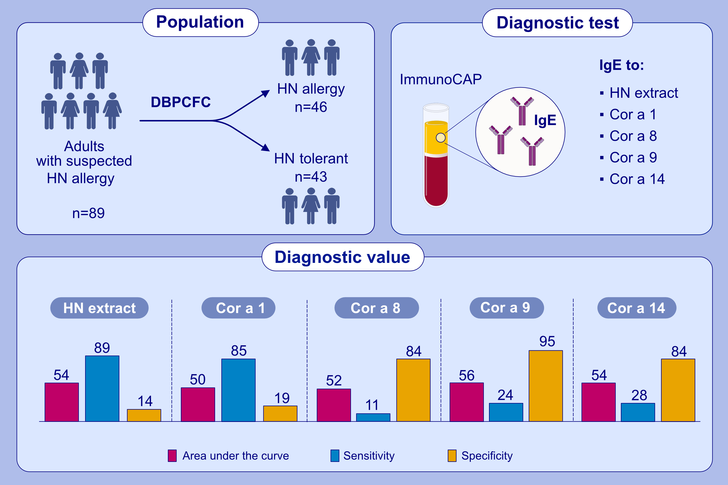
Measurement of IgE to hazelnut allergen components cannot replace hazelnut challenge in Dutch adults
Sarah A. Lyons, Paco M. J. Welsing, Mariam Hakobyan, Hannah M. Kansen, Edward F. Knol, et al.
Allergy. 2022; 1559-1569 https://doi.org/10.1111/all.15166
© 2019 EAACI and John Wiley and Sons A/S. Published by John Wiley and Sons Ltd.
Notes:
HIGHLIGHTS
Dutch hazelnut allergic adults are usually sensitized to hazelnut extract and Cor a 1 (sensitivity 85-89%).
Dutch hazelnut tolerant adults are usually not sensitized to Cor a 8, 9 or 14 (specificity 84-95%).
Measurement of IgE to hazelnut allergen components (AUC 50-56%) cannot replace hazelnut challenge for diagnosis of hazelnut allergy in adults in birch-endemic regions.
Abbreviations: AUC, area under the curve; DBPCFC, double-blind placebo-controlled food challenge; HN, hazelnut

